Slide 1
Entering a Foreign Market
Study Abroad in India
MGS 4410 / FI 4410
Nov. 14, 2015
Dr. Satish Nargundkar

Slide 2
Learning Objectives
The Entry Decision Making
Modes of Entry into Foreign Market
Measuring distance between countries
Market Segmentation
Process Innovation

Slide 3
The Entry Decision
Which market to enter?
Size of market, Purchasing power, Indigenous competition, Economy, Law
When to enter it?
First mover pros/cons
How big an entry/investment?
Resource commitment pros/cons

Slide 4
Modes of Entry
Direct Export
Licensing
Franchising
Partnering
Joint Ventures
Acquisitions
Piggybacking
Turnkey Projects
Greenfield Investments
What are the Pros/Cons of each?
Source: http://www.tradestart.ca/market-entry-strategies

Slide 5
Pros/Cons of Various Modes
Mode | Pros | Cons | Examples
Export | Low cost, production scale economies | Manufacturing cost, transportion cost, Lead time | Sony TVs, Japanese Cars
Piggyback | Low cost, low risk | Dependent on another firm | Movie themed products
License | Low cost, overcomes trade barriers | Knowledge transfer Future competition | Disney characters, Xerox, Technology
Turnkey | Big returns for tech knowhow | No ownership or long-term interest, creating competition | Western built Oil refineries in the middle east
Franchise | Similar to license, but for services | Quality control, Damage to name brand possible | McDonalds, Four Seasons
Joint Venture | Shared costs/risks, local knowledge | Technology transfer Conflicts | GM and SAIC in China
Acquisition/Greenfield (Wholly owned Subsidiary) | Control over operations | High Cost | Semiconductors, Pharmaceuticals

Slide 6
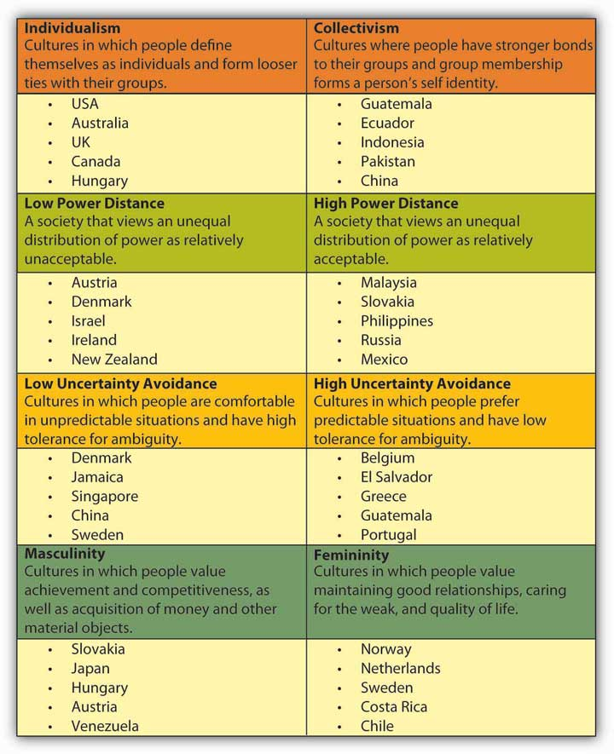
Hofstede’s Cultural Dimensions

Slide 7
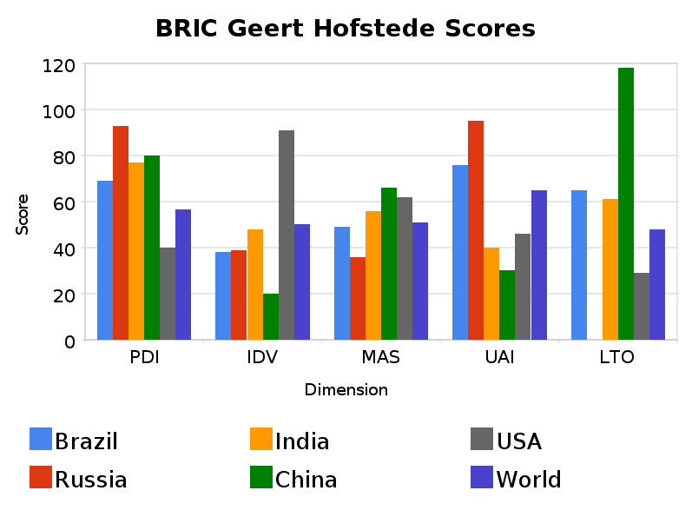
Hofstede’s Cultural Dimensions
Power Distance, Individuality, Masculinity, Uncertainty Avoidance, Long-term Orientation

Slide 8
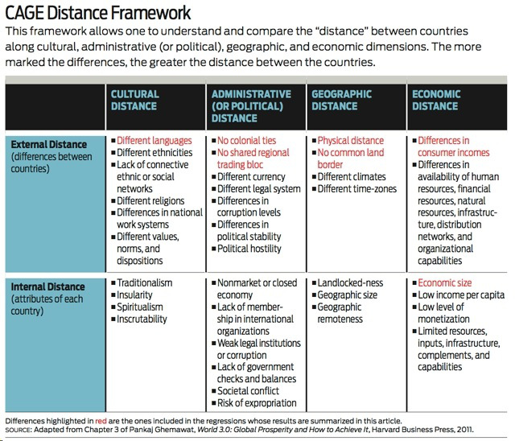
CAGE Model

Slide 9
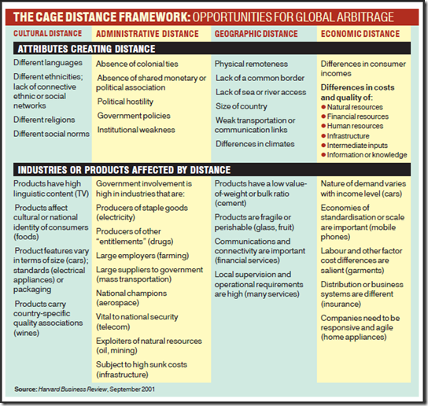
CAGE Impact on Industries

Slide 10
Case: Oreos in India
http://www.businesstoday.in/magazine/lbs-case-study/how-kraft-foods-won-over-customers-in-china-and-india/story/193162.html

Slide 11
Market Segmentation
Averages can deceive – find the segments and vary the strategy
How to segment?
What characteristics are important?
What kind of analysis can be done?
Applications/Examples of Segmentation
Financial Services
Credit Cards / Loans
Insurance
Healthcare
Location Decisions
Treatment Decisions
Other?

Slide 12
Financial Services Example
Customer Segment
Attribute | A | B | C | D | E | All
Age of Head of Household | 38 | 62 | 48 | 44 | 52 | 43
Length of Residence | 9 | 12 | 9 | 6 | 9 | 9
Household Income | 48 | 45 | 88 | 73 | 71 | 62
No. of Credit Cards | 24 | 2 | 10 | 15 | 8 | 7
No. Cards with Balance > 0 | 13 | 1 | 3 | 6 | 2 | 3
BankCard Utilization % | 69 | 6 | 29 | 51 | 7 | 30
Months since most recent BankCard open | 11 | 75 | 21 | 15 | 32 | 35
Interpret each segment. What kind of people are in group A?
How would your strategy vary by customer segment?

Slide 13
Tool: Pivot Tables in Excel
Purpose - Crosstabulation
To see numeric data across segments defined by categorical data.
Marketing - Sales by Region and by Salesperson
Spread of epidemic – Number of people with illness by age group and gender
Ratings for Advertising - Number of TV viewers by show, by age group
See Excel Demo

Slide 14
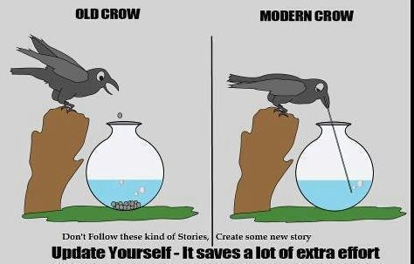
Process Innovation

Slide 15
Process Innovation
Ball Game – Simulation of Production Process

Slide 16
Learning Objectives Summary
Modes of Entry into Foreign Market
Pros/cons of different modes
The Entry Decision Making
Which market to enter?
When to enter?
How big an entry?
Measuring distance between countries
Cultural
Administrative
Geographical
Economic
Segmentation
Reason to segment, interpretation
Pivot Tables in Excel
Process Innovation
What is it
Why needed

