Slide 1
Maximizing Your Experience Abroad
Georgia State University
Office of International Initiatives
Study Abroad Programs
Fall 2015

Slide 2
Documents you must submit before you study abroad:
Student Health Clearance Form
Must be signed by a licensed MD
Upload a copy of your passport
If you don’t have access to a scanner, please visit the Study Abroad Office!
Emergency Contacts

Slide 3
IEF Scholarship Service Requirements
5 service requirements: reflection, photos, survey, volunteer, attend
I send out emails for events to volunteer & attend
Due 1 year after you return, otherwise hold will be placed on your account & you will be required to pay back $1000
Alternative service requirements if you’re graduating: Alumni Reference Network, video interviews, blogging
Contact info: Emily Caskey ecaskey@gsu.edu

Slide 4
GES Service Requirements
Due 1 year after you return, otherwise hold will be placed on your account & you will be required to pay back scholarship
Contact info: Alex Ricker aricker1@gsu.edu
Classroom Campaign:
A minimum of five 5-minute classroom presentations scheduled throughout Fall and Spring.
The Buddy Program:
Pair up with an international exchange student
Conversation Partner Program (CPP):
Connect with an international student from the GSU Intensive English Program (IEP) to help him/her improve his/her English.
Representative at Events/Workshops:
Participate and/or possibly present at two Study Abroad Programs event(s) that are scheduled throughout Fall and Spring semesters
Individualized Contribution (case-by-case basis):
If you have an idea that you think might serve this purpose, just let us know!

Slide 5
Health Insurance: In Case of Emergency
In case of medical emergency, please contact CISI insurance’s emergency assistance provider AXA Assistance:
Collect from outside the US: 001-312-935-1703;
Toll-free from within the US: 855-327-1411;
Email: MEDASSIST-USA@AXA-ASSISTANCE.US
In an emergency, seek appropriate medical care first and then contact CISI!

Slide 6
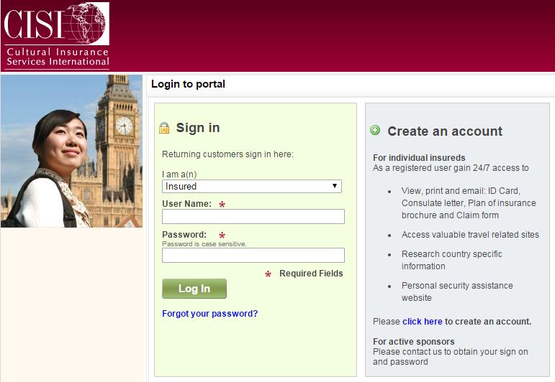
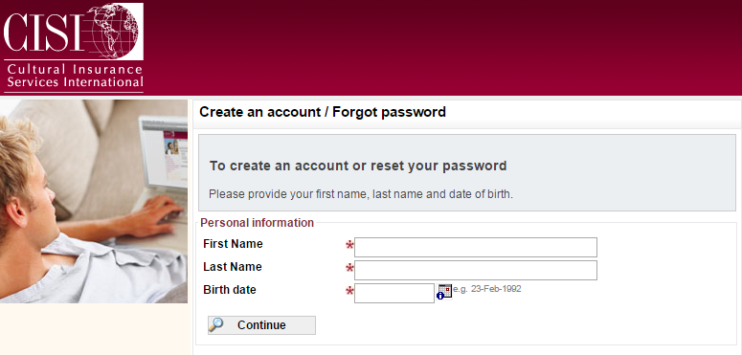
Health Insurance: Logging in to CISI
https://www.mycisi.com/CISIPortalWeb

Slide 7
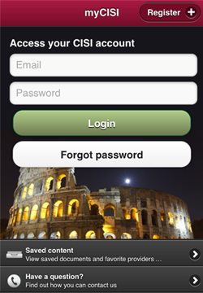
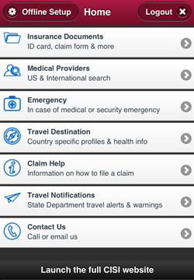
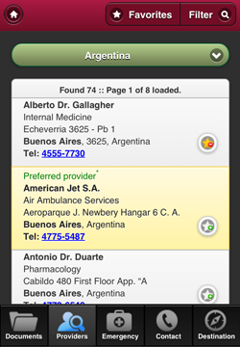
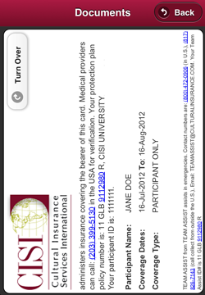
Health Insurance: Logging in to CISI

Slide 8
Health Insurance: Submitting a Claim
Should you need any medical care abroad, you will most likely need to submit a claim for reimbursement, so make sure to set aside money to pay for your medical care upfront or have an emergency credit card available.
To be reimbursed, you will need to submit a claim to CISI. You can download a claim form when you login to your CISI account.
If you have any questions regarding your benefits or the claim submission process, please contact CISI & include your policy number on all communications submitted by email or mail.
Calling toll-free from within the US: (800) 303-8120 ext. 5130
Calling collect from outside of the US: (203) 399- 5130
Email: claimhelp@culturalinsurance.com

Slide 9
CDC Recommended Vaccines

Slide 10
Health: Immunizations & Prescriptions
Recommended and Required Immunizations
Research country-specific immunizations and talk to your physician.
Prescriptions
Take enough prescriptions for the duration of your travels including some extra in case you are unexpectedly delayed.
Keep prescriptions in their original, labeled containers and pack them in your carry-on bag since checked baggage is occasionally lost or delayed.
Be careful travelling with over-the-counter medications: what’s legal here may not be there! Get a letter from your physician in case you are questioned about your carry-on medication; some countries have strict restrictions on bringing prescription or even non-prescription medications into the country without proper medical documentation.
Ask your pharmacy or physician for the scientific name of your prescriptions in case you need to purchase additional medication abroad.
Check the Center for Disease Control’s travel site http://wwwnc.cdc.gov/travel/
Bring common OTC medications you may need, including Imodium, Pepto-Bismol, etc; talk to your doctor about prescript anti-diarrhea medications such as Cipro.

Slide 11
Funds Abroad
Please refer to your director and returned students for funding advice while abroad: the below guidelines are great, but are not universal!
Before you leave, notify your bank, credit card company, or other financial institutions that you are going overseas.
Be sure to maintain around $100 for emergency purposes: keep it stashed. Your program director is not an ATM!
Change some money to the local currency before you go
Diversify your sources of currency: the eggs-in-one-basket cliché
Use caution when using ATMs: don’t get robbed by thieves or…your own bank!
Keep your money close to your person
Never put anything in your back pockets or outside backpack pouches!
DO YOUR RESEARCH ABOUT THE COUNTRY YOU ARE TRAVELLING TO!

Slide 12
Safety
Practice good situational awareness: stay on your toes, keep your head on a swivel, constantly assess risk!
You are subject to the local laws: the law will not care if you are an American citizen or a citizen of Oceana
Always let someone know where you will be
Travel in pairs
Avoid confrontations
Avoid demonstrations & political activities
Be hyperaware at popular tourist locations/destinations
Keep your money close to your person and never put anything in your back pockets!
Drugs: never, period, enough said.
Alcohol: moderation & the laws of the land.
DO YOUR RESEARCH ABOUT THE COUNTRY YOU ARE TRAVELLING TO (myCISI security info)!

Slide 13
myCISI Security Information

Slide 14
Packing
Pack half of what you think you need because stairs are no joke! If you can’t carry your bag ¼ of a mile without collapsing, you’ve over-packed!
Pack an extra set of clothes in your carry-on bag in case your checked baggage doesn’t arrive at the same time you do.
Coordinate with people on your program.
Do you need an adapter or converter? What’s the difference?
Save room for souvenirs!
Pack according to the local weather and culture.
Do your research about the country you’re traveling to!

Slide 15
Communications
Set up a communication plan with your friends & family before you leave: you will be wonderfully distracted upon arrival!
Make sure to share emergency pocket brochure & insurance benefit coverage with emergency contacts.
They will worry and want to know that you arrived safely!
Remember: we don’t all have the same internet! Popular websites like Facebook, Twitter, and YouTube are banned in some parts of the world.
Keep your emergency pocket brochures & insurance card on you at all times!
Do not leave the group without a way to get back!

Slide 16
GSU Ambassadors
You are bound by the GSU Student Code of Conduct
You are not travelling on your own
You are not on a ‘trip’
You are not suddenly invincible to everything once you step out of the magical aluminum tube in another land
You are representing your country, your state and GSU
If you serve as an unfit ambassador or a poor representative for any of the above the consequences can not only be immediate removal from your study abroad program, but also disciplinary action back at GSU

Slide 17
Culture Shock - What is it?
a state of bewilderment, disorientation, doubt, nervousness, and distress experienced by an individual who is suddenly exposed to a new, unfamiliar, or foreign social and cultural environment (way of life or set of attitudes)
the way you react and feel when the cultural cues you know so well from home are lacking

Slide 18
Culture Shock: Feelings and Reactions!
Expect to experience some Culture Shock
Everyone experiences Culture Shock differently
Before you leave
Feelings of anxiousness, depression, anticipation
Feelings of not wanting to leave/regretting your decision
Excitement
Tips: tell someone, take photos from home with you on the trip, make friends
During the program abroad
Feelings of stress due to new kinds of interaction
Mental Fatigue/Language Immersion
Tips: be aware that this is normal, be patient with your feelings, remember to breathe, talk with someone, stay positive, participate!

Slide 19
How to prepare for culture shock…
Know as much as possible about your host country before you leave
Do some research! Get interested!
Find logical reasons for cultural differences:
Many norms have evolved over time for very specific purposes that are no longer apparent.
Avoid criticizing the host culture:
Stay positive → differences and newness are challenging and help you grow!
Spending time with other Americans and bashing your host country will only heighten challenges and won't help you adjust!
Give yourself some credit: Believe in yourself!
Study abroad isn’t easy and you are doing it!
You will survive, learn, adjust, and have a positive experience.
Believing in the experience and dedicating yourself to the challenge will:
give you the drive and energy to learn about a new culture with an open mind
allow you to embrace a new culture and be transformed by your experience

