Slide 1
Comparative Cultural & Institutional Context: India
Jacobus F Boers

Slide 2
MAPS: Finding out Way…
Watching the north star (or is the southern cross) while we search for exciting and rewarding Business Opportunities

Slide 3
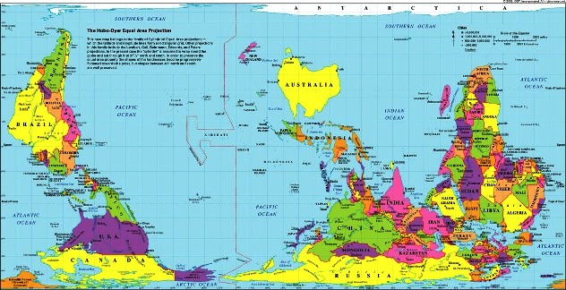

Slide 4
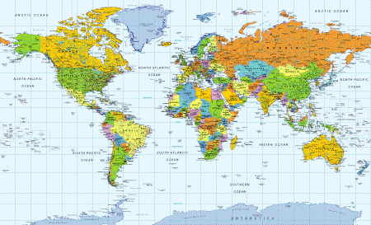

Slide 5
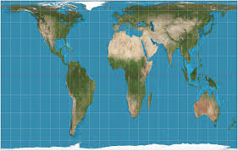

Slide 6
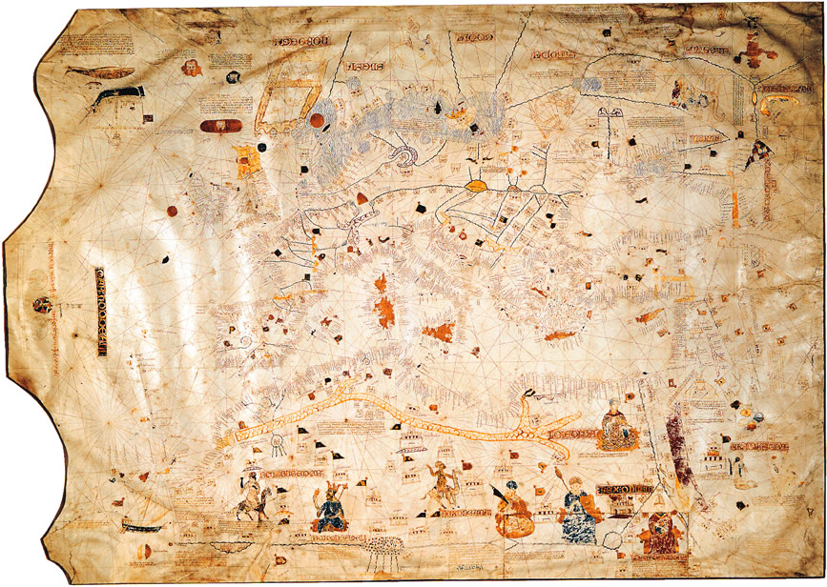

Slide 7
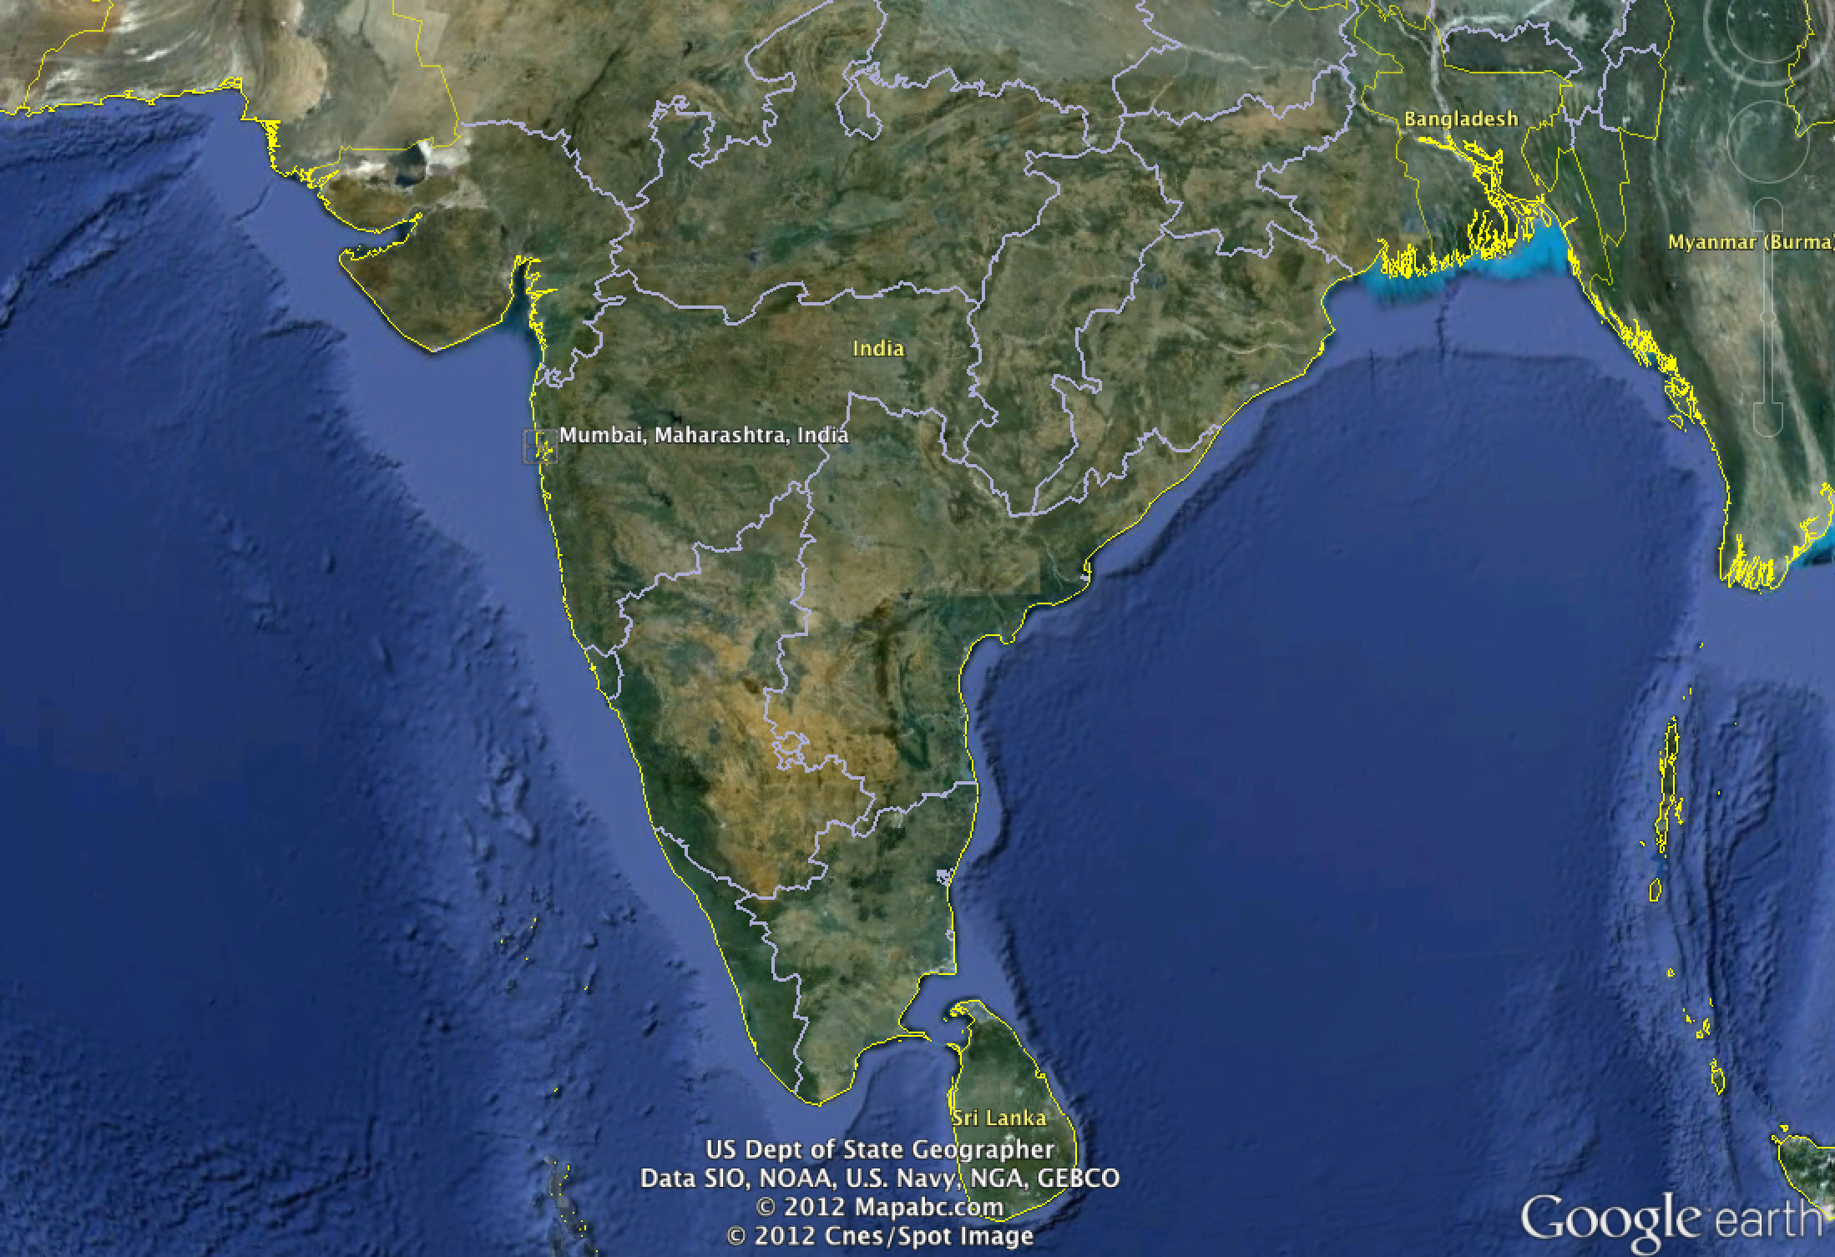

Slide 8
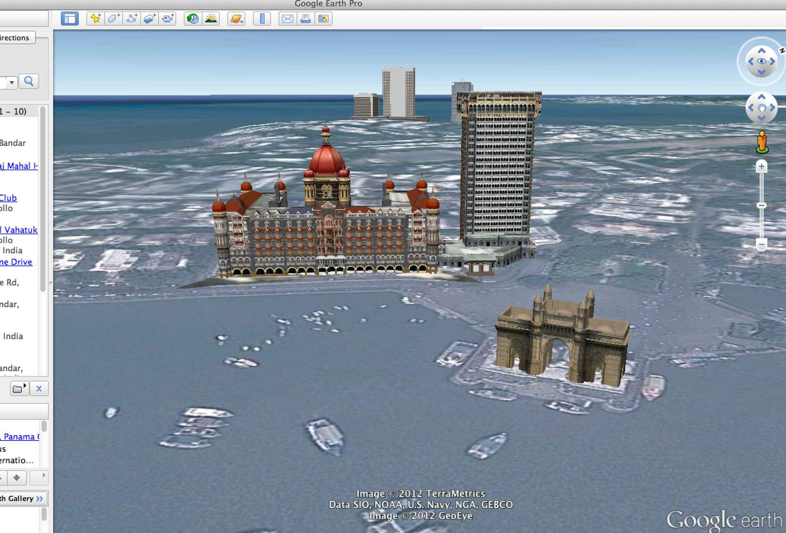
Thank You VERY MUCH!

Slide 9
Institutional Logics
Ideational Logics
Material Logics
Civil Society
Historical Influences
Role of the State

Slide 10
BUSINESS SYSTEMS
ECONOMIC INSTITUTIONS
CULTURE
Ownership
Management
Networks
Financial Capital
Human Capital
Social Capital
Rationale
Identity
Authority

Slide 11
Institutional Logics
Ideational Logics
Material Logics
BUSINESS SYSTEMS
INSTITUTIONS
CULTURE

Slide 13
Institutional Logics
ROLE OF THE STATE
Ideological Self-sufficiency that discouraged (and for a period outlawed much) FDI
ROLE OF CIVIL SOCIETY
Remains of caste system on many levels continues to have significant influence over individual behavior
KEY HISTORICAL INFLUENCES
British Raj
Resistance & Independence Struggle
Partitioning
…
…
…
…
…
…
State laws a significant barrier to national commerce
Religious & spiritual influences remain powerful and guides behavior on many levels

Slide 14
MATERIAL LOGICS
Demographics (>1Bn)
Long coastlines with Africa, “Persia” & Arabia on east and Southeast Asia on west
EXTERNAL IDEATIONAL LOGICS
Ghandi & nonviolence
British Administrative legacy
Tropical Climate
Three mighty rivers (Indus, Ganges & Brahmaputra)
…
Tata’s Nano car
…
Huge rural population
…

Slide 15
Culture
RATIONALE
Non-linear view of time (recurrence vs. progression)
IDENTITY
Historic institutionalization of caste system on many levels continues to have significant influence over individual allegiance
AUTHORITY
High Power Distance (Hofstede) with knowing place in world as primary source of “power”
Stratified society
Low Individualism: Family, village & educational relations dominate and constitute major support structures throughout life
Strong religious & spiritual ties
High context (ET Hall)
Admiration of knowledge & wisdom
Ends: independence & non-aligned
Means: support of basic needs of participants
Ends: peaceful coexistence
Means: Spirituality
Means: Religious diversity
…
…
Low Masculinity (Hofstede)
Ends: limited privacy
Moral code of religious authority serves as powerful influence
…
…
...
Means: Strong emphasis on science & technology

Slide 16
Institutions
CAPITAL
Source: community (cooperative, family, conglomerate)
Oversight: community consensus
HUMAN CAPITAL
Overall literacy rates remain very low with huge variability between states, age & socioeconomic groups, and gender
Highly educated sub-segment in technology & science
SOCIAL CAPITAL
Legal System in many cases complicated as it contains remnants of earlier political structures
With caste system formally abolished by law, many forms of the caste system survives in Indian life
Conditions: Support community subsistence & prosperity
Forces: Highly localized
Forces: Attempts by government to modernize capital markets
Large portion of labor force untrained doing manual labor
No gender differentiation in unskilled labor markets
Significant size of informal sector
…
…
…
…
Many tensions between cultural traditions & societal value systems held in check by need for coexistence in close proximity
…
…

Slide 17
Business System
OWNERSHIP
Closely held communal ownership (family, village)
Conglomerates (family, historical, para-statal) with significant vertical integration
NETWORKS
Family, village, school and other collective networks coordinating production chains within ownership structure
Large diversified family conglomerates coordinating activity across sectors of activity
MANAGEMENT
Management structure overlay nature of power structures in collective ownership
Within large conglomerates rising leaders may compete fiercely on merit
Small number of large relatively young public corporations in selected sectors
…
…
…
…
…

