Slide 1
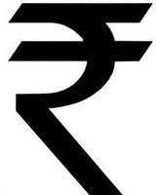
The Indian Economy
An Overview and Analysis

Slide 2
Class Exercise: What else could have happened? What else can happen?
Counterfactuals
Where would India’s economy be today if:
Gandhi’s economic vision had been adopted
Liberalization had not occurred at all
Scenarios
What all could still go wrong with India on the economic front?
Different doomsday scenarios

Slide 3
The Evolution of India’s Economy

Slide 4
25%
23%
24%
16%
3%
13%
4%
9%
Notes:
4

Slide 5
What Happened?
We missed the Industrial Revolution
Impact of British Rule
Positive
Common currency
Stable economy, stable polity, legal system
Fiscal conservatism
Infrastructure (Rail, ICS, Data Collection)
Negative
Traditional industries decimated (Textiles)
Did not invest in industrializing India

Slide 6
Aurobindo & Naoroji on British Rule
Sri Aurobindo
One great fact … the terrible poverty of India and its rapid increase during British rule, that is to say, the ‘drain’ represented by British economic imperialism
Dadabhai Naoroji
The cost to India of British colonization was, contrary to rhetoric, to the vast benefit of Britain and the extreme disadvantage of India
The evils of foreign rule involved the triple loss of wealth, wisdom, and work

Slide 7
Economic Strategy Pre-Independence
Congress did not have a clear economic strategy
Agreement on problems:
Poverty
Threat of famine
Need to maintain economic independence
Inequalities within society
Drain Theory:
Dadabhai Naoroji

Slide 8
Congress: Strands of Thought
Bombay Plan (developed by leaders of industry)
Economic development through growth of textile and consumer industries
State to provide infrastructure, protect industry, invest in “expensive industries”
Planned Modernization
Advocated by Civil servants and Thinkers from princely states—Vishweshwarayya
Influenced by Japan, and later, the Soviet Union
Pragmatic view of roles of industry, state
Expert panel to provide intellectual brain

Slide 9
Congress: Strands of Thought
Nehru & Bose
Imperialism propelled by capitalist expansion
State to develop “mother” industries
Ownership in public sector for redistributive and security reasons
Gandhi
“Industrialize and perish”
Caste (and consequent occupational roles) can be dissolved through moral persuasion
Decentralized, independent development

Slide 10
Influences on India’s
Economic Development
Arguments &
Ideas of
Intellectuals
The Indian
Economy
Pressures &
Claims of
Democratic
Politics
Social &
cultural
norms

Slide 11
Four Phases of India’s Economic Growth—Panagariya (2008)
Phase I (1951-65):
Takeoff under Liberal Regime; Open foreign investment policy; relatively open trade policy until late 1950s; investment licensing tightens only towards the late 1950s, early 1960s
Phase II (1965-81):
Socialism strikes with a vengeance
Phase III:
Ad hoc liberalization during 1975-79, 1980-84 and then more substantial liberalization during 1985-86 and 1986-87.
Phase IV (1988-present):
Systemic and systematic liberalization
Notes:
Source: Panagariya

Slide 12
How Is India Doing Today?
Source: Arun Maira

Slide 13
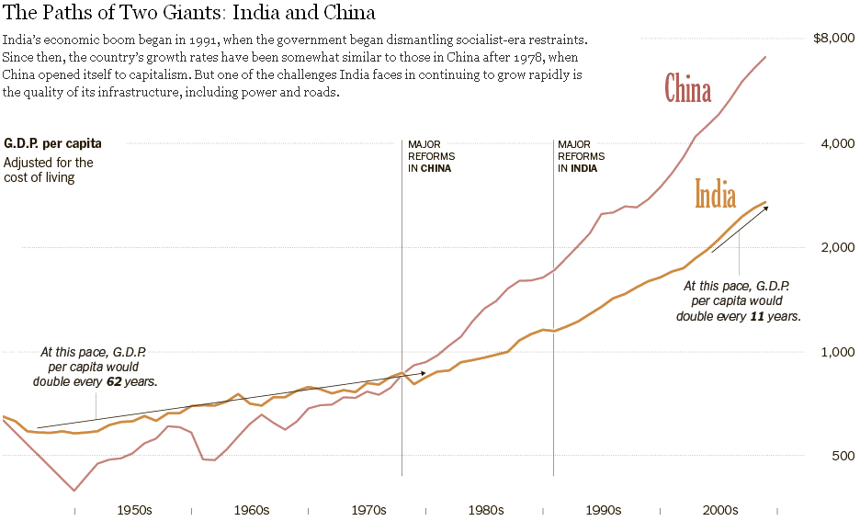
Notes:
http://www.nytimes.com/interactive/2011/06/08/world/asia/india-china-graphic.html?ref=asia

Slide 14
Features Common to the Four Phases
Reasons why India escaped prolonged stagnation or decline
Macroeconomic stability
Political stability
Gradual and predictable policy changes
Capacity to implement policies
Notes:
Source: Panagariya

Slide 15
Post-Independence: The Agenda in the Early Years (Phase I)
Multipronged Development => Self-reliance
Rapid industrialization; import subs’n; K goods
Prevention of foreign capital domination
Land reforms: abolish zamindari; land to tenant
Introduction of Cooperatives
Growth with equity: therefore positive discrimination and reservations for SC & ST
State to play central role through direct participation in the economic process => active public sector
Planned rapid industrialisation within a democratic & civil libertarian framework (an uncharted path!)

Slide 16
Nehruvian Activist Agenda
Constitutional democracy
Economic & social redistribution
State-directed industrialization
State to create conditions for economic expansion;
Forego quicker growth (through consumer industries) for long-term development
State industrial investment would be a counterweight to “cyclical swings and fashions of private investment”
Productive public sector => resources for redistribution
(1947 AICC Committee: “transfer from private to public ownership should commence after a period of five years”)
Nehru does not push fully due to lack of consensus => Mixed Economy prevails

Slide 17
Nehruvian Theory & Practice
Economic planning within mixed economy
Unique combination of democracy, markets and economic planning
Industrial licensing system
More restrictive after Industrial Policy Resolution 1956
Tariff policy (infant industry protection)
Emphasis on import substitution
Foreign exchange shortages justify such regulation
Mahalanobis Model: Heavy + Capital Goods Industries
Public Sector captures “commanding heights of the economy”
Small scale industry protection; expected to address unemployment
Significant investments in health and education; neglected by British
Science & Technology:
Atomic Energy, National Labs, CSIR => India’s scientific manpower
In practice, pragmatism rather than doctrinaire approach; not much opposition from organized business, which was actively consulted; lays the foundation for India’s physical and human infrastructure, the precondition for modern India’s development

Slide 18
Problems Nehru faced
Unequal distribution of land ownership defended by a powerful social order
Power to legislate regarding land reforms given to states
Low levels of productivity
Great inequalities of social order largely preserved
Bureaucracy to push developmental agenda
Industrialization based on Planning Commission for strategy, & bureaucrats for implementation

Slide 19
Nehru’s Achievements and the Immediate Post-Nehru Period
Moderate growth
Democratic legitimacy
Economic stability through prudent financial management
Undermined by crises
Political discontinuity – Shastri’s early death
Wars with China (1962) & Pakistan (1965)
Successive monsoon failures – 1965, 1966
Devaluation of currency to get IMF aid

Slide 20
Indira Gandhi – Early Years (Phase II)
Fears about India’s external vulnerability
Had to establish herself politically
Used economic policy as active instrument
Success of green revolution created bullock capitalists as economic and political force
State subsidies to gain their support
Other interest groups flexed their muscles
Economic populism to gain support of poor
Leftward shift – bank nationalization
Constraints on pvt. industry (e.g. MRTP)
Indirect taxes to fund populism
Fiscal conservatism broadly maintained

Slide 21
By the late 1980s … (Phase III)
Protectionist system of controls primarily to sustain state, not support development
Huge bureaucracy to “rein in business”
Deficits increased, fiscal prudence slowly declined
Rising interest rates made foreign borrowing costly to fund deficit, more conditions put by foreign lenders
Rajiv Gandhi enters and moves toward liberalization
Lowers taxes and tariffs, introduces computers
Telecom Revolution
Even though teledensity does not rise that much, the Public Call Offices make communication available to all easily

Slide 22
The Fiscal Crisis in 1991
Collapse of Soviet Union dented trade flows
Gulf War in 1991 boosted oil import bill
Forced repatriation of Indian migrant workers from the Gulf reduced inflows of workers’ remittances.
Withdrawal of non-resident Indian deposits
As foreign exchange reserves dwindled, India was forced ask the IMF for balance of payments support
A new government came to power in June 1991 with an immediate agenda of:
Stabilization (devaluation, deficit reduction)
Liberalization of the domestic economy
Opening up to international trade
Notes:
Mark P Thirlwell: India The Next Economic Giant, Lowry Institute for International Policy, Double Bay, New South Wales, Australia, 2004.

Slide 23
Liberalization (Phase IV)
Dismantling of licensing system
Removal of MRTP (earlier restricted growth)
Removal of technology import restrictions
Removal of physical constraints on imports
Reduced tariffs
Reduced taxes
FERA → FEMA & Current account convertibility (allows cos to access ForEx to expand overseas)
Companies had freedom to price IPOs
Divestment in public sector

Slide 24
Factors Enabling Growth Post-Liberalization
Entrepreneurship
Dismantling of license raj lowered costs
Competition from foreign companies (100% allowed in high-tech)—led to learning, partnering, tech adoption
Pent-up demand unleashed
Institutions were in place to nurture markets
India’s affordable, educated workforce as a comparative advantage
Scaling up in employee numbers readily possible
Cos knew how to deal with very price sensitive market
Leapfrogging possible—little burden of legacy systems
Foreign Direct Investment increased substantially

Slide 25
Concerns
Unaimed liberalization could:
Widen the gap in social opportunity between rich & poor
Sharpen rural-urban divide
Increase regional imbalances
Number of poor large in absolute terms
Economy has to be evaluated on the basis of what happens to poor & dispossessed
Is growth all that matters? What about quality of life?
Is India drifting dangerously towards a state of indebtedness and economic dependency in an uncertain world economy?
Is Indian policy to be dictated by World Bank etc?

Slide 26
Liberalization: Dalit Perspectives
State and public sector are emancipators, providing jobs
Even this benefits only a small portion of Dalits
Dalit communities, due to history, are less prepared for marketplace competition
Liberalization, without private sector social justice oriented initiatives will result in a new exclusion
As basic stepping stones to development—health, education —get privatized, exclusion of Dalits will worsen
What applies to Dalits also applies to numerous historically disadvantaged groups
60 years after Independence, people Below Poverty Line still constitute more than 25% of India
Now SEZs, (earlier development), displaced poor without making them benefit from progress

Slide 27
The reforms are not simply about the renegotiation of India’s relationships with the global market-place, nor even are they about the relationships of private capital with the Indian state in the formal economy; the reforms are also about the reworking of the idea of the State itself and of the state’s capacity to work on behalf of those who stand outside India’s (expanding) social and economic elites.
—Corbridge and Harriss, 2000, p. 169
Notes:
Corbridge, S and J.Harriss (2000), ‘Reinventing India: Liberalisation, Hindu Nationalism and Popular Democracy’ (London, Polity Press).

Slide 28
The Public Sector
Grew larger than envisaged, and in more areas
Over-zealous bureaucracy
Compulsions of electoral politics
Performance below expectations
Inexperience in enterprise management
Lack of requisite autonomy
Constant interference by administrative ministries
Excess manpower due to political interference
But did achieve variety of social objectives
PSU sales decline from 45% to 37%
Seven of top 10 firms in 1998 are PSUs (six in oil)
Privatization slow: Modern Foods, Sterlite
Navratna privatization or disinvestment now opposed

Slide 29
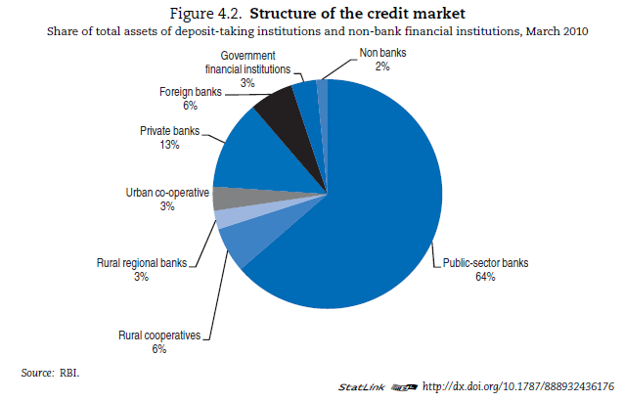
Public Sector Still Dominates In Certain Domains
Notes:
Source: OECD Economic Surveys India 2011

Slide 30
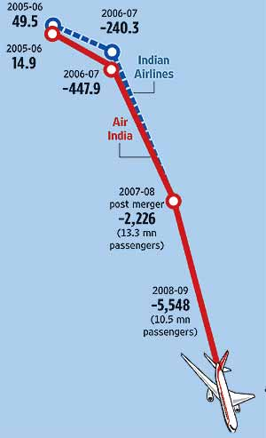
But Not In Others: Air India!
At the close of financial year 2009-10, Air India has incurred a cumulative loss of over Rs 13,300 crore since its merger with Indian Airlines in 2007
Before the merger in 2006-07, the losses reported by erstwhile Air India and Indian Airlines were Rs 447.93 crore and Rs 240.29 crore, respectively.
Notes:
http://www.outlookindia.com/article.aspx?265609
http://www.business-standard.com/india/news/air-india-losses-pegged-at-rs-13300-crore/128589/on

Slide 31
Arvind Subramanian comments …
The Indian state, despite rapid economic growth, has deteriorated over time. Whether it is providing basic law and order, or ensuring sanctity of contract, or delivering public services, the stench of decline is hard to ignore.
There is a fundamental asymmetry between state and markets. It is easier to create markets than it is to create state capacity or to prevent its deterioration. Creating markets is a lot about letting go, establishing a reasonable policy framework, and allowing the natural hustling instinct to take over.
Building state capacity, on the other hand, is quite different. It involves overcoming collective action problems, mediating conflict, creating accountability mechanisms where outputs are multiple and fuzzy and links between inputs and outputs murky, and contending with the deep imprints of history.
Notes:
http://economistsview.typepad.com/economistsview/2008/08/the-growth-futu.html#more

Slide 32
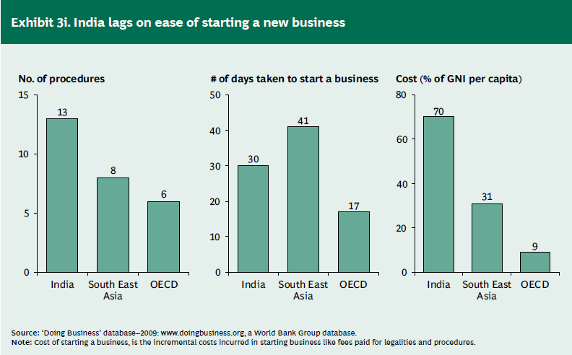
India: Still Trapped in Red Tape

Slide 33
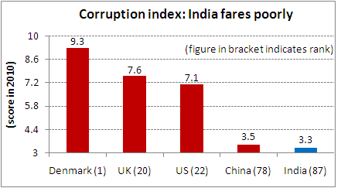
The Governance Deficit
Notes:
http://www.equitymaster.com/5minwrapup/images/2010/103010-Corruption-index-India-fares-poorly-equitymaster.gif

Slide 34
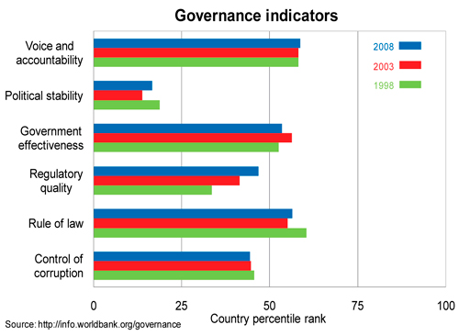
India: Governance Indicators

Slide 35
Today’s and Tomorrow’s India
https://www.youtube.com/watch?v=muJGrASkXEA

Slide 36
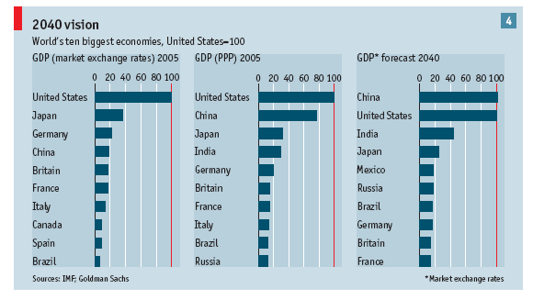
India is growing!
Source: Economist
India will be the third largest economy by 2040
India will be the 5th largest consumer market by 2025

Slide 37
The BRICs Verdict on the Indian Economy
Overtaking the G6:
When BRICs’ US$GDP will exceed G6
China
India
Russia
Brazil
BRICs
UK Germany Japan US
Italy France Germany Japan
Italy France Germany
Italy France Germany
G6
* dots indicate when BRICs US$GDP exceeds US$GDP in the G6
2000
2005
2010
2015
2020
2025
2030
2035
2040
2045
2050
G-6, Brazil, Russia & China expected to slow down over the next 50 years, India’s growth rate to remain above 5% throughout India’s GDP to outstrip Japan’s in 2032
India per capita income to rise to 35 times current levels by 2050
GS BRICSs Model Projections

Slide 38
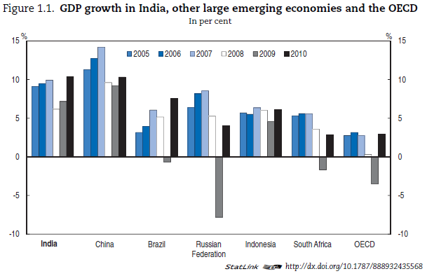
Notes:
Source: OECD Economic Surveys India 2011

Slide 39
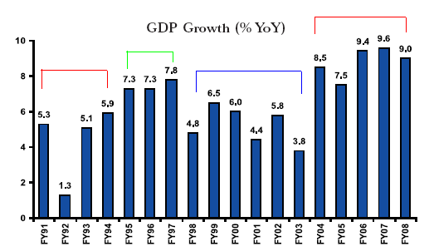
Post-Liberalization GDP Growth
Notes:
http://www.dalalstreet.biz/old_images/stocktips/gdp-growth-india-772752.PNG

Slide 40
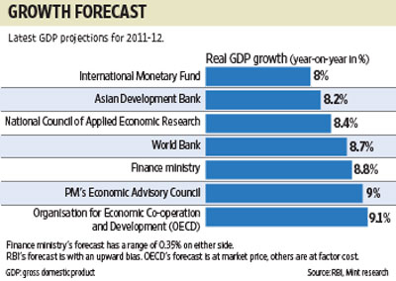
The Current Year
Notes:
http://www.livemint.com/images/94607888-4CC5-4CA5-A9F3-0AEABFB2BAA6ArtVPF.gif3C9ca_7dBbY0Tv0ZGmvxh6bq6

Slide 41
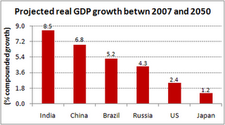
Notes:
http://4.bp.blogspot.com/_iWfE7UcxWAk/S4PS9JZmY7I/AAAAAAAAAQk/Fq5D0y6sLsw/s320/gdp-growth.gif

Slide 42
Factors Driving India’s Growth

Slide 43
A Rising Savings Rate
 | 1980-81 | 1990-91 | 2000-01 | 2010-11
Savings rate/GDP, /% | 18.5 | 22.8 | 23.7 | 34
Source: Government of India, Economic Survey 2010-11, www.indiabudget.nic.in

Slide 44
Integration with Global Economy
Gross Flows (Current and Capital Accounts)
Year | Billion USD | % to GDP
1957 | 5.2 | 19.5
1967 | 9.6 | 20.7
1977 | 20.4 | 22.0
1987 | 53.0 | 23.9
1997 | 177.3 | 49.9
2007 | 909.3 | 110.0

Slide 45
India's trade performance
US$ billion
Over the six year period 2002-03-2007-08, average annual growth in
Exports – 25%
Imports – 31%
Trade – 28%
However total trade grew only by 10% in 2008-09 due to the global slowdown
Source: Reserve Bank of India
Government envisages to double the share of India in global trade by 2020. India’s total share in goods and services trade was 1.6% in 2008

Slide 46
India’s forex reserves … fifth largest in the world
US$ billion
Largest holders of forex reserves
1.People’s Republic of China
2.Japan & Euro zone
3.Russia
4.Taiwan
5.India
6.South Korea
7.Brazil
8.Hong Kong
9.Singapore
10.Germany
Source: Wikipedia
Source: Reserve Bank of India
Forex reserves for the week ending July 15, 2011 stood at US $315 Billion
Notes:
http://articles.economictimes.indiatimes.com/2011-07-22/news/29803498_1_foreign-exchange-reserves-forex-reserves-appreciation-or-depreciation

Slide 47
Inflation level….
Wholesale Price Index (in percent)
Source: Reserve Bank of India
Inflation touched a peak of 12.8% in August 2008 due to increased pressure on global commodity prices
Wholesale price index for the month of February 2010 was 9.9% (y-o-y)

Slide 48
Index of Industrial Production
(in percent)
Manufacturing sector has witnessed a perceptible slowdown due to
(i) Global meltdown and
(ii) Contractionary monetary
policy stance of RBI
IIP Growth in
April’09 - 1.2%
May’09 - 2.2%
June’09 - 7.8%
July’09 - 7.2%
Aug’09 - 10.2%
Sept’09 - 9.1%
Oct’09 - 10.3%
Nov’09 - 11.7%
Dec’09 - 16.8%
Jan’10 - 16.7%
Source: Central Statistical Organization
March 2011 7.8 %
For the economy to clock 8-10% growth, manufacturing sector needs to grow by at least 12%

Slide 49
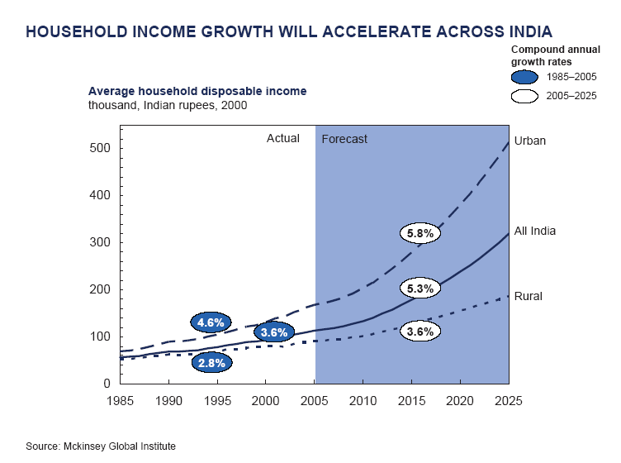
Increasing Discretionary Income

Slide 50
Given the demography & rapidly growing middle class, India has huge untapped market potential…..
Growing middle class…..
India’s middle class constitutes 50 million people at present. Likely to go up to 583 million people by 2025
Households that can afford discretionary spending likely to go up from 8 million at present to 94 million by 2025
Source : McKinsey Global Institute

Slide 51
The domestic market is growing
Telecom subscriber base (in millions)
Higher disposable income, easy availability of credit and high exposure to media and brands has increased the average propensity to consume
India has a mobile subscriber base of over 500 million and is currently adding around 8-10 million subscribers every month; about 50% penetration is expected by 2012
Automobile production now exceeds 10 million units per annum including passenger vehicles, commercial vehicles, two- and three-wheelers
Automobile production (in millions)
* Apr-Jan 2010

Slide 52
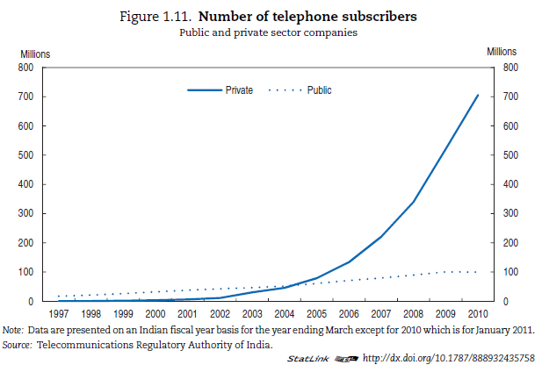
Notes:
Source: OECD Economic Surveys India 2011

Slide 53
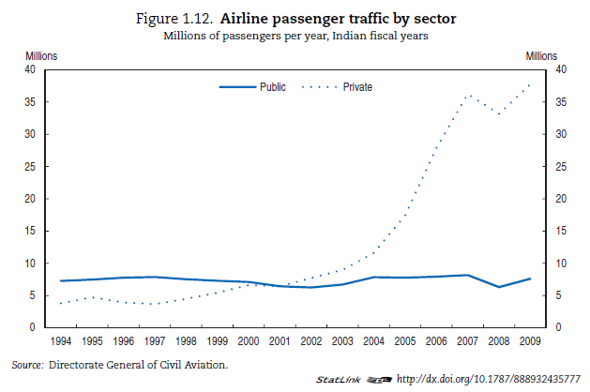
Notes:
Source: OECD Economic Surveys India 2011

Slide 54
What sets India apart…..
India has the advantage of being one of the “youngest” countries
 | Size of 15-59 age group in 2007 (in million) | Size of 15-59 age group in 2050 (in million) | Growth of 15-59 age group ( in million)
India | 696 | 1020 | 324
United States | 191 | 225 | 34
Japan | 76 | 45 | -31
Germany | 50 | 36 | -14
United Kingdom | 36 | 36 | 0
France | 37 | 35 | -2
China | 895 | 755 | -140
Source: United Nations
In the year 2006, about 52% of India’s population was below 25 years
Median age would be 30 years even as late as 2025
India’s work force (15-59 years) would go up by around 324 million by 2050.

Slide 55
INDIA’S DEMOGRAPHIC DIVIDEND WILL CONTINUE TILL 2025 (% share of age groups)
India will remain a young nation with the median age going up from 21 in 2000 to 26 in 2025

Slide 56
Strong knowledge base….
What sets India apart…..
India’s educational infrastructure
Over 380 universities (11,200 colleges)
1,500 research institutions and around
9,000 PhDs
Over 200,000 engineering graduates
Over 250,000 post graduates and
2,000,000 graduates
India has a significant English speaking
population
Source : A.T. Kearney
India has the third largest scientific and technical manpower in the world
The number of MNCs undertaking R&D activity in India has gone up from 100
in the year 2003 to 300 in 2007

Slide 57
Factors Driving India’s Growth
Population & demographic trends:
Every two years, India adds Germany’s labor force!
Urbanization
Human capital
English-speaking skilled workers: scientists, trained IT specialists, technicians and engineers
Rising integration into global trade and investment
Can also capitalize on Diaspora, especially in USA
Investment trends: infrastructure
PPP to finance and execute infrastructure projects (rail, airport, seaports)
Policy and institutional determinants of growth
Macro policies
Institutional and regulatory environment

Slide 58
Drivers of Economic Transformation
Spirit of entrepreneurship
Unleashed with the IT revolution and emergence of BPO / outsourcing industry
Rise of knowledge based industry, taking cue from successful entrepreneurs in the Silicon Valley
IT industry leveraged on Modular Development and Global Delivery Model
Benefits from 24 hr work day and productivity gains
Technology drove outsourcing of business processes
Indian IT Cos devising strategies to move up value chain
Other sectors transforming are Pharma and Auto-ancillaries
Huge opportunities seen in improving supply chain efficiencies and catering to domestic market across sectors
Telecom revolution unleashes tremendous economic impact

Slide 59
India Growth Story: The Constraints
Infrastructure remains a critical bottleneck
Quality of education archaic; not innovation-oriented
How can we educate 500 million youngsters properly?
PSUs still hold monopoly in some sectors
Aerospace, defense production & nuclear power prodn.
Reforms slowed due to need for political consensus
Capital markets still not very efficient
Slow growth in agriculture, occupation of 60% people
Urbanization at a rapid pace, but not planned or managed carefully
Can lead to huge impacts on environment & efficiency
Challenge to ensure inclusive growth,
Economic gains to be equitably distributed while evolving right incentives for growth

Slide 60
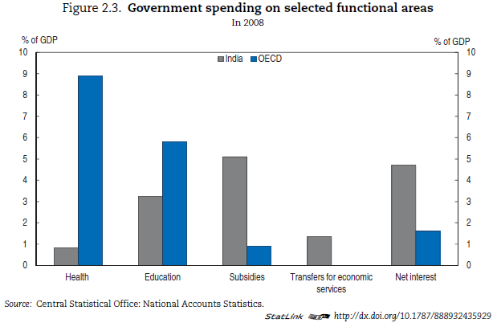
Notes:
Source: OECD Economic Surveys India 2011

Slide 61
Arvind Subramanian again …
Growth may itself cause changes which have in turn a growth-reinforcing effect – a positive feedback loop.
A good example is education. For long, development economists bemoaned the poor levels of educational attainment in India, directing their critique at the government’s failure to supply better education.
But economic growth changed the education picture dramatically. It increased the returns to, and hence the demand for, education.
And if government supply remained weak, consumers simply turned to the private sector to meet their demand for education.
Improvements in educational attainment over the last 15 years are attributable in part to more rapid growth.
Notes:
http://economistsview.typepad.com/economistsview/2008/08/the-growth-futu.html#more

Slide 62
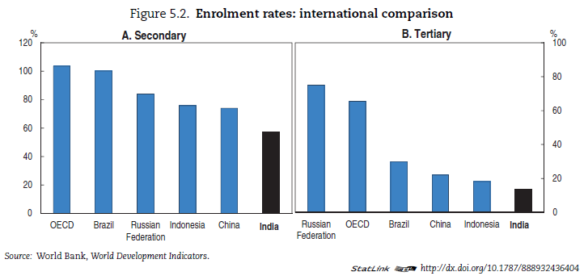
Notes:
Source: OECD Economic Surveys India 2011

Slide 63
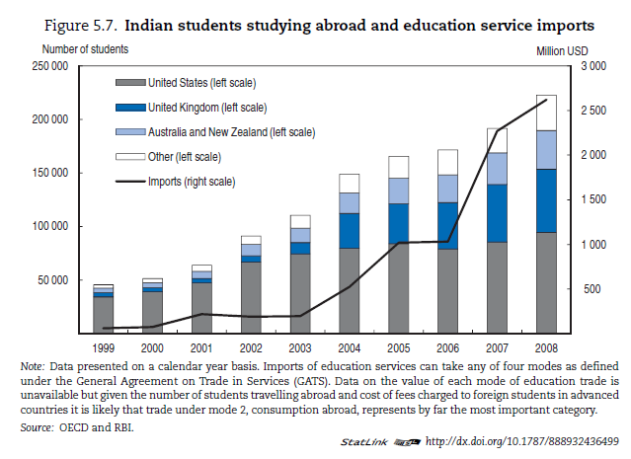
Notes:
Source: OECD Economic Surveys India 2011

Slide 64
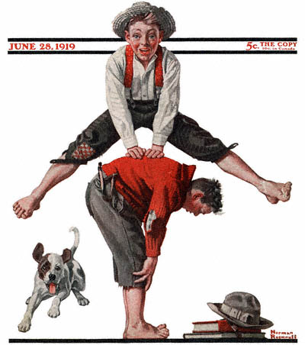
India’s Services-led Growth: Leapfrogging Over Manufacturing?
Notes:
http://www.best-norman-rockwell-art.com/images/1919-06-28-Saturday-Evening-Post-Norman-Rockwell-cover-Boys-Playing-LeapFrog-no-logo-400-Digimarc.jpg

Slide 65
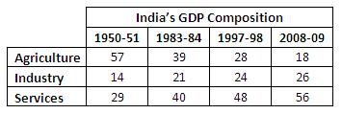
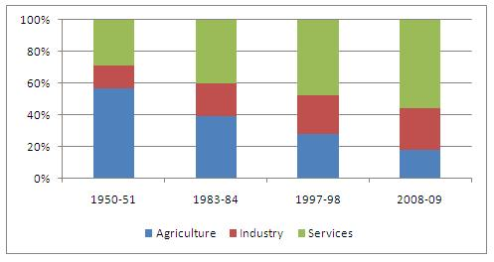
The Changing Composition of India’s Gross Domestic Product
Notes:
http://capitalstock.wordpress.com/category/indian-gdp/

Slide 66
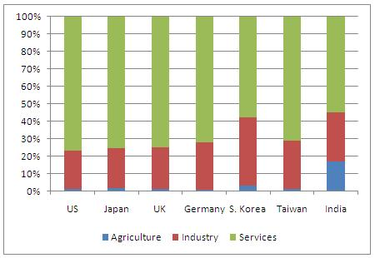
Comparing India’s GDP Sectoral Composition with Other Countries
Notes:
http://capitalstock.wordpress.com/category/indian-economy/

Slide 67
Service Sectors
Trade- wholesale and retail
Hotels and Restaurants
Railways
Transport- road, water, air
Communication- postal, money orders, telegrams, phones, overseas communication
Banking
Insurance
Dwellings, Real Estate
Legal services
Business services- renting of machinery, computers, accounting
Public administration, defense
Personal- domestic laundry, barber, beauty shops, tailors, recreation, entertainment
Community services- education, research, medical, religious
Source: Barry Eichengrem, & Poonam Gupta, April 2010

Slide 68
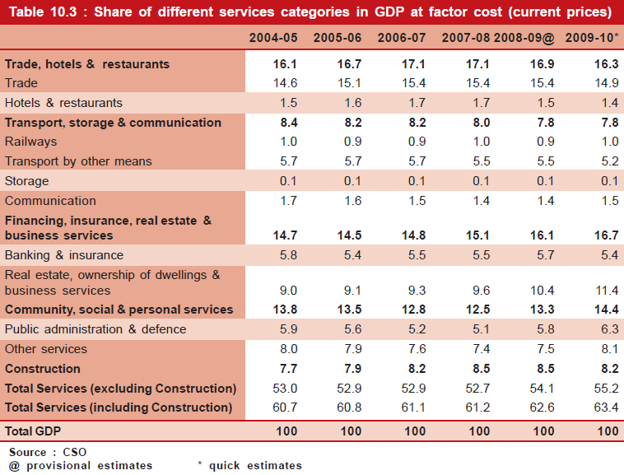

Slide 69
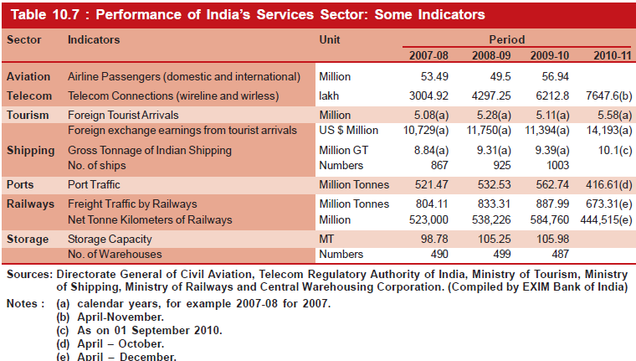

Slide 70
Service Sectoral Growth
Greatest sectoral growth
Source: Barry Eichengrem, & Poonam Gupta, April 2010

Slide 71
Current Services Provided in India
Source: Arun Maira

Slide 72
Factors Favoring Service Sector Growth
“Concept Arbitrage”
Services that have worked in other countries introduced in India
E.g., housing mortgages
From non-organized/informal services to organized/formal services
E.g., real estate: from individual homes and cash investments to builders and cheque payments

Slide 73
India’s Manufacturing Sector

Slide 74
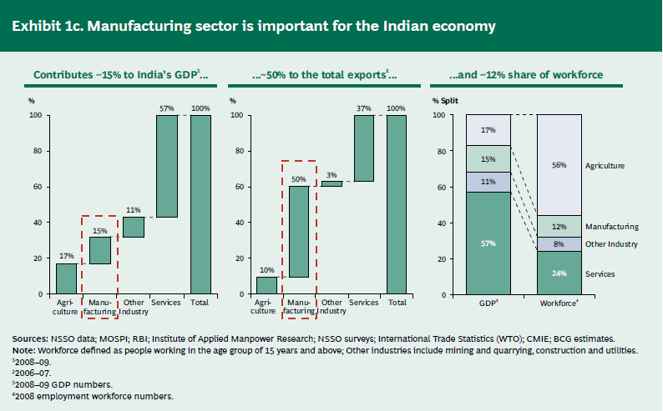

Slide 75
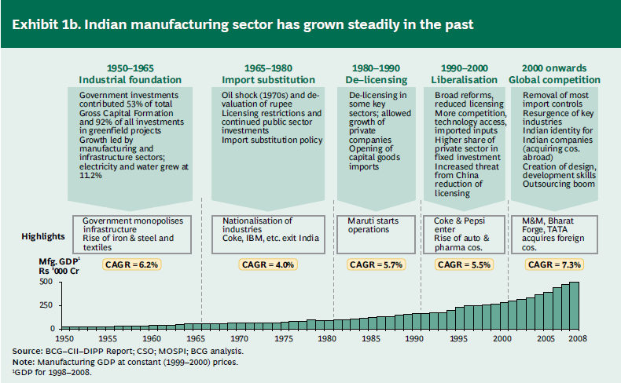

Slide 76
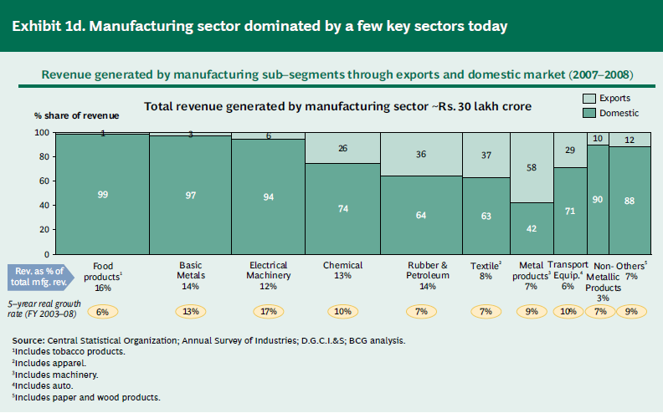

Slide 77
India as a Manufacturing Hub
Companies like Cummins, DaimlerChrysler, Toyota Motors, ABB, Honeywell and Siemens have set up/are setting up shop
Global automakers which spend 3 to 5 percent of their annual revenue on R&D activities, are turning increasingly to India
Auto-ancillary industry has demonstrated India’s potential to emerge as a low-cost outsourcing destination for sourcing assembly components
Exports constitute 15-20 per cent of the industry size of about $10 billion in FY06 and are likely to reach 50 per cent in five years
Availability of large pool of qualified engineers will propel skill-intensive industries requiring advanced technical expertise
Industries like fabricated metal products, machinery, pharma and telecom equipment
A foothold in India enables companies to be close to consumers so as to identify the pulse of the market and respond rapidly

Slide 78
India as a Manufacturing Hub
India, as a Regional Marketing Hub, is suitable for most of MNCs, which use quick model of "design—develop—market”
Indian industry has critical skills required for product, process & capital engineering
Product Engineering:
Indian engineers can design quickly, which helps reduce development costs and lead times
One Indian supplier, for example, took only 6 months to design a steering system for an automaker that was taking them more than four years in other low-cost countries
Many automakers are now creating engineering and design centers in India to capitalize on these skills

Slide 79
India as a Manufacturing Hub
Process Engineering:
Redesign of manufacturing processes to make them more labor intensive and less capital intensive enabling overall cost reduction
“De-automating” the production processes used in Western factories can cut overall manufacturing cost by 20%
Capital Engineering
India’s advanced tooling and machinery industry makes it possible to produce capital equipment locally
India is also now at par with global standards, as far as communication infrastructure is concerned

Slide 80
Frugal Engineering
A philosophy that implies a “clean sheet” approach to product design.
Not about cutting features from existing products but designing from scratch to meet needs of emerging markets
In India, customers are hard pressed for funds and look for products at lower costs, but do not compromise on product quality, functioning, comfort and environment friendliness.
Examples:
Tata Nano
GE’s $1000 ECG Machine
Nokia 1100 mobile handset
Notes:
www.strategy-business.com/media/file/sb59_10201.pdf
http://www.indiaprwire.com/pressrelease/computer-software/2011071992392.htm

Slide 81
India as a Manufacturing Hub
Infrastructure is the key bottleneck which restricts the growth of manufacturing sector
Erratic electricity supplies, poor roads, and gridlocked seaports and airports
Government labor policies that discourage hiring and policies that hold back domestic demand for goods in many sectors
Discounting a few centers of excellence, education at all levels suffers from lack of quality and stress on innovation
Government policies encouraging setting up of SEZs and investment in infrastructure through PPP
Export competitiveness has been given priority

Slide 82
Sourcing Components: Toyota
Toyota was the first auto maker to recognize India as a source of components
Invested $ 200 million in JVs to help local suppliers scale in their manufacturing operations
Focused on localizing content for Qualis and Corolla models
Turned India into a regional sourcing hub through economies of scale in manufacturing
Also invested significant amounts in offering training and processes to bring Indian suppliers up to its global standards

Slide 83
INDIA’S BOOMING MIDDLE CLASS

Slide 84
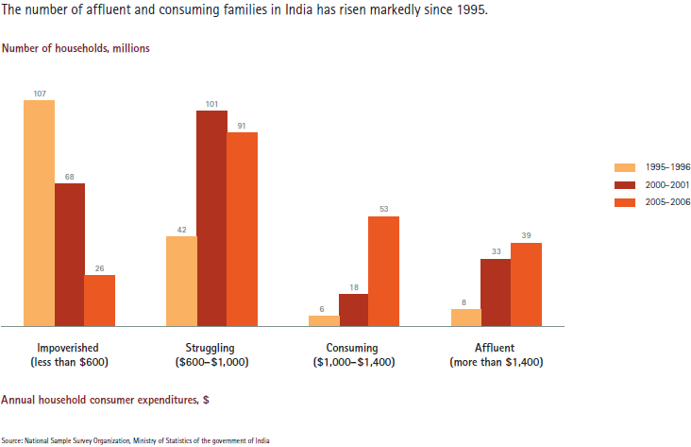

Slide 85
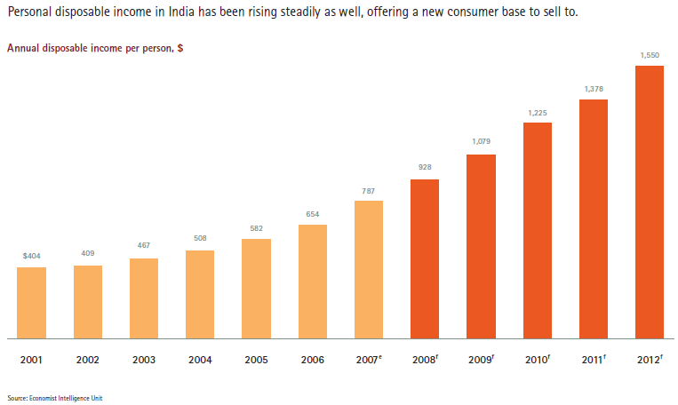

Slide 86
Who are they?
According to the National Council of Applied Economic Research, the term "middle class" applies to those earning between $4,000 and $21,000 a year ($20,000-$120,000 in purchasing power parity terms).
But this definition suits only about 60m (under 6 per cent) of the population. Nevertheless, there seems to be an underlying intuition about the "middle class-ness" of those moving up from $5 a day to $10
People who employ household help are middle class?

Slide 87
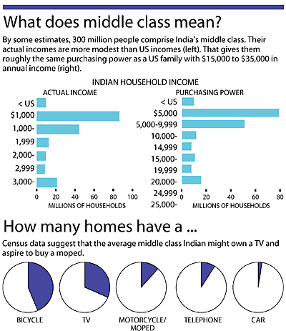
Notes:
http://www.dolcera.com/wiki/images/PersFin_Middle_Class.gif

Slide 88
Impact?
The shifting of expenditure from needs to wants is what distinguishes the Indian middle class most sharply from the middling social groups of the past
The average middle class consumption per capita per year works out to Rs 12,546
New research from the McKinsey Global Institute (MGI) shows that within a generation, the country will become a nation of upwardly mobile middle-class households, consuming goods ranging from high-end cars to designer clothing.
In two decades the country will surpass Germany as the world's fifth largest consumer market

Slide 89
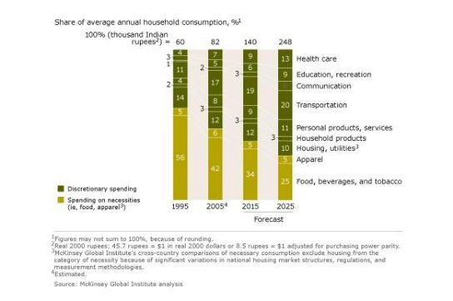
Notes:
http://sramanamitra.com/wp-content/uploads/2008/01/indian-middle-class-spending.jpg

Slide 90
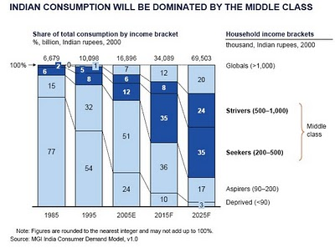
Notes:
http://growglobally.org/wp-content/uploads/2010/11/IndiaMiddleClass.jpg

Slide 91
Value-conscious consumers
Before India embarked on its program of economic reforms, the country had only 0.8 fixed telephones per 100 people, and virtually no mobile phones.
Now, mobile phone subscribers are expected to reach 211 million by end-2008.
India's mobile market is currently growing even faster than China's, and overall communications spending will grow at a very rapid 13.4 percent per year over the next two decades.
Other fast-growing categories will include transport, education and health care.
But India’s mobile telephony costs are among the lowest in the world (and companies still make profits!)

Slide 92
How the Indian Consumer Really Behaves?
https://www.youtube.com/watch?v=vJaHbUru7Ok

Slide 93
Urbanization and India
Urban India accounts for about 30 per cent of the total population (about 300 million) and its share is expected to rise to about 40 per cent by 2030.
By 2015, about $90 billion needs to be invested in urban infrastructure excluding metro railway projects. But what would be available, on the basis of 2004 figures and projections, is only $10 billion.
In 2007, the housing shortage was about 24 million units and it is expected to touch 26 million by 2012.
About 99 per cent of this deficit pertains to lower income groups.
93
Notes:
from The Hindu, Mar 4, 2008
93

Slide 94
Growth of Middle India
Much of the consumption and income growth is not in the metros, its in the Tier II and Tier III cities
51 districts in India have at least one town with a population of more than 500,000. Together, they have twice the market potential of the four metros (Mumbai, Delhi, Chennai and Kolkata) combined. (RK Swamy BBDO)
Towns such as Chandigarh, Ahmedabad, Jaipur, Lucknow, Indore and Pune have three-quarters or more of the affluence levels of Mumbai. On growth potential they do even better. That small-town urban India is attractive in terms of purchasing power, time spent on media, and product consumption comes across clearly.

Slide 95
Myths & Realities
Myth: The Indian middle class lives in the metros.
Reality: Of the 80 million households that constitute the Indian middle class, only 25 million are in Tier I cities. Close to 55 million belong to the smaller towns. Mercedes sells more cars in small-town Ludhiana than it does in Mumbai.
Myth: India is a "price sensitive" market.
Reality: For products such as Vim Bar dishwashing detergent and Head & Shoulders shampoo, the Indian market easily absorbed price hikes of 13% and 18%, respectively, in 2007. Yet for years, candy manufacturers have been trying in vain to increase prices from 50p to Re 1. Value sensitivity, not price sensitivity, is the buzzword.
Myth: Imported is always premium.
Reality: Euro RSCG's brand momentum study in 2004 showed that eight of the top 10 brands in the country were of Indian origin. The days of "imported equals premium" are long past.

Slide 96
Entrepreneurial
Indian middle class also marked by entrepreneurial spirit — focused in thought, global in outlook, proactive in approach, and meticulous in execution – Rishikesha T. Krishnan, IIMB Professor
Represented by companies such as Infosys and Bharti Airtel
All have been global in outlook in terms of adopting global standards, the best technology and operating on global scales
Examples of middle class to billionaires

Slide 97
A Mega Market Online?
Between now and 2015, internet users in India will more than triple to 350 million, according to a recent study by McKinsey & Co. This will make India’s online population larger than the entire current population of the United States.
As a result, get ready for the tipping points that are set to change the way businesses interact with consumers and clients. So be wise: look at where the trends are pointing, and position yourself and your business ahead of the curve.
India’s online trends are relevant on a global scale, too: of the world’s 1.14 billion internet users, 100 million are Indian.
Notes:
http://blogs.wsj.com/indiarealtime/2011/07/13/chief-mentor-five-internet-trends-to-keep-an-eye-on/?mod=WSJBlog&mod=irt&mod=livemint

Slide 98
Trends Changing the Face of Technology Penetration in India
1. Smartphones. India’s mobile growth is already impressive, but in addition to voice and SMS, increased smartphone penetration will allow an entire generation of Indians to access the Web on their handsets without needing a computer. Today only 8% of Indian households have access to a PC. However, by 2015, the mobile phone is expected to help unlock internet access, with more than half of the anticipated 350 million internet users accessing the internet from their mobile phones.
Notes:
http://blogs.wsj.com/indiarealtime/2011/07/13/chief-mentor-five-internet-trends-to-keep-an-eye-on/?mod=WSJBlog&mod=irt&mod=livemint

Slide 99
2. Mobile Commerce. Today, in India people primarily research the features, benefits and prices of products and services online and then buy offline. This is why popular eCommerce portals, such as those in the retail and travel sectors, in India have offline delivery and payment options. But online purchases on mobile phone are making strides: 38% of mobile internet users say they have used their phones to shop online.
Notes:
http://blogs.wsj.com/indiarealtime/2011/07/13/chief-mentor-five-internet-trends-to-keep-an-eye-on/?mod=WSJBlog&mod=irt&mod=livemint

Slide 100
3. The power of women. Today, Indian women make up only 20-30% of the online population, Asia’s lowest percentage. (Thailand has the highest, with 72.5% women users). Although with more than 25.45 million users India is the world’s fifth biggest Facebook nation, only 29% of them are female, according to data provided by comScore, a company that focuses on digital market intelligence. But this figure is likely to increase in coming years: If other Asian markets are any indication, over time the percentage of women online should come closer to 50%.
Notes:
http://blogs.wsj.com/indiarealtime/2011/07/13/chief-mentor-five-internet-trends-to-keep-an-eye-on/?mod=WSJBlog&mod=irt&mod=livemint

Slide 101
4. Cloud computing. Cloud computing services are already more popular than they are in many other parts of the world, with 88% of respondents to one survey conducted by KPMG saying they use cloud services for applications such as emails, sharing photos and videos. As broadband penetration increases, cloud service use will also grow. Half of India’s internet users now watch videos online. The potential of online video in India was made obvious during the cricket World Cup: Although in January 2011 Indians watched 3.4 million online videos, views sky-rocketed to 37 million in March.
Notes:
http://blogs.wsj.com/indiarealtime/2011/07/13/chief-mentor-five-internet-trends-to-keep-an-eye-on/?mod=WSJBlog&mod=irt&mod=livemint

Slide 102
5. Social media. This is destined to keep growing – in India as elsewhere. Social media and micro-blogging services such as Twitter will become increasingly important sources of feedback about products, policies, and people – with users more likely to voice their opinions, especially when they’re negative.
Notes:
http://blogs.wsj.com/indiarealtime/2011/07/13/chief-mentor-five-internet-trends-to-keep-an-eye-on/?mod=WSJBlog&mod=irt&mod=livemint

Slide 103
The Formal Corporate Sector

Slide 104
Indian Entrepreneurship Before Independence…
1800s
Opium Trade with China--
Jamsetji Jeejeebhoy, etc
Inter-War Period
Heavy Industry
Tatas, Birlas, Dalmias, Walchand, Singhanias
Maharaja of Mysore—Steel (Vishweshwarayya)
Textile Mill Magnates

Slide 105
Indian Business Houses in Pre-liberalization Era
Expansion & consolidation (in spite of constraints of industrial policy) → expansion of industrial base
Acquisition of British business houses in India
Growth in 1914-47 due to British focus on World Wars; Great Depression
Strategic use of industrial licensing system
Corner licenses to prevent competition
Expand into unrelated lines just because license is obtained
Compete easily in political markets of corridors of power
Precious little innovation
Dependent on State Funds
Industrialists often owned small % of shares; LIC, etc. rest
Global expansion by far-sighted houses (e.g. Aditya Birla)
Third generation splits weakened many houses
External pressures on joint-family
Availability of funding from FIs and banks

Slide 106
Context and Corporate Growth
Notes:
Source: Krishna Palepu and Tarun Khanna

Slide 107
Indian Business Houses in Pre-liberalization Era
Weak on technology, quality
Control remained with family members, though family members better educated over time
Forward-looking houses high on professionalization
Business became more respectable, but few could attain the status of pre-independence business leaders!

Slide 108
Impact of liberalization on Business
Liberalization => competition => technical change. But Indian business also now more ambitious & efficient (better K/output)
Existing business houses invest in new product lines, more focused
Tatas sell TOMCO to HLL; SRF sells finance arm, buys core biz
Some efforts at tech development; more R&D (esp. Pharma)
Import of technology
Nicholas Piramal buys entire R&D lab of Hoechst
Entry of multinationals challenges Indian cos.
Lots of JV, M&A, acquisition of Indian firms (Parle)
New class of entrepreneurs
Educated, informed, ambitious, progressive; not old money
IT Success
No products; efficient processes; leverage educated raw material & labour cost arbitrage; untouched by government

Slide 109
Now, the Indian Multinational?
LN Mittal: does his empire qualify?
Bharat Forge, Moser Baer, Wipro, Tata Steel, Aditya Birla, all buying companies abroad
Aditya Birla group expanded overseas since license-permit raj days, to avoid dealing with Indian government restrictions on growth
ONGC Videsh: a PSU in international markets
The Entrepreneurial Success of the Indian Diaspora and its demonstration effect

Slide 110
The Other India

Slide 111
The Informal Sector
As per 2005 Sample Survey on Employment and Unemployment (NSS) 93 percent of India’s total labor force, and 82 percent of its non-agricultural labor force is informally employed.
Informal workers produce legal goods and services, but engage in operations that are not registered or regulated by fiscal, labor, health, and tax laws.
They construct buildings, clean homes, sew clothes, and weld car parts.
Produces about 60%of India’s GDP [Kabra 2003].
Despite their contributions, informal workers in India and elsewhere live in dire poverty and insecurity.
Notes:
http://casi.ssc.upenn.edu/iit/agarwala
http://alexmthomas.wordpress.com/2009/09/26/on-the-unorganised-sector-in-india/
Kabra, Kamal Nayan (2003), The Unorganised Sector in India: Some Issues Bearing on the Search For Alternatives, Social Scientist, Vol. 31, No. 11/12 (Nov. – Dec., 2003), pp. 23-46.

Slide 112
India’s Informal Sector
Low level of organisation; small in scale usually employing < ten workers and often from the immediate family;
Heterogeneity in activities;
Easier entry and exit than in formal sector;
Usually minimal capital investment; little or no division between labour and capital; informal capital sources
Mostly labour intensive work, requiring low-level skills; usually no formal training as workers learn on the job;
Labour relations based on casual employment and or social relationships as opposed to formal contracts;
Due to their isolation and invisibility, workers in the informal sector are often largely unaware of their rights, cannot organise them and have little negotiating power with their employers and intermediaries (ILO 2000).
Notes:
http://www.fibre2fashion.com/industry-article/printarticle.asp?article_id=1877&page=3

Slide 113
Informal Sector’s Changed Labour Movement Strategies
First, because informal workers are not coming together on a shop floor every day, they organize around the neighborhood.
Second, because they have no legal right to make demands on their employers, they are using their power as voters to make demands on the state.
Finally, since the target of their demands has changed, the nature of their demands has changed from traditional work benefits – minimum wages and job security – to welfare benefits – education scholarships, houses, and health clinics.
These strategic changes enable Indian informal workers to bypass their employer, avoid disrupting production, and protect their fragile incomes.
To operationalize their movements, informal workers are launching tripartite organizations, known as “welfare boards.”
Notes:
http://casi.ssc.upenn.edu/iit/agarwala

Slide 114
In December 2008, the Indian parliament passed the Unorganized Sector Workers’ Social Security Bill to cover informal workers’ life, disability, health, and old age insurance.
The largest program under this Act, The Rashtriya Swasthya Bima Yojana (RSBY) or “National Health Insurance Program” provides 750 dollars to informal workers’ families to cover medical expenses at participating hospitals.

Slide 115
Social Regulation of Indian Economy
Gender
Caste
Religion
Classes:
Labour: in dependent alliance with caste patrons
Capital: rise of Intermediate Class; dominate non-metros
State Regulation: doesn’t go below surface
Huge untaxed, unregulated, externality-driven economy
Tremendous corruption at implementation level
Reforms create more opportunity for market exploitation of rents and labour
Conversion of black money to white

Slide 116
END
https://www.youtube.com/watch?v=PAYG0-PdXZE

