Slide 1
Study Abroad: MGS 4410 & FI 4410 Introduction to India
Geographic
Political, Economic, Social, Cultural Basics
Satish Nargundkar
Milind Shrikhande
November 7, 2015

Slide 2
Namaste!

Slide 3
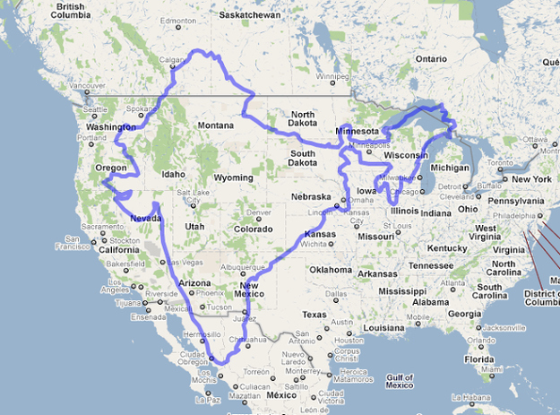
India & US – Basic Facts
United States |  | India
320 Million | Population | 1,267 Million
9.16 Million | Land Area (Sq. Km) | 2.97 Million
$52,800 | GDP per Capita | $4,000
45 | GINI Index | 36.8
79.5 | Life Expectancy (years) | 67.8
6.2 per 1000 births | Infant Mortality (<1 year) | 43.2 per 1000 births
698 | Prisoners/100,000 | 33
Notes:
http://www.nationmaster.com/country-info/compare/India/United-States

Slide 4
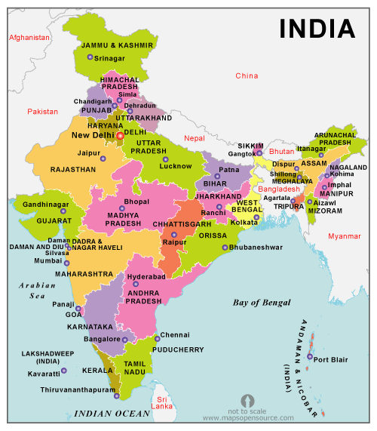
Political Map

Slide 5
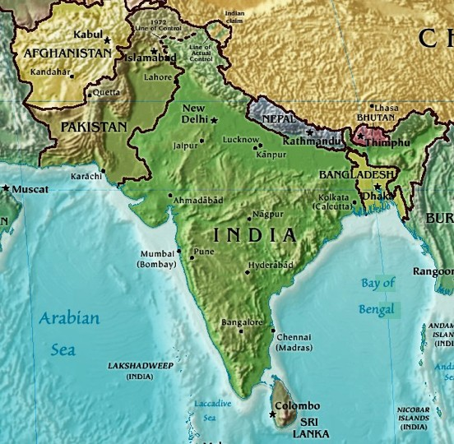
Physical Map

Slide 6
Politics/Government
29 states, 7 union territories - “Republic of India”
Parliamentary System
President – Head of State
Prime Minister – Head of Government
States are led by
Governers
Chief Ministers

Slide 7
Economic Issues
Swachh Bharat Mission
Cleanliness
drinking water, sanitation
Poverty
Corruption
Infrastructure
Schools, Colleges with inadequate infrastructure
Cell phones permitted a leap without landlines
Transportation - Highways, Railways, Flights

Slide 8
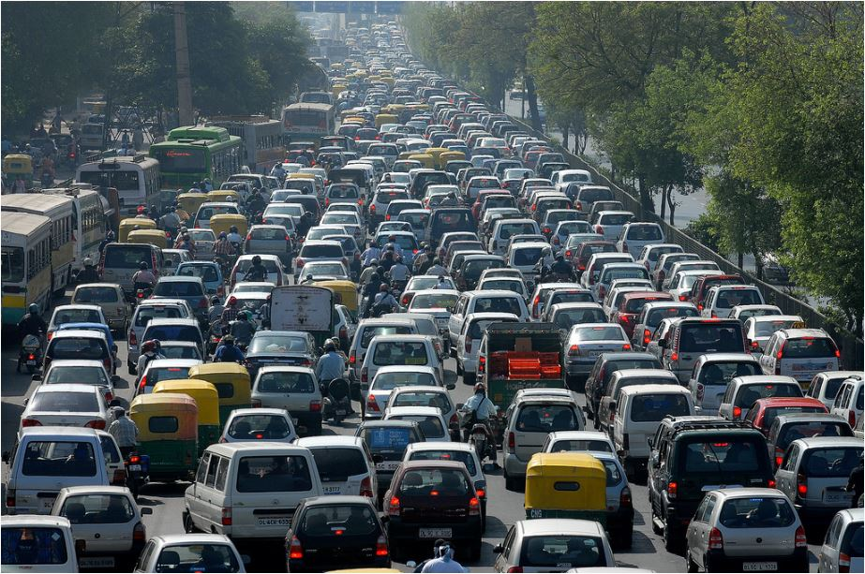
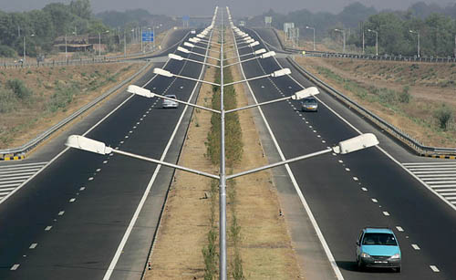
Transportation – Two Views

Slide 9
Social Issues and Initiatives
Affirmative Action
Based on inequities of Caste system
Quotas in education, employment
Religion and Caste based violence
Empowerment of Women
Education, Health,
Domestic Violence, Dowry system
Traditional vs Modern
Dating, Romance, Marriage
Meat eating / Vegetarianism

Slide 10
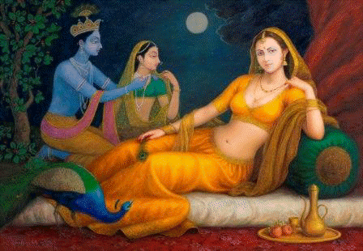
Arts

Slide 11
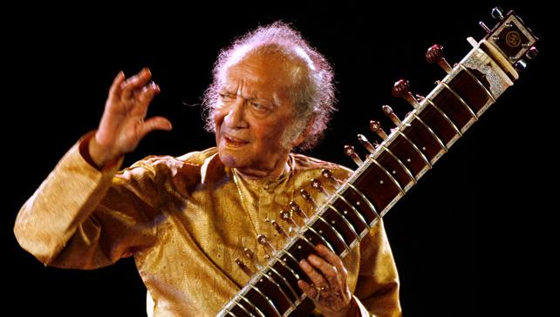
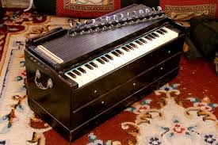
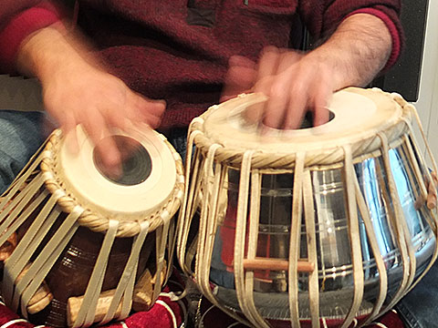
Music

Slide 12
Spirituality

Slide 13
Languages
Languages spoken: (English is widely taught and used as medium of instruction in schools)
Hindi 41.0% Bengali 8.1% Telugu 7.2% Marathi 7.0% Tamil 5.9% Urdu 5.0% Gujarati 4.5% | Kannada 3.7% Malayalam 3.2% Oriya 3.2% Punjabi 2.8% Assamese 1.3% Maithili 1.2% other 5.9%
Opinion: The problem with English in India (Forbes Magazine)

Slide 14
Hindi Lesson
See Devanagari Script Handout

Slide 15
Final Thoughts
Assignment: 2-page paper on a famous person / story from the list assigned to you.
Questions?

