Slide 1
The Indian State
Briefly, deep history (Handout 1)
Emperor Ashok (Maurya Empire)
https://www.youtube.com/watch?v=6XojmEmy7kw
https://www.youtube.com/watch?v=wmNU9ijkFcc
https://www.youtube.com/watch?v=dTcwboZ0NB4

Slide 2
The Big Questions
How did India become a successful democracy?
In a nation with so many divides and inequality, how come there has been no bloody revolution?
How has the Indian political landscape evolved?
Is democracy decaying and on the decline?
Is India an exception to the impact of electoral rules on democratic evolution?
In what ways can Indian democracy be improved?
What are the major challenges facing India today?

Slide 3
The Evolution of the Indian State

Slide 4
India, historically …
Before British, no empire ruled over whole subcontinent
Still significant cultural unity & sense of Indianness existed
Indians ruled themselves at the village/community level; little need for imperial intervention; politics a spectacle
Emperors’ role usually restricted to collecting taxes
Local communities governed themselves continuously through an elaborate social order that resisted empire
Jati & Varna (Social structures governing behavior)
Dynamic yet resilient (accommodates invading groups/ religions; allows social mobility, e.g., Marathas)
Balance of power among varnas
Local, not national; perpetuated by endogamy, pollution
Makes society easy to govern, difficult to change

Slide 5
The Country that the British came to
Strachey’s taunt:
“there is not, and never was an India, never ever any country of India, possessing according to European ideas, any sort of unity, physical, political, social or religious; no nation, no ‘people of India’ of which we hear so much”
And Winston Churchill’s:
"India, is merely a geographical expression. It is no more a single country than the Equator."

Slide 6
The British in India
Role essentially Hobbesian: maintaining order
Demarcated and mapped territory => India
Cultivated local (bicultural) elite: Macaulay
Empire intruded into social habits: Sati abolished
Introduced representative politics in provinces
Representation given to collectives, not individuals, on the basis of religion (Minto-Morley Act, 1909)
Responsible government (Montagu-Chelmsford, 1919)
Federal structure (Government of India Act 1935)
British believed India would balkanize (into kingdoms)
Therefore, ultimately, actively supported partition

Slide 7
Notes:
http://www.bl.uk/collections/images/independence/indiabeforepartition.jpg

Slide 8
Indian National Congress: Early Days
1885: Society to request equal rights as British citizens; stressed India’s right to collective liberty
1920s: Started to lay claim, in the name of the nation, to possession of the state & its territory
Gandhi turned party into a mass movement
Non-violence, Satyagraha: unique, slow techniques; Party also pushed for modern socio-political agendas
Participated in 1937 election in alliance with powerful landed interests; Muslim reps felt betrayed in UP
Not fully democratic internally; Gandhi key
Gandhi aim: direct self-rule by people, no state
Bose/Nehru: liberal democracy along with socialism

Slide 9
Towards Freedom
Led by Mahatma Gandhi and the Congress party, India’s freedom struggle was unique in its non-violent character, and was an umbrella movement of all types of Indians.
Alternate strategies—Bose’s Indian National Army fails

Slide 10
The British Policy of Divide and Rule
In the 1930s & 1940s Congress faced a strong challenge from the Muslim League, which argued that Muslims would become an oppressed minority after the British left.
The Muslim League therefore wanted Muslim-majority regions to be formed into a separate state of Pakistan.
Faced with bloody religious riots in the late 1940s, the British partitioned India when they departed
A secular India and a Muslim-dominated Pakistan resulted—truncated and geographically separated—West and East Pakistan (which became Bangladesh in 1971)
Nationalist Muslims refused to accept Pakistan; India still has one of the largest Muslim populations in the world
But the poison of religious hatred & violence remains.

Slide 11
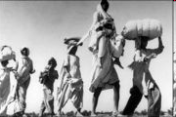
The Tragedy of Partition
Notes:
Top Left: http://images.google.co.in/imgres?imgurl=http://www.samvada.org/082006/indiapart1.gif&imgrefurl=http://www.samvada.org/082006/akhand_bharath.html&h=289&w=407&sz=31&hl=en&start=6&um=1&usg=__vv0n1qbWpKG1rcJxj_2yDQEZP7Y=&tbnid=A9lNJOpvgd0kTM:&tbnh=89&tbnw=125&prev=/images%3Fq%3Dpartition%2Bindia%26um%3D1%26hl%3Den%26client%3Dfirefox-a%26rls%3Dorg.mozilla:en-US:official%26sa%3DN
Bottom Left: http://www.nytimes.com/imagepages/2006/09/20/books/singh2.html Photograph by Margaret Bourke-White
Centre: http://images.google.co.in/imgres?imgurl=http://lh4.ggpht.com/_jxTfNSJ9B38/SHCYPS8KxcI/AAAAAAAAAMc/RjvfuZ3vCD0/180px-Old-sikh-man-carrying-wife1947.jpg&imgrefurl=http://picasaweb.google.com/lh/photo/eliExVrTZrEewwRWTZsqEw&h=120&w=180&sz=9&hl=en&start=149&um=1&usg=__YMs8uEssbfwl1yhLJITL_XFzN-Y=&tbnid=E3y3m-LRbwwoKM:&tbnh=67&tbnw=101&prev=/images%3Fq%3Dpartition%2Bindia%26start%3D140%26ndsp%3D20%26um%3D1%26hl%3Den%26client%3Dfirefox-a%26rls%3Dorg.mozilla:en-US:official%26sa%3DN
Bottom right: http://images.google.co.in/imgres?imgurl=http://lh5.ggpht.com/_i7uips-JmPY/R0vqVwi64PI/AAAAAAAAADs/wLJpTwG6Xb0/Partition,%2Bone%2Bof%2Bhistory%E2%80%99s%2Blargest%2Bmigrations,%2B1947.jpg&imgrefurl=http://picasaweb.google.com/lh/photo/M5URcHnLn7u8WMFpXQHQdw&h=424&w=600&sz=24&hl=en&start=138&um=1&usg=__1_VYk2wipjJkNA3hVWOjIgI_0kY=&tbnid=a7VoYP1zqQtWvM:&tbnh=95&tbnw=135&prev=/images%3Fq%3Dpartition%2Bindia%26start%3D120%26ndsp%3D20%26um%3D1%26hl%3Den%26client%3Dfirefox-a%26rls%3Dorg.mozilla:en-US:official%26sa%3DN

Slide 12
Notes:
http://images.google.co.in/imgres?imgurl=http://www.samvada.org/082006/indiapart1.gif&imgrefurl=http://www.samvada.org/082006/akhand_bharath.html&h=289&w=407&sz=31&hl=en&start=6&um=1&usg=__vv0n1qbWpKG1rcJxj_2yDQEZP7Y=&tbnid=A9lNJOpvgd0kTM:&tbnh=89&tbnw=125&prev=/images%3Fq%3Dpartition%2Bindia%26um%3D1%26hl%3Den%26client%3Dfirefox-a%26rls%3Dorg.mozilla:en-US:official%26sa%3DN

Slide 13
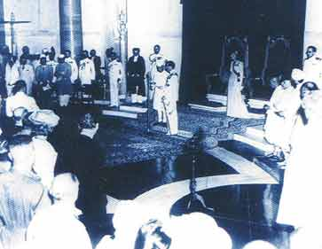
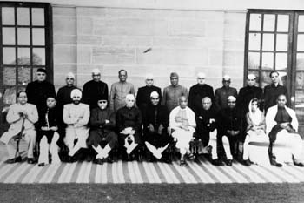
Independent India’s first cabinet ministry
Jawaharlal Nehru being sworn in as India’s first Prime Minister

Slide 14
The Diversity Within India
Religions
Hindu 80.5%
Muslims 13.4%,
Christians 2.3%
Sikhs 1.9%
Buddhists 0.8%
Jains 0.4%
Jews, Zoroastrians,
Tribals 8.1%
Each of the languages on a rupee note is an official Indian language
There are more than 400 languages within India, drawn from different linguistic roots

Slide 15
Patel & the Unification of India
Maharajas pensioned off, fade into history; except for Air India logo!
Sardar Vallabhbhai Patel ensured that the 500+ kingdoms merged into India
India had to send in police/troops to get Hyderabad, and later, Goa, to join India
Kashmir acceded after Pakistan invaded

Slide 16
Constituent Assembly’s Legacy
CA an unrepresentative body of elites
Favors Nehru’s reforms > Patel’s conservatism
Nehru: state must reconstitute & reform Indian society
Patel: state must just express and tend existing patterns
CA creates sovereign, democratic republic
Constitutional democracy, universal suffrage emerges not from popular pressure but from this elite body
Not itself clear on implications & results of experiment
Ambedkar: political but no social or economic equality
Tensions:
Federalism (strong centre; many reforms left to states)
Citizenship: individual vs community rights (minority religious protections; SC/ST reservations)

Slide 17
India’s Constitutional Framework: The Preamble
We, the people of India, having solemnly resolved… to secure to all its citizens:
Justice, social, economic and political;
Liberty of thought, expression, belief, faith & worship;
Equality of status and of opportunity;
and to promote among them all
Fraternity assuring the dignity of the individual …

Slide 18
Complications
Social Justice, Economic Justice and Political Justice may sometimes be in conflict
India historically a highly unequal society
Caste was a key determinant of status and of opportunity, both of which were highly skewed in favour of a small minority of upper castes
Fraternity was minimal: division between castes, religions, etc. Untouchability was rampant
So the nation-building project is also a massive exercise in social engineering; the challenge is to change mindsets and overcome prejudices

Slide 19
Secularism & India
The Congress, especially under India’s first prime minister, Jawaharlal Nehru believed that nationhood lay in “unity in diversity.” Respecting pluralism is best for India.
India is built on the notion of secular democracy
Rejects religion as a determinant of nationhood
Indian secularism means respect for multiple religions and protection of the rights of religious minorities
Yet, over time we see a revival of identity politics, mainly for economic and political gains
Political gains accrue by appealing to voters on identity: caste, religion, region, ethnicity, language

Slide 20
The Indian State
Nehru, after Independence, convinced that:
India needs a national state, whose central responsibility is development
This must be a constitutional, non-religious regime, (secularism key to self-definition), extend social opportunities, maintain sovereignty internationally
Partition a test of Indian sovereignty
Tests government’s ability to protect its citizens, keep order, and justify territorial ownership
Territorial issues central to new state:
Kashmir, Nagaland, Hyderabad, Goa: use of force

Slide 21
The Nehruvian State
State accumulates disparate responsibilities:
Patrolling borders, abolishing untouchability, constraining religious tension, building nuclear reactors—full time trustee for Indian people
Nehru emphasizes democratic rules and norms
Congressmen observe democratic rules as no ideology in majority in party; also idealistic politics still existed
Establishes the State as core of Indian society
Sovereignty asserted in international arena
Non-aligned movement and Nehruvian leadership
Nehru shows centrality of leadership in Indian context
Armed forces under strict civilian control

Slide 22
How Has India Worked Politically?
At independence in 1947, it was not quite certain whether the newly founded Indian state would be able to hold together the complex and multifarious nation it inherited.
Six decades later, we see that the Indian state has substantially consolidated its political, social, and economic existence by trying to accommodate diversity.
Notes:
Rahul Mukherji & Sunila Kale

Slide 23
Ashutosh Varshney’s Assessment
India has long baffled theorists of democracy. Democratic theory holds that poverty, widespread illiteracy, and a deeply hierarchical social structure are inhospitable conditions for the functioning of democracy.
Yet except for 18 months in 1975-77, India has maintained its democratic institutions ever since it became independent of Britain in 1947.
Over those five decades, there have been 12* parliamentary elections and many more state assembly elections.
Peaceful transfers of power between rival political parties have occurred seven times at the central (i.e., federal) level.
*(15 as of 2009)
Notes:
Ashutosh Varshney - Why Democracy Survives - Journal of Democracy 9:3 Journal of Democracy 9.3 (1998) 36-50

Slide 24
So India’s Democracy Survives
Since 1967, the party that ruled in New Delhi has not ruled in nearly half of the states.
Since 1977, moreover, incumbent governments have been repeatedly defeated in elections.
The press has remained vigorous, free, and unafraid to challenge the government.
The judiciary, despite periodic pressure from the federal executive branch, maintains institutional autonomy.
Election turnout keeps rising, exceeding the levels typical in several advanced Western democracies. Having started at 45.7 percent in the first general elections (held in 1952), turnout now often rises above 60 percent.

Slide 25
Identity Politics & Accommodation
States Reorganization on Linguistic Lines
Challenge: Punjabi suba intertwined with religion
States Reorganization on Ethnic Lines
Challenge: NE groups feel left out of mainstream
States Division and Disaffection
Abortive Telangana Movement (development inequity)
Assam; perceived injustice, demographic changes
Jharkhand, Chattisgarh, Uttarkhand finally successful
Secession
Tamil movement in 1960s questioned; now not so
Punjab and Khalistan
Kashmir: legitimacy of governance; external meddling

Slide 26
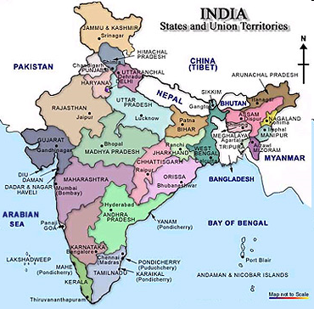
Notes:
http://india.deepthi.com/images/india-map.jpg

Slide 27
How did Democracy Thrive Amidst Inequality?
Rudolphs’ Analysis from In Pursuit of Lakshmi:
Marginality of class politics due to Government being key; hard to pit labour vs capital in public sector
Fragmentation of confessional majority (Hindus)
Electoral strength of minorities & SC/ST
Increasing clout of Bullock Capitalists (OBCs)
Imperatives of capturing power in Delhi
Constraints of cultural diversity and social pluralism in a federal setup
Advantages to centrist party of plurality-based, first-past-the-post electoral system

Slide 28
Is India a State Nation?: Linz, Stepan and Yadav
A “State Nation” is forged by state institutions and policies that respect and protect multiple and complementary identities, and that is not limited to ethnolinguistic federalism.
The state’s policies ensure democratic survival and consolidation by getting all groups in the nation to identify with the state as their own.
India ensures power sharing and does not privilege any one identity.
Panchayati Raj has ensured democracy is practiced across the land, and seen as Indian.

Slide 29
Panchayati Raj
Elected local governments introduced by the 73rd Amendment—rural—and 74th Amendment—urban
Funds and responsibilities devolved
Reservations ensure representation and leadership positions to women, OBCs, too
Electoral competition at village level gives political parties grassroot presence

Slide 30
Modern Indian Political History

Slide 31
Electoral System I: Congress Domination
Largest party in India post-independence
All-encompassing umbrella party; grand coalition of social forces
Internal “voice” mechanisms resolve conflict
Centrist, committed to democracy, minority rights, secularism, federalism, mixed economy
Party of consensus in midst of parties of pressure
Faces first big challenge in 1967; loses several big states to coalitions led by middle peasantry
Leads to decline in power of Syndicate (regional satraps who had installed Indira Gandhi as PM)

Slide 32
Congress (I): Electoral System II
Indira Gandhi splits Congress in 1969
Adopts aggressively progressive agenda
Bank nationalization, privy purse abolition
Garibi Hatao, charismatic politics => mid-term win
Victory over Pakistan; liberation of Bangladesh
Decline of party organization; CMs as puppets
Opposition slowly rallies against her; unrest
Indira declares Emergency (> Allahabad High Court verdict unseats her); arrests opposition; civil rights suspended; censorship; excesses

Slide 33
…and her Gandhian opponent Jayaprakash Narayan
Indira Gandhi

Slide 34
1977: The Reprieve & the Rebuff
Elections in 1977; Emergency lifted
Opposition parties unite under Janata banner
Old Congress + defectors, Peasants, Socialists, Jan Sangh
Alliance with Left parties; regional parties (Akali Dal)
Janata sweeps North India; Congress South
Indira-Sanjay routed
Janata’s grand coalition splits on personality & ideology grounds (dual membership in RSS)
Charan Singh replaces Morarji Desai
Congress withdraws support; wins 1980 election
End of bipolar experiment on national scale

Slide 35
Congress post Indira
Indira victim to Sikh extremism (nurtured by her?)
Rajiv succeeds; wins landslide; liberalization begins
100 year party very personalised; orgn in decay
Rajiv loses momentum over questionable defense deals
Rajiv defeated in elections; ex-colleague VP Singh leads Janata Coalition to office with BJP & Left support
Janata Coalition falls over Mandal Mandir politics
Rajiv assassinated during re-election bid
Narasimha Rao strengthens; party declines, (in North)
Muslims, Dalits, & OBCs go; splits/challengers in regions
Sonia succeeds; finally ushers in Cong coalition in 2004
Congress consolidates; returns stronger in 2009

Slide 36
Bharatiya Janata Party: Electoral System III
Bharatiya Jana Sangh set up in 1950 with RSS support
Ethno-nationalist ideology: Hindutva
India has Hindu sacred geography & unique Hindu culture
Antagonistic to Semitic religions
Base was upper castes & small business; now broader
Limited electoral support; almost wiped out in 1984
Revived through Ram Janmabhoomi Movement
Rises to power through deft coalitions, after initially being regarded as “untouchable” in 1996
Fails to consolidate and retain power in 2004
Now going through internal convulsions over strategy

Slide 37
The Janata Family Tree
Janata drew mostly from middle & peasant castes
Built significantly on old Congressmen & Socialists
Excellent at implosion over personality feuds
Caste central to agenda; Lohia; homespun narratives
VP Singh implements Mandal commission report
Legitimacy questioned by upper castes; seen as electoral ploy; results in unrest; consensus later
VP Singh unable to unite OBCs & Dalits who are natural class enemies; intermediate castes prove difficult to unite nationally across states
Spawned lots of regional parties, SP, RJD, JDS, BJD

Slide 38
The Left
Left only in Kerala, West Bengal, Tripura; unable to build on early efforts in Andhra; ideology hold declining
Ideological splits (pro-Russia-CPI vs pro-China-CPM)
CPI much more pro-establishment; joins coalitions
Left-democratic parties participating in system; oppose and destroy extremist Naxalite movement
Support restricted to organized & agricultural labour
Bengal: Left cadres capture panchayati raj and cadreize governmental apparatus; strong-arm tactics?
Participates in UPA government arguing communal forces more dangerous than liberalizing Congress
Split with UPA on Indo-US nuclear deal; then decline

Slide 39
Bahujan Samaj Party
Unique: only major national party to emerge with no connection to independence era parties
Ideology based on Identity Politics: Bahujans constitute substantial majority in India
Opposes Manuvad (upper caste domination)
Strategic alliances => power (SP, BJP, Muslims)
Spoiler (Maharashtra); adds to bargaining power
Charismatic but volatile leadership (Mayawati)
Now moving toward big tent approach (wooing Brahmins and upper castes) to win UP
Fails to consolidate in UP in 2009 Lok Sabha poll

Slide 40
A Historic Opportunity Lost?

Slide 41
Regional Parties
Identity politics
Religion: Akali Dal, Muslim League in Kerala
State Culture: Andhra, Assam, Kashmir
Culture & Tradition: Tamil Nadu originally
Caste Groups: Tamil Nadu now, UP, Bihar
Tribal Identity: Jharkhand
Malleable Ideology built on Identity: Shiv Sena
Charismatic Leaders: Pawar, Mamata, Mufti, Vaiko
Success?
When they become one pole of state polity
Coalition arrangements (e.g., Tamil Nadu)

Slide 42
Extreme or Moderate Pluralism?
Extreme Pluralism & Centrifugal Tendencies?
Increase in number of parties in coalitions
Rise of “anti-system” (non-secular) parties
Increase in political violence
Moderate Pluralism!
BJP had to moderate ideology in NDA because of:
Region: Hindu-Muslim divide doesn’t resonate in South
Caste: lower castes are majority in India; accommodate
Alliances: secular parties forces moderation
Index of Opposition Unity
Parties uniting against a pole
Earlier vs. Congress, now also against BJP

Slide 43
Competing Explanations for Political Fragmentation
Growing politicization of social cleavages along regional lines; reaction to Congress centralization
Disillusioned Congressmen leaving
Delinking Lok & Vidhan Sabha elections since 1971; easier to ally for LS without losing local electoral base
Growth & political assertion of intermediate castes; now increased communalization & caste-based parties
Division of powers between Centre & State makes it rational to focus on state alone
Duverger’s Law: Importance of electoral system

Slide 44
Trends: Expansion of Democratic Choice
More participation/politicization esp. lower OBCs-Dalits
Experiencing power generally & under Panchayati Raj
Women voting more; not represented more
Minorities static; strategic voting against BJP
Rural areas voting > urban (educated disengage)
Politics shaping caste identities
Jati groupings on the rise due to electoral logic (Karnataka: Ahinda vs Internal Reservation in OBCs)
Waves on the decline; Anti-incumbency votes regular
Centrism prevails (BJP Cong economics)

Slide 45
Ironies: Bhasha-English Divide
Bhasha: language of democratic rights and social justice => politics
English: language of macro-economic and bureaucratic management => policies
While one section had the consolation of winning the elections, the other continued to rule. Just when the lower order had some access to political power, the most significant economic issues were removed from the political agenda
Lower castes gain government when it no longer matters much or can do much!

Slide 46
Overall … An Inclusive Democracy
India’s political system has been a power-sharing one, situated within a constitutional framework and a conception of the nation that is civic, territorial, and inclusive, rather than ethnic, religious, or linguistic.
Further, democracy and the constitution are not seen as imports or impositions but as indigenous products.
Importantly, the system’s centrist tendencies and emphasis on poverty-alleviation policies have limited class polarization and contributed to stability.
Accommodative politics has been able to absorb pressures from diverse groups over time

Slide 47
The Contradictions in Indian Politics
Ideals, Rhetoric, Reality
Identify all the contradictions in this video
www.youtube.com/watch?v=h2GyHHSeYPw
An Uncertain Glory: Jean Dreze and Amartya Sen (story of Two Indias)

Slide 48
DYNASTIC POLITICS
Notes:
http://newsimg.bbc.co.uk/media/images/40152000/gif/_40152899_nehru_gandhi_203.gif

Slide 49
Logic of Dynastic Politics
Brand image of dynasty—vote catcher
Dynastic succession solves leadership conflicts in political parties
India has feudal hangovers—acceptable
Elections increasingly costly; politics full time job
Electoral resources, typically unaccounted, flow to leaders with potential to come to power
Who trust only family to manage these resources
Marginalize others, concentrate power in families that control electoral resources
OK? Voters can always reject. Unlevel playing field

Slide 50
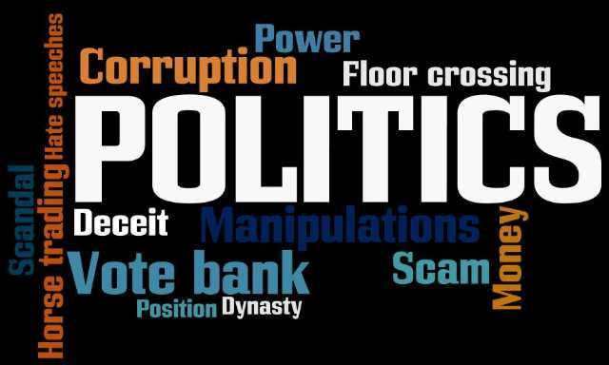
Political Issues in India Today: The System is Rotting …
Notes:
http://2.bp.blogspot.com/-cjDIBEmXsno/TiBjaxaosUI/AAAAAAAAAEI/7yvXI4-92FI/s1600/Indian-politics.jpg

Slide 51
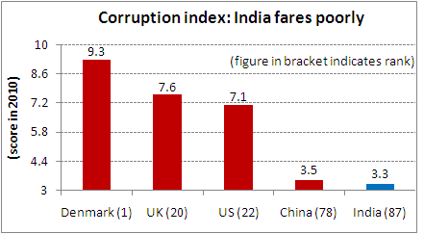
Governance Challenge 1: Corruption
The Governance Deficit
Notes:
http://www.equitymaster.com/5minwrapup/images/2010/103010-Corruption-index-India-fares-poorly-equitymaster.gif

Slide 52
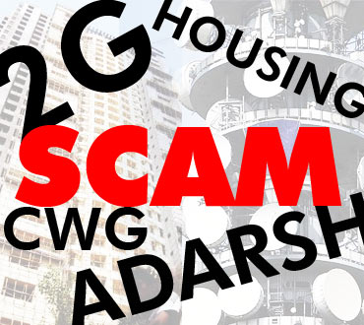
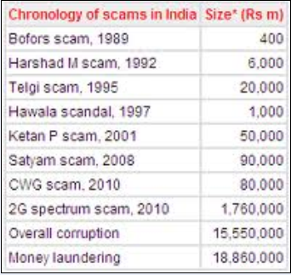
India’s Corruption: Diverse and Large Scale!
Notes:
http://www.cakarishma.com/wp-content/uploads/2011/10/india-corrupt.jpg
http://www.equitymaster.com/5minwrapup/images/2011/07202011-Chronology-of-scams-in-India-equitymaster.gif

Slide 53
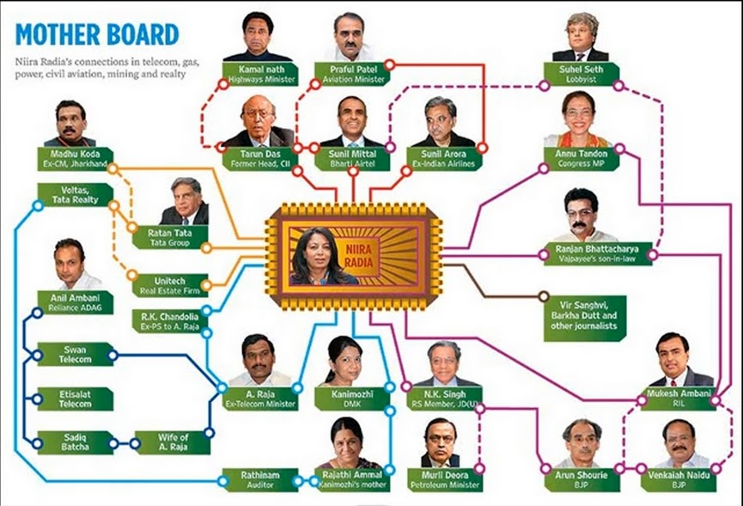
Radia’s Tapes Controversy: Key to 2G:
Tapping corporate lobbyist’ Nira Radia’s phones to investigate illegal funds transfers, the Income Tax Department unearthed the deep-rooted, corrupt connections between the many politicians and businessmen.
Notes:
https://lh5.googleusercontent.com/_DC7sXrp8k0w/TYCzz7r5OFI/AAAAAAAADAA/bzlflJ_2zXA/Indian-Mother-Board-Nira-Radia-Connections.jpg

Slide 54
Corruption in the Judiciary
According to Former Union Law Minister Shanthi Bhushan, 8 of the last 16 Supreme Court Chief Justices are corrupt.
Shanti Bhushan in his affidavit said that two former CJIs had personally told him that their immediate predecessors and immediate successors were corrupt judges. He said that the names of those four CJIs were included in the list of eight corrupt CJIs.
This only highlights the rampant corruption which is not only limited to the executive and legislature but also, extends to the judiciary.
These allegations are only strengthened given the 2008 Cash-at-judge’s door scam. The case had rocked the Punjab and Haryana High Court after Rs 15 lakh was wrongly delivered at the residence of Justice Nirmaljit Kaur, another judge of the High Court here, instead of Justice Nirmal Yadav, on August 13, 2008 following which she reported the matter to the Chandigarh Police. The money was said to have been delivered there due to confusion over names.
Notes:
8 Chief Justices of India corrupt, says Former Law Minister: http://www.ndtv.com/article/india/8-chief-justices-of-india-corrupt-says-former-law-minister-52586&cp

Slide 55
Governance Challenge 2: Interest Group Competition and Its Effects
Pranab Bardhan

Slide 56
Commonalities among Interest Groups
Group Equity: key slogan
All lobbies speak for the poor
However, even the Left really acts as a pressure group for relatively affluent farmers, office-workers, and unionized “labour aristocracy”
Luckily, no individual group is able to hijack India

Slide 57
Sharing the Spoils
Subsidies, protections etc. ~10% of Budget
Impacts fiscal deficits (especially revenue expenditure; wages)
Leads to underinvestment in capital infrastructure
State Electricity Boards in losses all over
Farmers demand parity with industrialists
Industrialists demand protection from MNCs
Banks bearing significant NPAs
States face bankruptcy because of handouts

Slide 58
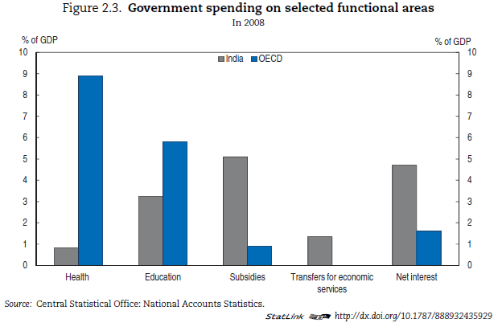
Notes:
Source: OECD Economic Surveys India 2011

Slide 59
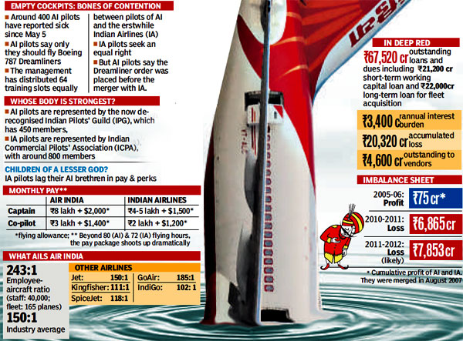
Notes:
http://www.hindustantimes.com/Images/Popup/2012/5/12_05_biz2.jpg

Slide 60
Governance Challenge 3: Vote Bank Politics
Since 1989, India has witnessed two major movements to create vote banks.
One movement—termed Mandal—aimed at empowering lower castes through aggressive affirmative action. Lower castes together constitute ~70% of India.
Advocated most strongly by Janata parties
Now supported by all political parties
The other movement—termed Hindutva—aimed to consolidate India’s Hindu majority
Identified with the Bharatiya Janata Party

Slide 61
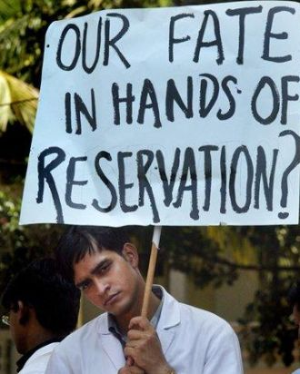
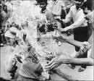
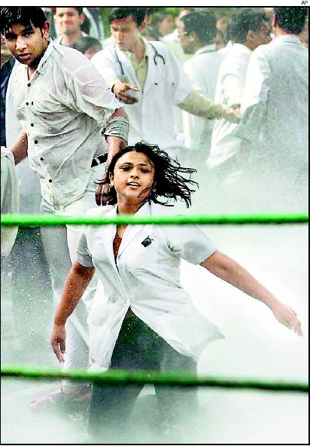
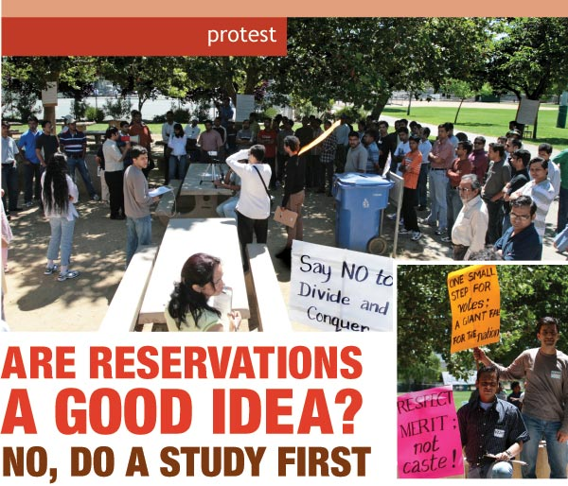
Caste Conflicts
Upper caste students protesting quotas in education & public jobs

Slide 62
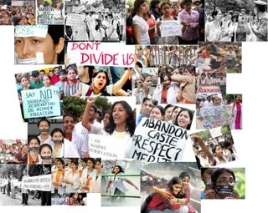

Slide 63
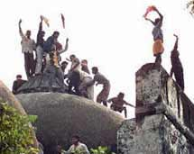
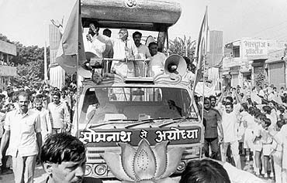
Hindutva & the BJP’s Rise to Power
BJP leader, L. K. Advani, on his “Rath Yatra”—the build Ram temple movement
Hindutva supporters demolishing the Babri Masjid

Slide 64
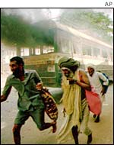
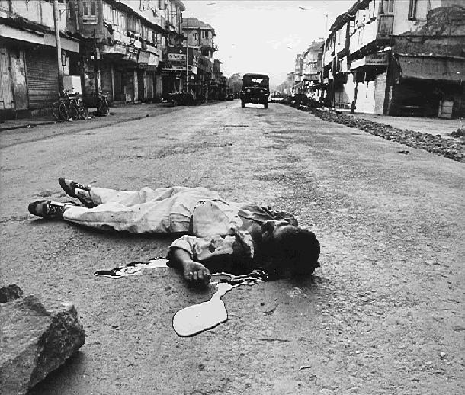
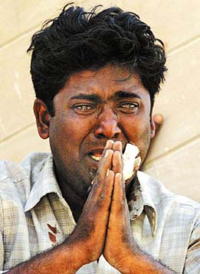
Images from Inter-religious or “Communal” Riots

Slide 65
Governance Challenge 4: Crime and/in Politics

Slide 66
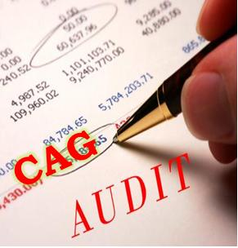
Existing Institutions That Check and Balance
Notes:
http://magnificentbihar.co.in/wp-content/uploads/2011/03/CAG4.jpg
http://photo.outlookindia.com/images/gallery/20120202/2G_20120202.jpg

Slide 67
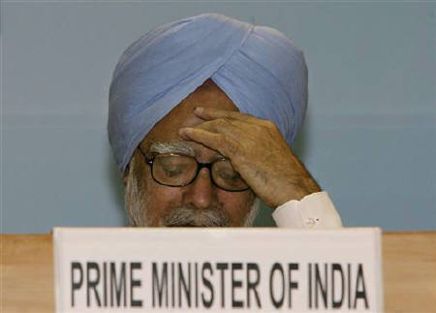
Governance Challenge 5: Policy Paralysis
Notes:
http://static.sify.com/cms/image//lcqtOkdhhbb.jpg

Slide 68
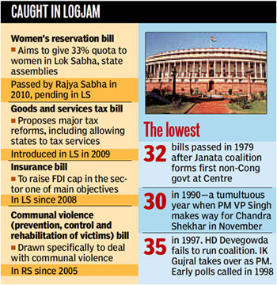
Notes:
http://www.hindustantimes.com/Images/Popup/2012/4/23_04_pg1a.jpg

Slide 69
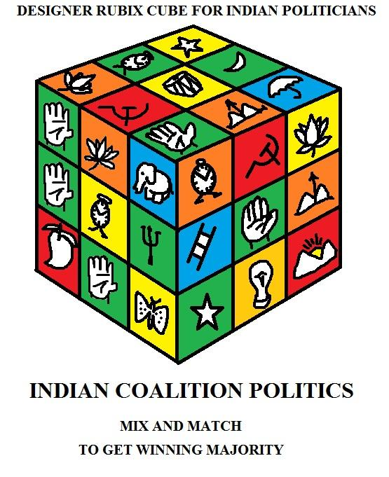
Coalitions & Paralysis in Governance
Notes:
http://static.adayinlife.timesofindia.com/usermedia/photos/2011/Mar/13ea41ecb2b6cda182acbcb544ef0ea5.jpg

Slide 70
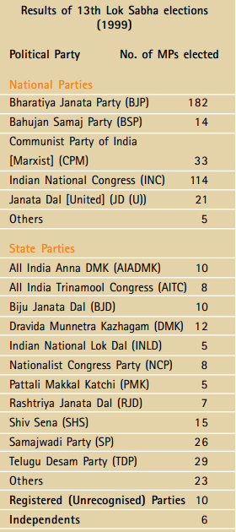
Notes:
http://www.iasexams.com/NCERT-Books/NCERTBooksforClass8/FreedownloadClass8SocialStudiesNCERTBook/Class8_SocialStudies_Unit03_NCERT_TextBook_EnglishEdition.pdf

Slide 71
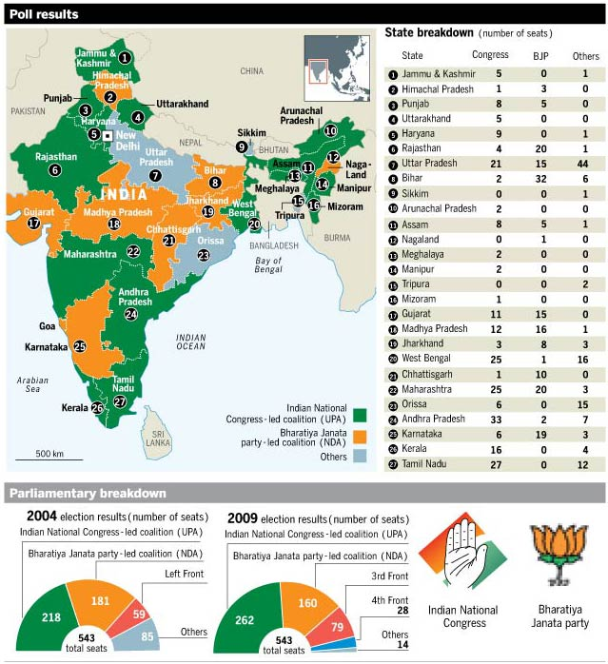
Notes:
http://www.ft.com/cms/a7ab849c-4309-11de-b793-00144feabdc0.jpg

Slide 72
Electoral Systems and Implications: The Modern Indian Paradox
Duverger’s Law would predict that India—with its constituency-based, plurality-driven election process—will see a two-party outcome
Yet, except in 1977 when the Janata Party won 345 seats and nearly all of north India and the Congress won 189 seats, sweeping the South, we have never seen a mainly two party outcome
So does India disprove Duverger’s Law?

Slide 73
The Level of Analysis Matters
Look deeper, at elections in Indian states
Typically they involve two parties/fronts
Congress-BJP in Gujarat, Rajasthan, Madhya Pradesh, Chattisgarh
DMK vs AIADMK in Tamil Nadu
Left vs Congress in Bengal, Kerala
Congress vs Akalis in Punjab
Only Uttar Pradesh and Karnataka seem to have substantially multi-cornered contests
As long as a party has concentrated support in a region, then it can survive and become a viable player in an era of coalition politics

Slide 74
Governance Challenge 6: Federalism

Slide 75
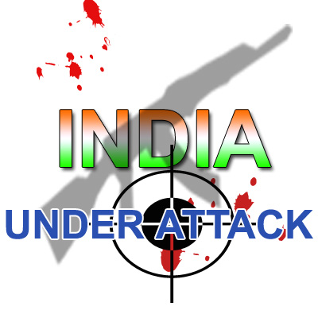
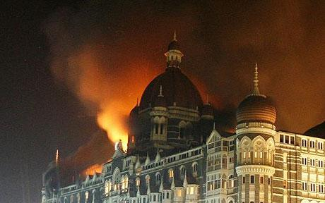
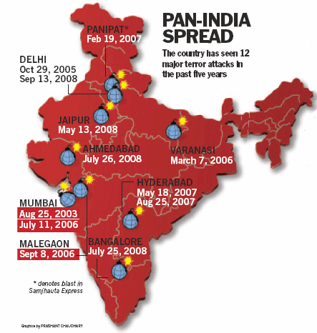
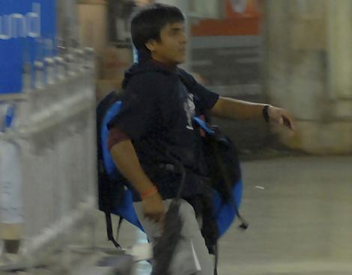
Notes:
http://scrapetv.com/News/News%20Pages/Everyone%20Else/images/taj-mahal-hotel-attack.jpg
http://www.indiabuzzing.com/wp-content/uploads/india-pakistan-relations-after-mumbai-terror-attack3.jpeg
http://blognostic.com/wp-content/uploads/2010/11/india_attack.jpg
http://specials.indiatoday.com/terror/images/india_terror.gif

Slide 76
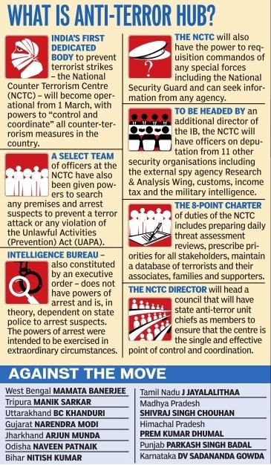
THE ARGUMENT
In India, law and order is a state subject
Section 43(a) of the Act empowers the NCTC “to arrest and detain any person if the body feels that the subject is associated with a terror act (even potential)” on its own.
States (mainly run by non-Congress or opposition governments) oppose the Act alleging central domination on state powers and authority.
Notes:
http://1.bp.blogspot.com/-VXWGlpQQ1DQ/T0ijipBgWEI/AAAAAAAAPHw/KLIABJKfm9c/s1600/nctc.jpg
http://www.civilserviceindia.com/subject/Essay/nctc-kanwar.html

Slide 77
Governance Challenge 7: Programme Implementation

Slide 78
India—A Flailing State?
“India is today a flailing state—a nation-state in which the head, that is the elite institutions at the national (and in some states) level remain sound and functional but that this head is no longer reliably connected via nerves and sinews to its own limbs.”
Lant Pritchett (2009)

Slide 79
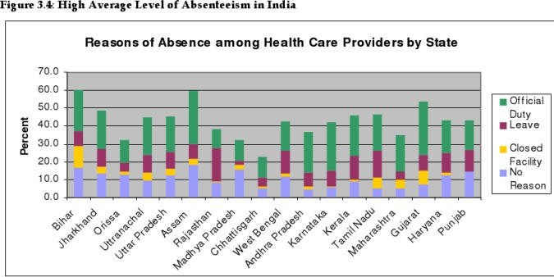
Government Service Delivery on the Decline
Notes:
http://reflow.scribd.com/1ua3h2hwu8kygbi/images/image-17.jpg

Slide 80
Governance Challenge 8: Armed Left-Wing Rebellion
Notes:
http://static.ibnlive.in.com/ibnlive/pix/sitepix/04_2012/collector_abduction.jpg

Slide 81
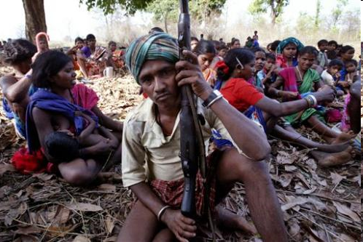
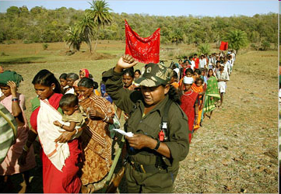
Deep in the Interior …
Notes:
http://images.google.co.in/imgres?imgurl=http://www.flonnet.com/fl2221/images/20051021005502101.jpg&imgrefurl=http://www.flonnet.com/fl2221/stories/20051021005502100.htm&usg=__9yjxVqaZZYIWk3iscPKFZBfp3zI=&h=225&w=351&sz=23&hl=en&start=12&um=1&tbnid=dDdkys3w51M7XM:&tbnh=77&tbnw=120&prev=/images%3Fq%3DNaxalite%26um%3D1%26hl%3Den%26client%3Dfirefox-a%26rls%3Dorg.mozilla:en-US:official%26sa%3DN
http://images.google.co.in/imgres?imgurl=http://www.sfgate.com/blogs/images/sfgate/foreigndesk/2007/05/21/naxalites498x333.jpg&imgrefurl=http://www.sfgate.com/cgi-bin/blogs/foreigndesk/category%3Fblogid%3D16%26cat%3D525&usg=__7DjQbqTpcD7d9PBvTEJQym3ciTc=&h=333&w=498&sz=44&hl=en&start=17&um=1&tbnid=lm-ljQUGUHhnnM:&tbnh=87&tbnw=130&prev=/images%3Fq%3DNaxalite%26um%3D1%26hl%3Den%26client%3Dfirefox-a%26rls%3Dorg.mozilla:en-US:official%26sa%3DN
http://images.google.co.in/imgres?imgurl=http://naxaliterage.com/wordpress/wp-content/themes/UpstartBloggerMinim/ubminim/images/header.jpg&imgrefurl=http://www.naxaliterage.com/&usg=__XHrqTwmWsKQYqvejejNipSRyv5E=&h=250&w=361&sz=49&hl=en&start=18&um=1&tbnid=44zI0yQ3EhkccM:&tbnh=84&tbnw=121&prev=/images%3Fq%3DNaxalite%26um%3D1%26hl%3Den%26client%3Dfirefox-a%26rls%3Dorg.mozilla:en-US:official%26sa%3DN

Slide 82
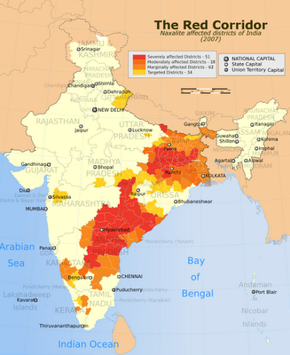
Far from India Shining … There’s a Red Storm Rising
Notes:
http://3.bp.blogspot.com/_2Tjhz0Hirgk/SfmE-N_j3zI/AAAAAAAAAZk/NC689cunOoA/s400/India_Red_Corridor_map.png

Slide 83
Governance Challenge 9: Development vs People/Environment

Slide 84
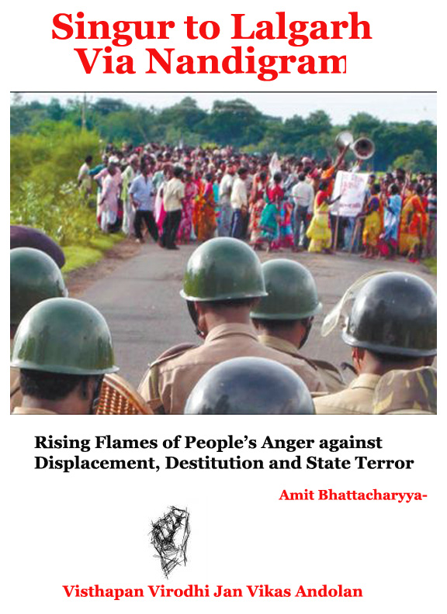
Notes:
http://indianvanguard.files.wordpress.com/2009/10/singur-to-lalgarh-via-nandigram-3.jpg

Slide 85
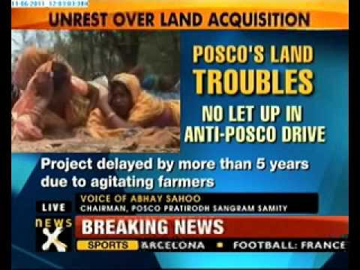
Notes:
http://i.ytimg.com/vi/PyuZggoiyE8/0.jpg

Slide 86
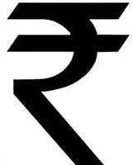
Governance Challenge 10: INEQUALITY
Notes:
http://www.decodeunicode.org/en/data/glyph/196x196/2AB6.gif

Slide 87
Inequality: Among States

Slide 88
New Government Estimates: Every Third Indian Is Poor
The Suresh Tendulkar committee has revised the poverty line in terms of money spent per person per month. From Rs356.30 a month, this has increased to Rs446.68 in rural areas. In urban areas it has risen from Rs538.60 to Rs578.8. At present, the Centre measures poverty by measuring calorie intake.
Notes:
http://beta.thehindu.com/opinion/columns/article68476.ece
http://www.dnaindia.com/dnaprint.asp?newsid=1323446

Slide 89
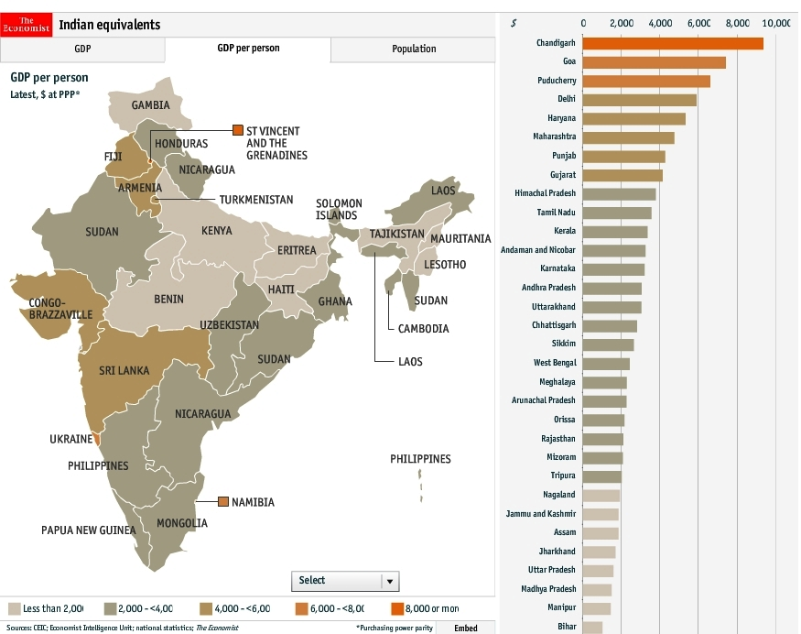
GDP per person equivalents

Slide 90
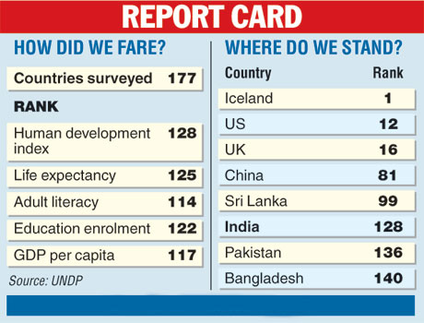
How India Fares on the Human Development Index
2007 Figures
Notes:
http://farm3.static.flickr.com/2047/2071027280_6a5912d758.jpg

Slide 91
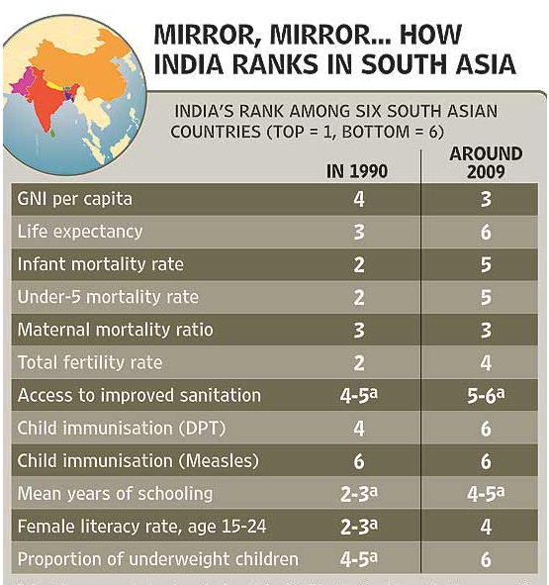
Notes:
http://www.oxfamblogs.org/fp2p/wp-content/uploads/India-v-South-Asia.png

Slide 92
India: The Cold Statistics
More than one-third below poverty line
42% of rural population spend just Rs 447 a month on food, light, clothing, etc.
India ranks #4 on Forbes billionaires! (53/1125)
Literacy 65-70%
>20% lack access to potable water
Only 36% households have toilets
Life expectancy at birth 61 years

Slide 93
Absence of Social Safety Nets
People Fall Into Poverty Too!
The World Bank estimates that one-quarter of all Indians fall into poverty as a direct result of medical expenses in the event of hospitalisation
Other factors: excessive spending on weddings and deaths
Indians investment in gold is partly a traditional social safety net

Slide 94
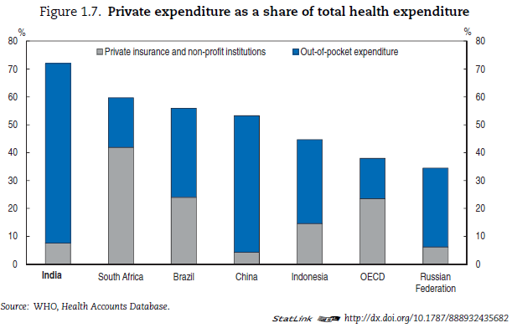
Notes:
Source: OECD Economic Surveys India 2011

Slide 95
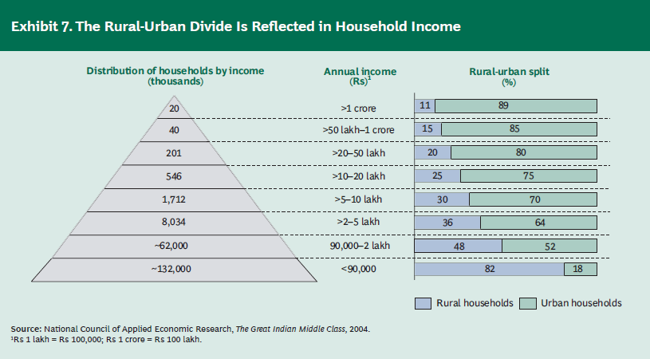
The Rural-Urban Divide
Notes:
Source: The Next Billion Customers, Janamejaya Sinha and Arvind Subramanian, Boston Consulting Group, 2007, www.bcg.com

Slide 96
END

