Slide 1
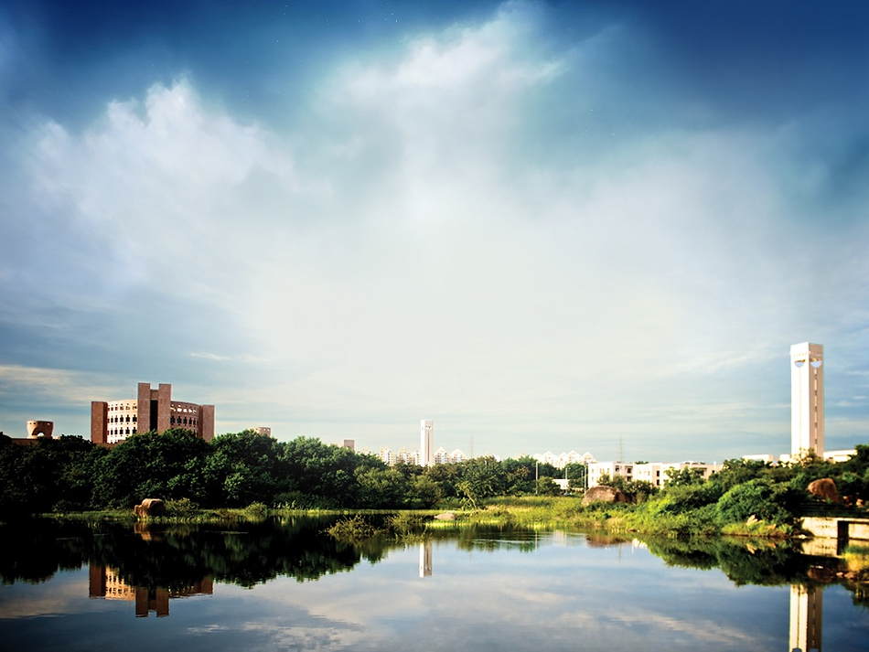
India History, Culture & Politics
Professor Kavil Ramachandran
Executive Director
Thomas Schmidhieny Centre for Family Enterprise
Indian School of Business

Slide 3
What do you know about India? What do you want to know?

Slide 4
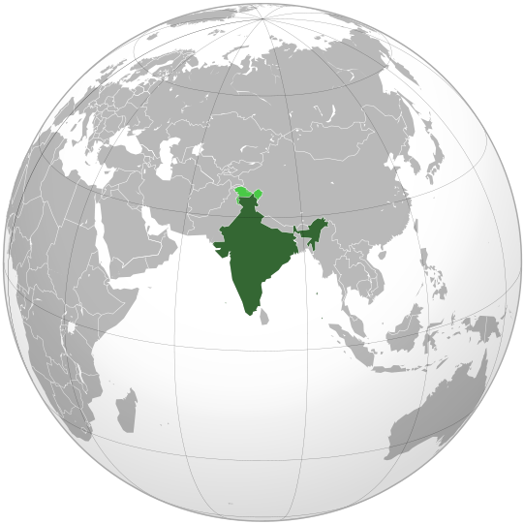
Independent India

Slide 5
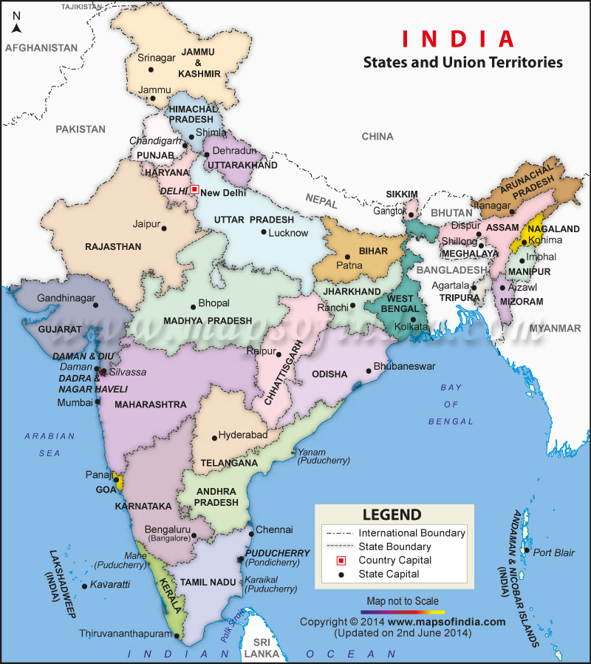

Slide 6
History
History of over 2000 years
Different combinations of nations of a unified territory
Many religions over centuries (Hinduism, Buddhism, Jainism, Islam, Christianity, Sikhs)
Britain gave umbrella cover for princely States
Gandhi strategy of involving masses
Independence and division in 1947
Unification of over 500 States to form the republic

Slide 7
Pillars of Indian Democracy
Executive
Democracy
Judiciary (+ RBI, Election Commisn)

Slide 8
Politics
Single national party to regional and caste driven parties and coalition politics
National leaders to regional leaders and short term
Neglected regions / people and growing restlessness (e.g. Maoist)
Media, RTI Act, Judicial activism and anti-corruption agitations to help bring balance
Punishing top bankers, CM, Coalgate…
Hope in Modi in 2014; disappointments…..

Slide 9
Elections 2014
814 million voters
930,000 polling stations
Voting was spread over nine phases 7 April-12 May 2014
Single party rule back

Slide 10
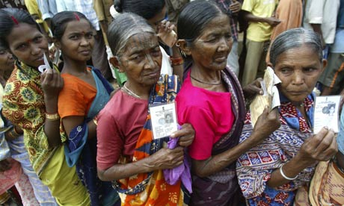
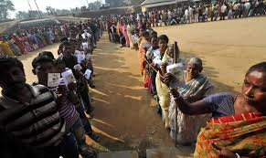
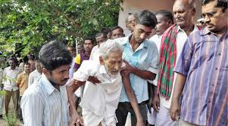
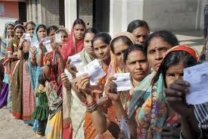

Slide 11
Unifying Forces
Multiple, overlapping empires
Hinduism as a way of life with worship, festivals to celebrate
Values of destiny and duty for life to be purified through re-birth
Ethnic unity
Strong practice of religions; overall harmonious co-existence
Philosophy to Medicine & Art – all linked to spirituality
Sports, films, language to unite
Growing connectivity, mobility

Slide 12
Indian values – some practices
Respect elders and their wisdom
Lasting marriage – no pre nuptial agreements (?)
Hindu succession – changing status of women
Joint family - all siblings not cousins (?)
Duty feeling of life – children take care of elders
Five stages of life (child, youth, married life, retirement, monk)

Slide 13
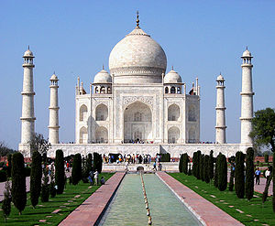
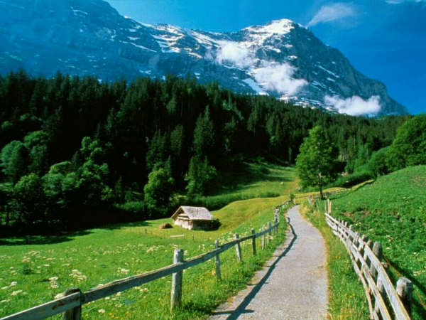

Slide 14
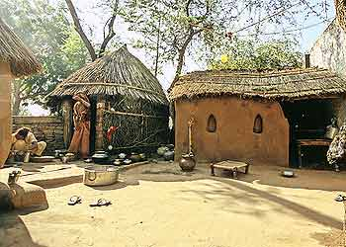
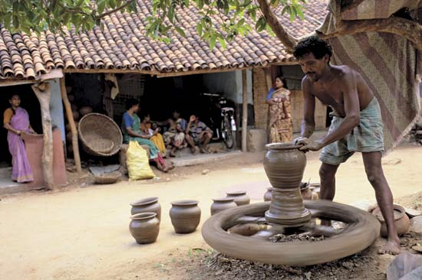
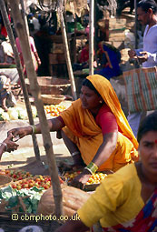
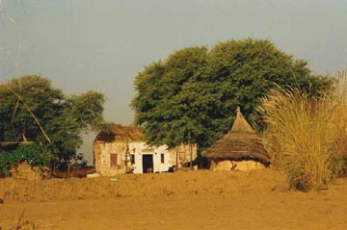
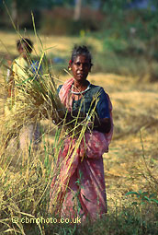
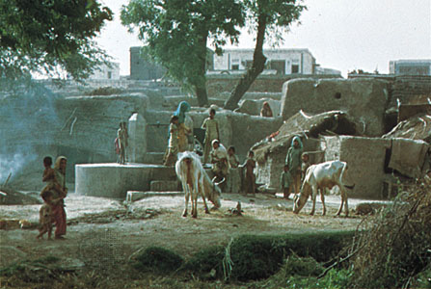

Slide 15
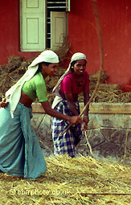
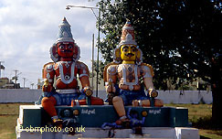
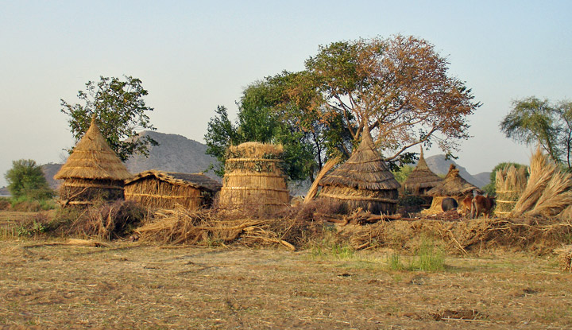
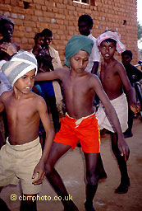
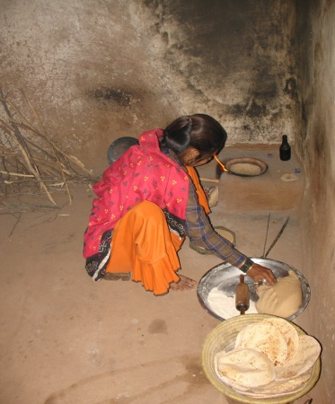
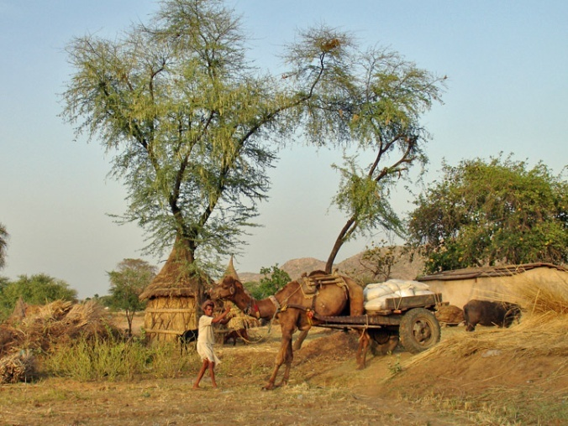
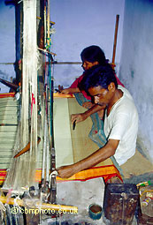
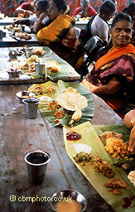
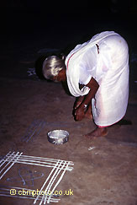
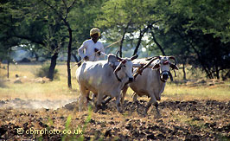
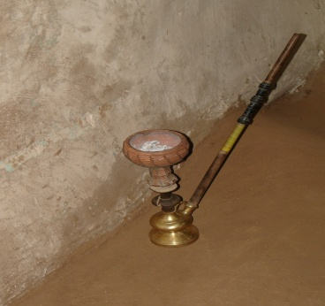

Slide 16
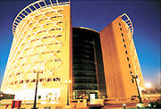
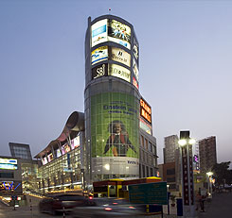
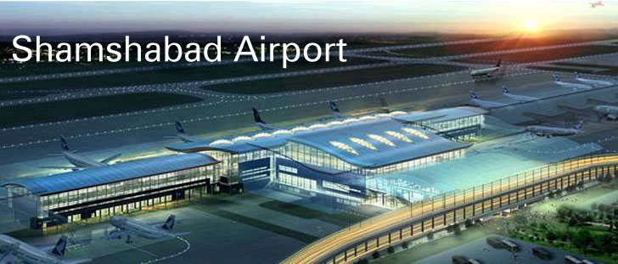
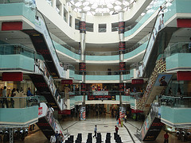
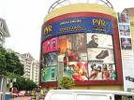
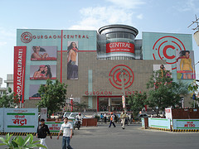
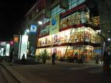

Slide 17
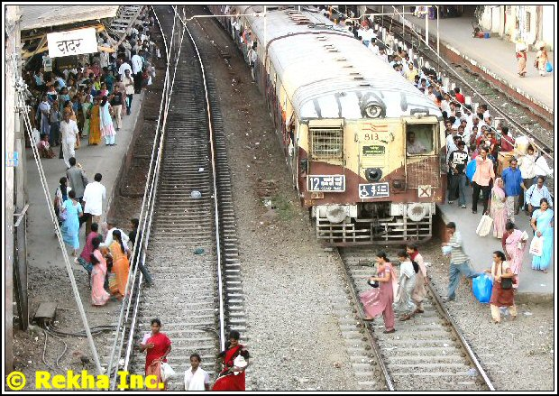
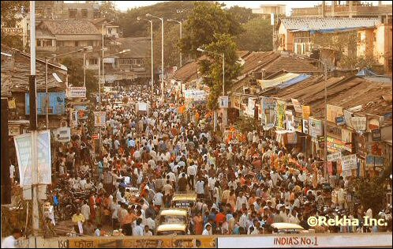
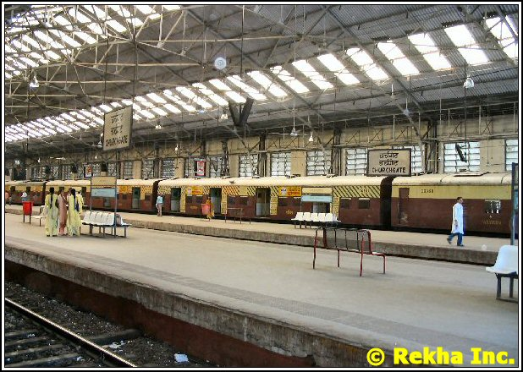
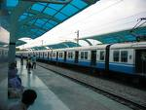

Slide 18
Unity in Diversity
84 languages, 1652 dialects
Multiple religions, castes
3500 kms long, all climatic zones
Innumerable political parties
All terrains, variety of crops
Variety of dresses, arts and crafts
Multiple festivals

Slide 19
Some amazing facts about India
India has the most post offices in the world with one of the best service quality!
Indian Railways is the longest (64000 km) with 18000 trains daily (1:1 passenger: goods), employing over a million people
930 million active mobile phone subscribers (78% teledensity); 7-8 million added every month
250+ m internet users; 500 million projected 2017, still very low in global ranking (131 to155/189)

Slide 20
Incredible India
22 languages given official status, 356 – Indigenous languages
17 % - Indian households that are located in slums
70% - share of Indians who are below the age of 36
80 million – pilgrims attending the 2013 Maha Kumbh Mela festival during which they bathe in the Ganges river
138 million – number of Indian Muslims, the 3rd largest Muslim population behind Indonesia and Pakistan
2.3% - Indians who are Christians, 1.9% Sikhs, 0.8% Buddhists, 0.4 % Jains

Slide 21
Paradoxes and entrepreneurial opportunities
Aircraft to Bullock cart
Malls to pan (tobacco) shop
Astronomy to Astrology
Complex surgeries to village quacks
Gated communities to village communes
Billionaires to homeless
India is complex, but transforming rapidly

Slide 22
Indian Economy

Slide 23
Pre 1984
1984- 1991
1991 – Mid 1990s
Mid 1990s onwards

Slide 24
Facilitating Factors
Strengthening socio – economic infrastructure
Control to freedom
Entrepreneurship no longer taboo
PPPs
Arrival of Indian VCs and PE firms
On the tide, 1st & 2nd gen –Wipro, Infosys, Cyient…
Innovation gaining momentum – DRL, Bajaj …opportunity in and outside India
Growth in service business – Reliance, Flipkart, Pantaloons, Makemytrip
Shifting focus to the rural – BoP and Chic
IT, Pharma, Engineering, Tourism to lead

Slide 25
Structure of Economy
% of GDP
Sector | 2000- 01 | 2013-14
Agriculture | 24 | 17
Industry | 27 | 26
Services | 49 | 57
GDP Per capita (2014-15) $ 6265; 3rd largest economy
Source : Calculated from CSO data

Slide 26
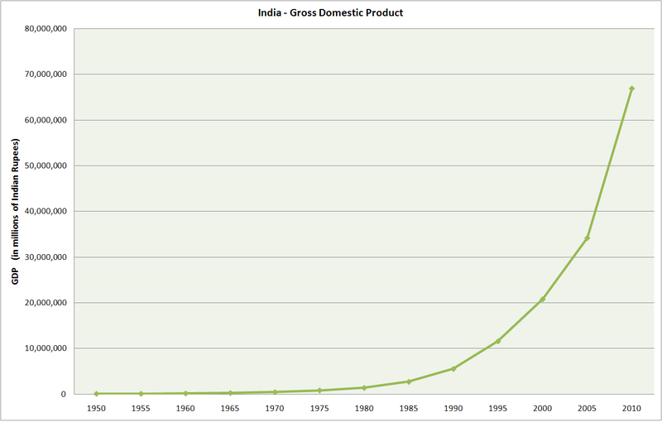

Slide 27
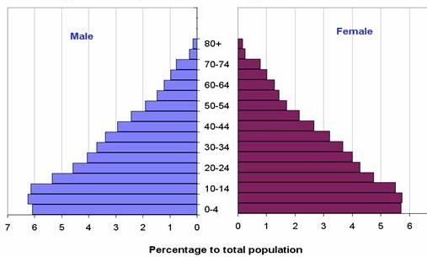
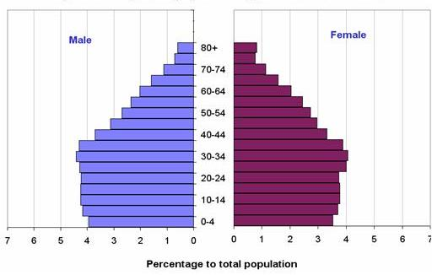
Population pyramid, India 2001
Projected population pyramid, India 2026

Slide 28
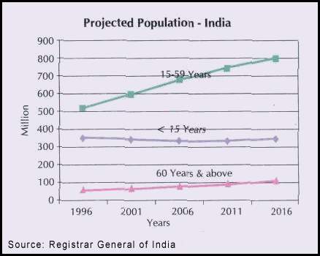

Slide 29
Strong bottom of the pyramid

Slide 30
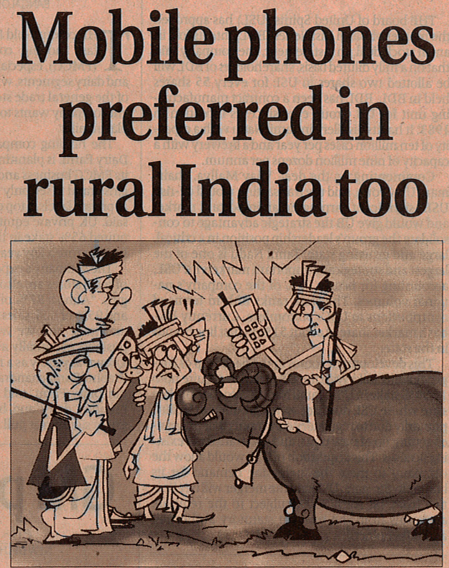

Slide 31
Income & Expenditure
More than 60% of India's income comes from rural
and small towns
Disposable surplus as% of income similar in both
Annual household income (Rs)

Slide 32
Structural Changes

Slide 33
Contributing factors
Growing :
Income
Literacy and health care
Social Awareness
Exposure to new products and services
Growing presence of micro finance and entrepreneurship

Slide 34
India : Social Indicators
Population (million – 2011 census) | 1210 million
Growth rate 1991 – 2001 2001 – 2011 | 21.54% 17.64%
Density (per sq.km) | 382
Sex ratio 2001 Sex ratio 2011 | 933 940
Literacy rate 2001 2011 | 64.83 % 74.04 %
Life expectancy at birth (2011) Male Female | 66.8 years 65.77 67.95
Per capita income (Rs) 2001 2011 | 16172 33731

Slide 35
Census (2011)
State | Decadal growth in population (%) |  | Literacy Rate |  | Human development index (Best = 1.00)
 | 2001 | 2011 | 2001 | 2011 | 1991 | 2005
Rajasthan | 28.41 | 21.44 | 60 | 67 | 0.347 | 0.537
Uttar Pradesh | 25.85 | 20.09 | 56 | 70 | 0.314 | 0.490
Uttarkhand | 20.41 | 19.17 | 72 | 80 | - | 0.628
Bihar | 28.62 | 25.09 | 47 | 64 | 0.308 | 0.449
Jharkand | 23.36 | 22.34 | 54 | 68 | - | 0.513
Madhya Pradesh | 24.26 | 20.30 | 64 | 71 | 0.328 | 0.488
Chhattisgarh | 18.27 | 22.59 | 65 | 71 | - | 0.516
Orissa | 16.25 | 13.97 | 63 | 73 | 0.267 | 0.452

Slide 36
India ranks 135 among 187 countries in 2013
on
Human Development Index (HDI)
Source : UN Human Development Report

Slide 37
Rank | State/Union Territory | HDI |  | Comparable Country
Very High human development
1 | Kerala |  | 0.790 | Argentina
2 | Chandigarh |  | 0.892 | Israel
3 | Lakshadweep |  | 0.796 | Argentina
High human development
4 | Mizoram |  | 0.790 | Argentina
5 | Delhi |  | 0.750 | Russia
6 | Goa |  | 0.617 | Indonesia
7 | Nagaland |  | 0.770 | Saudi Arabia
8 | Andaman and Nicobar Islands |  | 0.766 | Malaysia
9 | Daman and Diu |  | 0.754 | Russia
10 | Pondicherry |  | 0.748 | Russia
11 | Manipur |  | 0.707 | Iran
Source : UN Human Development Report 2011

Slide 38
Rank | State/Union Territory | HDI | Comparable Country
Medium Human Development
12 | Maharashtra | 0.572 | Iraq
13 | Sikkim | 0.684 | China
14 | Himachal Pradesh | 0.652 | Philippines
15 | Punjab | 0.605 | Tajikistan
16 | Tamil Nadu | 0.675 | El Salvador
17 | Haryana | 0.644 | Philippines
18 | Uttarakhand | 0.628 | Syria/ Namibia
19 | West Bengal | 0.625 | Namibia
20 | Gujarat | 0.621 | South Africa
21 | Dadra and Nagar Haveli | 0.618 | Indonesia
22 | Arunachal Pradesh | 0.617 | Indonesia
23 | Tripura | 0.608 | Tajikistan

Slide 39
Rank |  | State/Union Territory | HDI | Comparable Country
Medium Human Development
24 | Jammu and Kashmir |  | 0.601 | Tajikistan
25 | Karnataka |  | 0.600 | Tajikistan
26 | Meghalaya |  | 0.585 | Vietnam
 | All India |  | 0.575
27 | Andhra Pradesh |  | 0.572 | Iraq
28 | Rajasthan |  | 0.537 | India
29 | Assam |  | 0.534 | Congo
30 | Chhattisgarh |  | 0.516 | Bhutan
31 | Jharkhand |  | 0.513 | Kenya
Low human development
32 | Uttar Pradesh |  | 0.490 | Pakistan
33 | Madhya Pradesh |  | 0.488 | Angola
34 | Orissa |  | 0.452 | Haiti
35 | Bihar |  | 0.449 | Lesotho
Source : UN Human Development Report 2011

Slide 40
Recent trend
Public Private Partnerships for infrastructure
Tier I – Tier II cities to keep costs low but quality same – so move there
Family Business Entrepreneurship
Middle class mentality (save for future) changing– live today on assumed future earning
Rural demand continues to explode

Slide 41
Recent Trend
Acceptance of India and growth in entrepreneurship and alliances
Growing confidence of Indians and on India
Exploiting sourcing advantages (cost, language, legal, skill…)
Attractive market for long term
Indian manufacturing competitiveness high – Indica to 1 lakh car – a statement

Slide 43
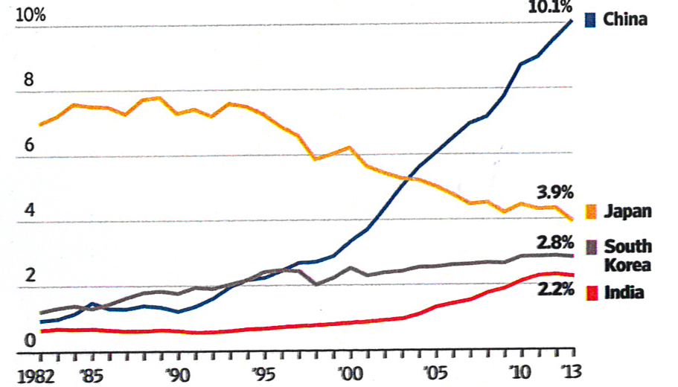
Tortoise and Hare ?
Share of World Trade in Goods and Services
Source : United Nations, Wall Street Journal, August 26, 2015

Slide 44
Overall attractiveness
Still young and growing (population, exposure to products / services)
Strong rural market unaffected by global factors
Niche manufacturing competitiveness
Strong intellectual manpower pool
Vibrant entrepreneurship
“Work is worship” value
Flexibility as value
“Guest is God” feeling
Legal System
Least affected BRICKS/Fragile FIVE

Slide 45
Remaining Concerns
Poverty far from removed
Delay in infrastructure growth
Rising religious tensions in pockets
Push for change in rural Indians not enough (IT is not India)
Coalition/caste politics
Corruption and bureaucracy
Quality of higher education institutions
Regulatory requirements
Family business professionalisation

Slide 46
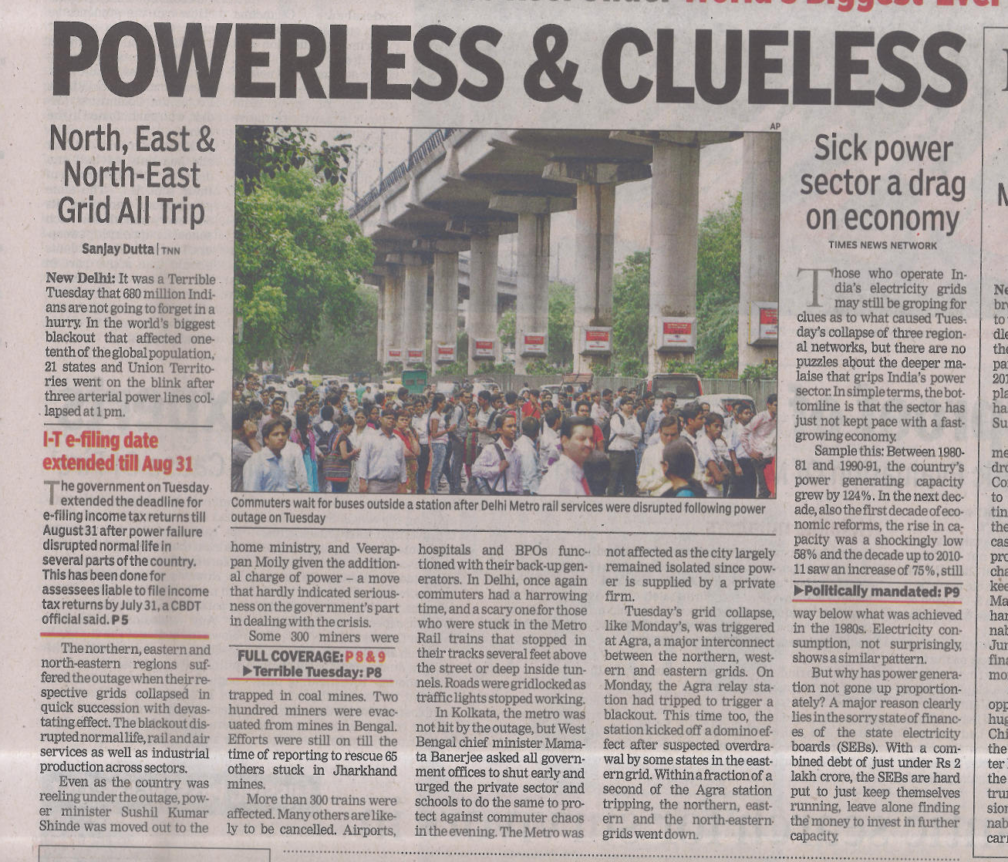
Source : Times of India, July 30 – 31, 2012

Slide 47
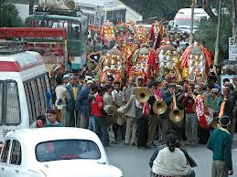
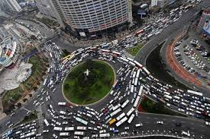

Slide 49
Opportunities for foreign firms
Sell in Indian market
Buy from India (Outsourcing : IT, MR, CR)
Set up Manufacturing Own / JV for local/export mkt
“Make in India”

