Slide 1
DMAIC
Improve
Lean Six Sigma Training

Slide 2

Improve Phase Objectives
  Discover multiple viable solutions
  Select the solution most appropriate for the organization
  Verify causality and pilot results
  Manage risks
  Prepare for full implementation
SOLUTION

Slide 3

Improve - Discovery
Through data analysis one solution might already be clear.
Consider developing alternative potential solutions to meet additional organizational priorities (sustainability, replicability, customer psychographics, etc…)
Leverage industry best-practices through benchmarking
Process Benchmarking
Performance Benchmarking

Slide 4
Call Center Benchmarking (practice)
Problem: Our target customer (women 18-24) has complained about excessive wait times. Our current average on hold time is 4 mns but we have received complaints about peak on hold times over 20 mns. The average on hold time for our Atlanta team call center (our best performing) is 3 mns.
1. Brainstorm sources of benchmarking
2. Benchmark:
Process Benchmarking (best processes)
Performance Benchmarking (best outcomes)
3. Report out on 2 potential recommendations. Share your rationale.
10 mns
https://www.arise.com/resources/blog/arise-customer-service-frustration-series-phone-hold-times
Notes:
https://www.arise.com/resources/blog/arise-customer-service-frustration-series-phone-hold-times

Slide 5
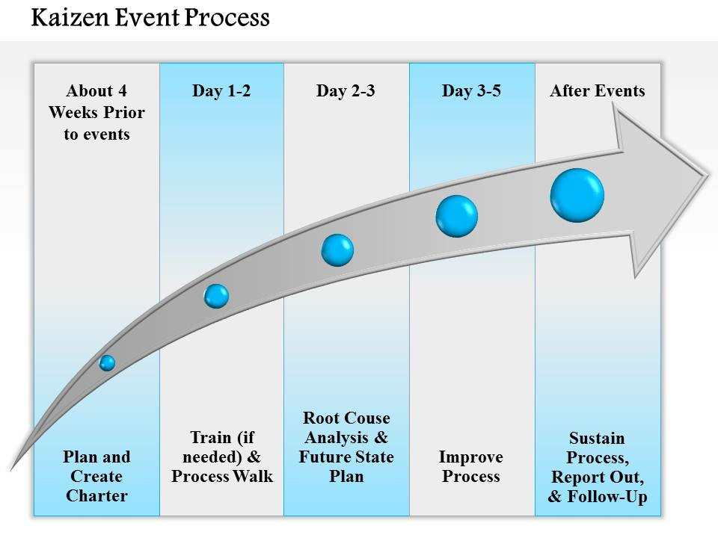
Improve – Create Future State
Process Map Value-add Analysis
Kaizen Events
  Develop and Simulate Future State
  Mistake-Proof New Process
Time – The next dimension
Notes:
Context: austerity + limited resources -> small improvements + low costs + implemented quickly.

Slide 6
Kaizen Event Report Out (VSM)
Complete Current State - am
  Report-outs of key learnings
  Addition of collected data
  Identify key opportunities
  Experiments to test viability
  Management progress review
Create Future State - pm
  Perform experiments
  brainstorm improvement opportunities and potential benefits
  Create high level future state (“desired” state)
Notes:
From the Japanese Kai (improvement) and Zen (good)

Slide 7
Simple Solutions – 5 S + 1
    5 S is a foundational Lean (Six Sigma) methodology to create and maintain an organized, clean and safe work environment.
    Elements of 5S
      Sort
      Straighten
      Shine
      Standardize
      Sustain
    The “Sixth” S --- Safety
    “A place for everything and everything in its place”
Notes:
Sort or Seiri,
Store and Set in Place or Seiton,
Shine or Seiso,
Standardize or Seiketsu, and
Sustain or Shitsuka.
Time: 5 minutes

Slide 8
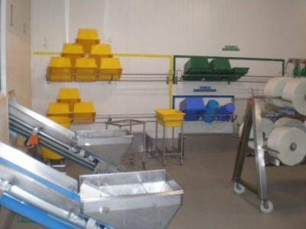
5 S + 1 examples
    “A place for everything and everything in its place”
Application:
5S + 1 principles applied with color coded totes and containers, properly stored according to designated locations (everything has its place).
Benefits:
Employees and Supervision have a good visual representation of where equipment and tools in the work area are staged/stored.
Notes:
Sort or Seiri,
Store and Set in Place or Seiton,
Shine or Seiso,
Standardize or Seiketsu, and
Sustain or Shitsuka.
Time: 5 minutes

Slide 9
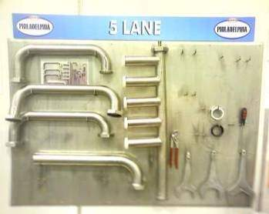
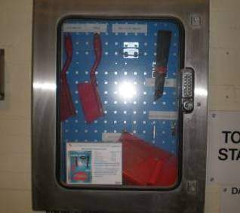
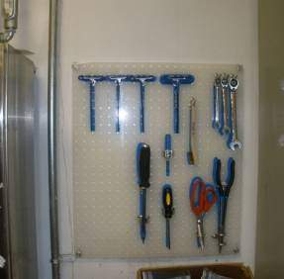
5 S + 1 examples
    “A place for everything and everything in its place”
Application:
Sanitary piping equipment has a designated location for equipment and tools needed for the job task. Picture in identifies “what good looks like” for comparison and training purpose.
Benefits:
Employees, Mechanics and Supervision have a visual board indicating what parts and tools are needed for the job task. The parts and tools are located close to the work area for easy access
Notes:
staging/storage of sanitary piping equipment and tools.
Time: 5 minutes

Slide 10
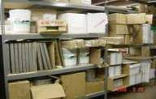

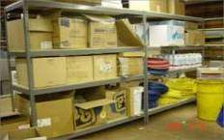
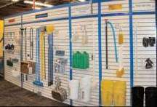
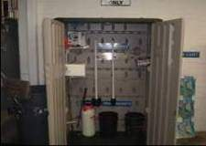
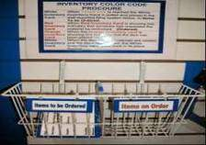
5 S + 1 examples
Application:
Visual storage and replenishment of sanitation tools and supplies
Benefits:
Annual supplies spending reduced by 40% from $30M to $18M. Less time lost to searching for supplies. Improved ergonomics and safety in area
Before:
After:

Slide 11
CI/Lean Team Best Practice Example
Best Practice: 5S + 1, Sanitation Supplies Storage
Location: Fresno, California (Capri Sun Ready-To-Drink Beverages)
Definition: Workplace organization techniques.
Application: Visual storage and replenishment of sanitation tools and supplies
Benefits: Annual supplies spending reduced by 40% from $30M to $18M. Less time lost to searching for supplies. Improved ergonomics and safety in area.
Contact: Please contact a CI/Lean Team member or Fresno CI Manager Aaron Rouse if you have any questions or need additional assistance with this Best Practice application.
Before:
After:

Slide 12
5S – Summary
5S implementation leads to improved processes and ultimately:
  Reduced set-up times
  Reduced cycle times
  Increased floor space
  Lower safety incident/accident rate
  Less wasted labor
  Better equipment reliability
Notes:
Time: 15 minutes
Optional: Break participants up into teams: ask how you would use 5S at home
5 minutes brainstorming
10 minutes sharing of ideas, 2-3 minutes per team.

Slide 13
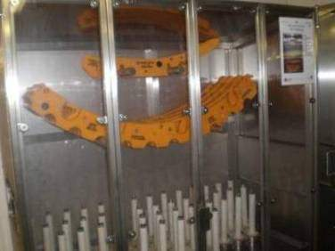
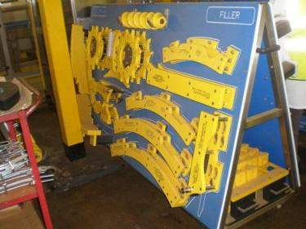
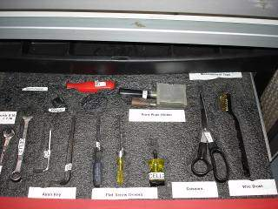
5S – Application
Where can you implement 5S + 1?
Notes:
Time: 15 minutes
Optional: Break participants up into teams: ask how you would use 5S at home
5 minutes brainstorming
10 minutes sharing of ideas, 2-3 minutes per team.

Slide 14

Managing Risk

Slide 15

Risk Assessment - FMEA
Structured approach pioneered by the US military in the late 40’s adopted by aeronautical engineers (late 40’s). NASA credits the FMEA for the successful moon landing. Ford followed in the 70’s.
To identify possible failures
To prioritize potential risks
To organize the necessary actions
to mitigate risks
to minimize negative impact
Notes:
Preventing failure because it was so expensive.
Same for the Ford Motor company

Slide 16
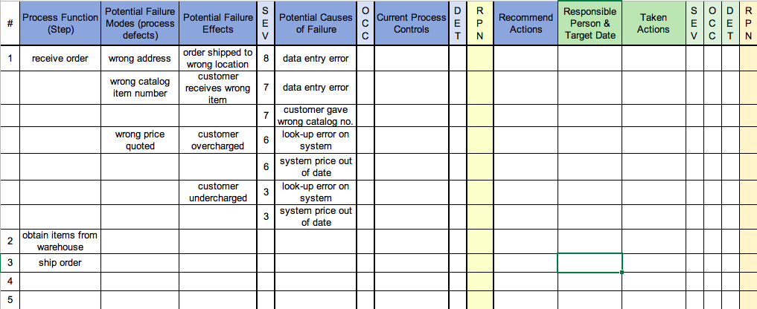
Process FMEA – An example

Slide 17
Process FMEA – How to
Start with the improved process
Choose scope of FMEA
For each process step:
  Brainstorm failure modes
  Assess
    Severity (impact) of failure
    Occurrence (frequency) of causes of the failure
    Detection (likelihood of detection) before it reaches the customer
Calculate the Risk Priority Number (RPN)
Develop action plan for prioritized steps
Recalculate RPN after carrying out risk mitigation plan

Slide 18
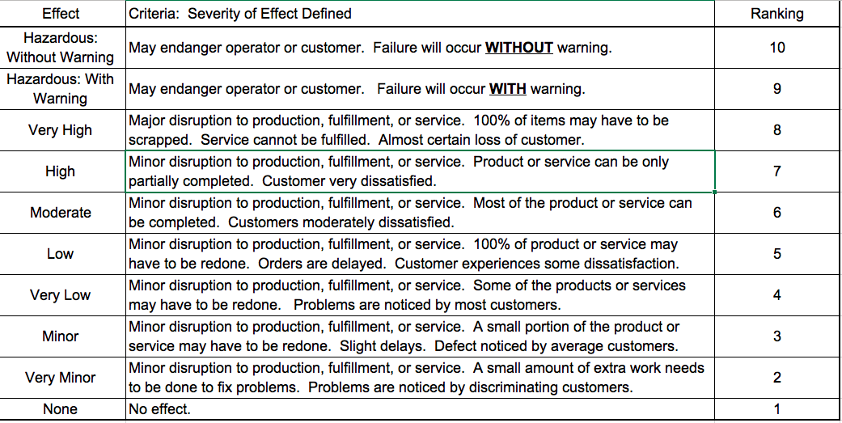
FMEA - Severity

Slide 19
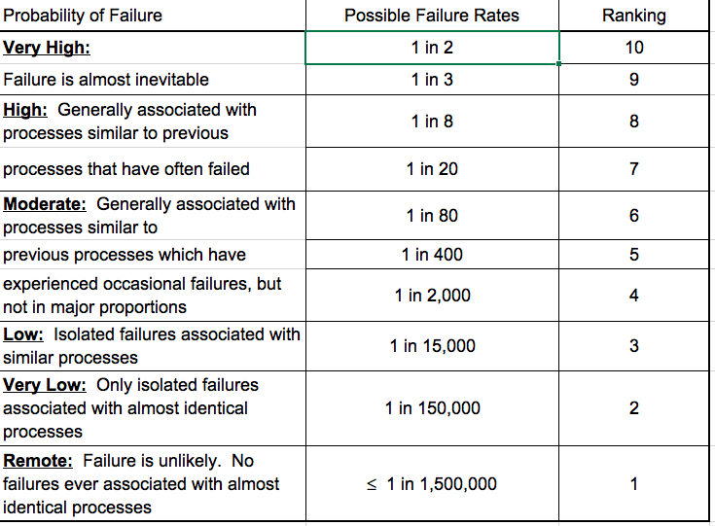
FMEA – Occurrence

Slide 20
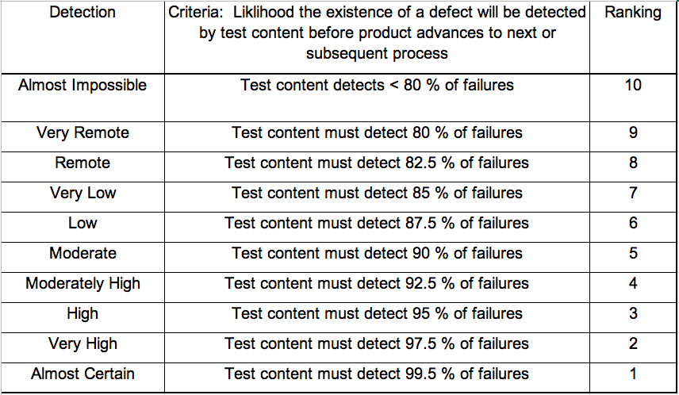
FMEA - Detectability

Slide 21
FMEA - Using the RPN to Determine Priorities
Risk Priority Number
Severity x Occurrence x Detectability = RPN
Pro tip:
If you have access to historical data use it to evaluate the RPN
If you lack historical failure data or for practical use in Lean Six Sigma projects, set a benchmark and use 9, 3, 1 (high, medium, low) or 9, 7,4,1 (to avoid defaulting to middle ground) to evaluate S, O, and D and prioritize RPNs

Slide 22

Practicing the FMEA

Slide 23
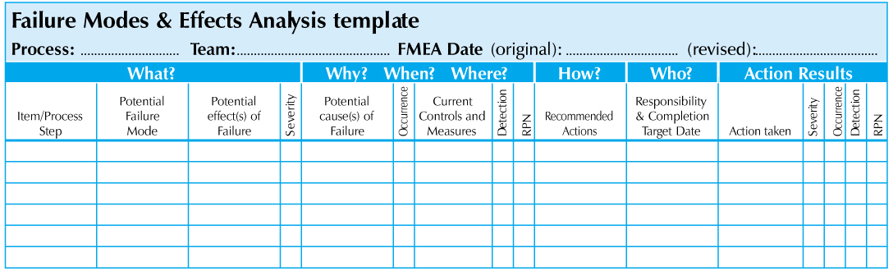
The FMEA Template

Slide 24
FMEA - Caution
Remember: without data the S,O, D and RPN are subjective
The value is found in the discussion generated in creating and using the FMEA, and in carrying out the action plan
Use caution when mitigating processes with high severity ratings. Beware of legal implications. Consult your legal department as needed

Slide 25

Piloting:
Because without data…

Slide 26

Piloting
Y= F(X)
Testing all or part of the solution on a small scale in order to better evaluate its impact and to learn how to make the full scale implementation more effective

Slide 27
Piloting – Benefits
Get an early version out to a preferred customer segment
Lower risk of failure by surfacing and solving problems earlier
Gather feedback in real operating conditions
Assess expected results (Y= f(X1, X2,…,Xn))
Improve the solution further
Generate buy-in to amplify during implementation
Test measurement system

Slide 28

Piloting - Tips
Try and pilot full range of inputs and process conditions
Allow time to review and adjust after pilot results before full scale implementation
Expect difficulties scaling up even after the most successful pilot
Test measurement system and communication plan

Slide 29

Preparing for the Control Phase
Are you confident and ready
for full implementation?

