Slide 1
Measure Tools & Approaches
Lean Six Sigma Training

Slide 2
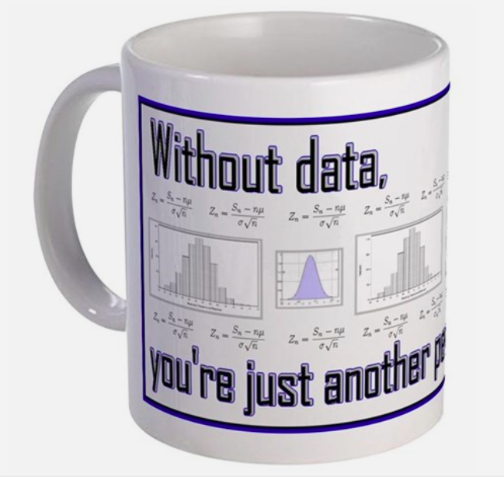
Data: At the heart of the DMAIC journey
Because without data…

Slide 3
Why Measure?
Practical Problem
Statistical Problem
Statistical Solution
Practical Solution

Slide 4
Where do you Measure?
LSS is a data-driven methodology
Measure throughout the entire DMAIC process
Control
Improve
Analyze
Define
Measure

Slide 5
Measure Phase Outcomes
Collect Data (Select CTQ)
Understand the Voice of the Process (VOP)
Identify sources of variation
Measure current state process capability

Slide 6
Select CTQs (Kano Analysis)
Wikipedia says: The Kano model is a theory for product development and customer satisfaction developed in the 1980s by Professor Noriaki Kano, which classifies customer preferences into five categories.

Slide 7
Select CTQ’s: Kano model:
Satisfied
Delighters
The more the better
Dysfunctional
Does not work well
Functional
Works well
Neutral
A. Must haves
Dissatisfied

Slide 8
Select CTQs (Kano Analysis) Things to remember:
Kano helps prioritize needs ie. resource allocation.
Must deliver flawlessly on Must haves before tackling the more the better, and get real value from delighters etc...
Needs evolve.
Delighters become “must be” over time, as competitors copy and customers become accustomed to your offerings.
Other categories of needs
Indifferent
Oxygen
Reverse Quality
Notes:
Others categories include: Indifferent: Does not add or take away from customer satisfaction. Reverse Quality: Think of them as turn-offs. Also “Oxygen needs”: Basic needs that people won’t mention because they are so fundamental without which your product/service will fail.

Slide 9
Translate VOC into Measurable CTQs
Voice of the customer | Customer Need | Measurable CTQ
I waited on hold for a long time before I got to speak to the technician. | Excessive hold time | On-hold time
You transferred me 3 times and I had to say the same thing over and over again. But in the end they fixed it. | Get me to the right person directly | First call resolution
https://onholdwith.com/
Notes:
Example VOC to CTQ template.
What happens when customers wait on hold for too long?
How do you measure on hold time? Pros and cons of using industry metrics?
How long is the customer willing to wait? Where should you set your target?

Slide 10
What do you Measure?
Y= f(X1, X2, X3….Xn)
Y is an Output of the Process (Project Y)
Xs are potential causes of variation

Slide 11
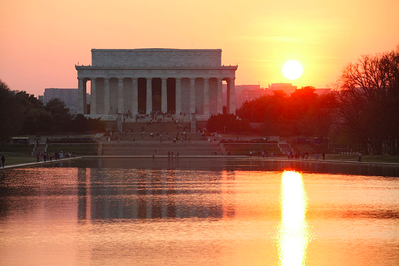
The Lincoln Memorial

Slide 12
Five Whys, Spiders and Flies?
Problem Statement: The stone on the Jefferson Memorial was deteriorating at a faster rate than the same stone on the Lincoln Memorial. Repairs would be expensive - Why was this happening?
After research it was determined that the Jefferson was washed more frequently - Why?
After further investigation it was determined that birds defecated on the Jefferson Memorial more than on the Lincoln Memorial. A solution was proposed that a net be placed over the monument to keep the birds away. But before acting on the solution, it was decided to dig deeper.
Why were there more birds on the Jefferson than on the Lincoln?
Digging deeper, researchers found that there was a particular spider on the Jefferson that was not on the Lincoln. The birds liked to eat this particular spider.
Why was this particular spider more plentiful on the Jefferson Memorial?
After researching further, it was discovered that there was a parasite on the Jefferson monument that the spider liked which caused the disproportionate number of spiders to grow there. This parasite was not on the Lincoln - Why?
It was discovered the parasite liked the type of lights on the Jefferson. The Lincoln employed a different type of light bulb.
Notes:
Associated Press in 1989, a group of private consultants were hired by the National Park Service (to the tune of $2 million) to perform a year-long study of the deterioration of the Lincoln Memorial and the Jefferson Memorial.
In April of 1990, the consultants published a report which found that “the increasingly toxic effects of nature” had accelerated the erosion of the monuments and that immediate steps were required to address “very serious structural problems”. A Park Service representative responded to the findings by assuring that “both memorials are in excellent shape overall” and that there was “absolutely no danger to the public”. Less than one month later in May of 1990, a 50 lb. block of marble fell from the volute on the top of a column in the Jefferson memorial. Thankfully, no one was injured, and major repair and rehabilitation projects were subsequently initiated to address the deficiencies in both monuments.
http://thekaizone.com/2014/08/5-whys-folklore-the-truth-behind-a-monumental-mystery/

Slide 13
The Jefferson Memorial

Slide 14
Types of data: Qualitative vs. Quantitative

Slide 15
Types of quantitative data: Discrete vs. Continuous

Slide 16
Types of data: Examples from your processes
1. Name the process
2. Select 2-3 CTQs
3. Share the project Y
Tell us why
4. Brainstorm 3 ways to measure your project Y
5. What type of data is it?

Slide 17
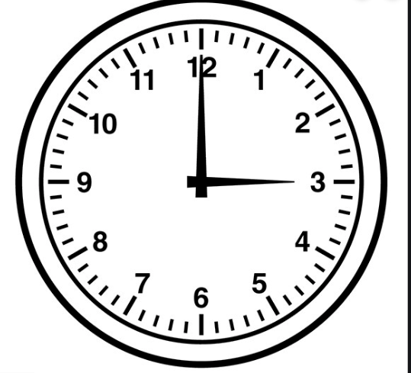
Measurement System Analysis
Is your measurement system reliable?

Slide 18
Measurement System Analysis
Actual process variation
+
Variation caused by the measurement system
________________________________
Observed process variation

Slide 19
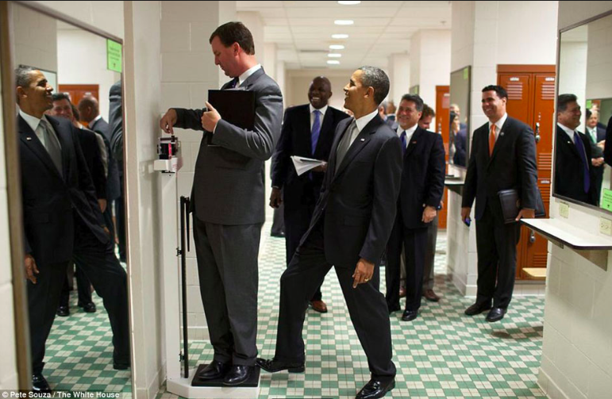
Measurement Systems Analysis

Slide 20
Why MSA Matters
Probability of
incorrectly accepting
a bad part
A COMPLIANCE ISSUE
Measurement
variation
True Process
Variation
Observed Process
Variation
Bad part’s
true value
LSL
USL
Notes:
How do we represent the measurement variation graphically?
The following Slides build up to give a graphical picture of measurement.
The Measurement Variation Risks
Now let us look at items we accept which are in fact bad. These will always be parts that are close to the Specification Limits.
Say we have a part with a value that is just outside the Upper Specification Limit. Because of the variation in the measurement system we will occasionally accept this bad part because the value we measure will be inside of our limit. (Note this also happens at items which are just outside the Lower Specification Limit)
Over time there will be extra product we accept which will be a compliance issue. As we said earlier it will also be a cost issue, because those we ship that are wrong will be discovered by the customer and it will cost us to replace the item and to appease the customer.

Slide 21
Why MSA Matters
Measurement
variation
Probability of
incorrectly rejecting
a good part
A COST ISSUE
True Process
Variation
Observed Process
Variation
Good part’s
true value
LSL
USL
Notes:
How do we represent the measurement variation graphically?
The following Slides build up to give a graphical picture of measurement.
The Measurement Variation Risks
First let us look at items we reject which are good. These will always be parts that are close to the Specification Limits.
Say we have a part with a value that is just within the Lower Specification Limit. Because of the variation in the measurement system we will occasionally reject this good part because the value we measure will be outside of our limit. (Note this also happens at items which are just within the Upper Specification Limit)
Over time there will be extra product we reject which will be a cost issue.
Will it Balance Out?
Won’t the items we reject wrongly balance out with those that we accept wrongly and therefore there will be no extra cost. Unlikely – those we reject will end up scrapped and we bear the cost. Those we ship that are wrong will be discovered by the customer and it will cost us to replace the item and to appease the customer.

Slide 22
Improving Your Measurement System
Develop Operational Definitions
Good operational definitions are critical to ensure consistency of measurement over time and between different data collectors.
Example
VOC/CTQ | Operational Definition
On time departure | A flight is counted as "on time" if it operated less than 15 minutes later than the scheduled time shown in the carriers' Computerized Reservations Systems (CRS). Arrival performance is based on arrival at the gate. Departure performance is based on departure from the gate
*Bureau of Transportation Statistics
Notes:
a clear and understandable description of what is to be observed and measured, such that different people collecting, using and interpreting data will do so consistently

Slide 23
Evaluating Current State Performance
DPMO
Sigma Level

Slide 24
Let’s calculate a Sigma Score
The DPMO method
O for Defect Opportunities
(# of CTQs in the process)
N for the number of units
D for the number of defects
(#of times a CTQ was not met
DPMO = (D / N*O) x 1,000,000
Notes:
An easy way to get a baseline sigma score for the measure phase is to use the DPMO calculation. Use the conversion table to convert to a sigma score

Slide 25
Sigma Score (DMPO Practice)
The DPMO method
N =
O =
D =
DPO = D/N*O =
DPMO = DPO * 1,000,000 =
Look up Process Sigma =
Notes:
An easy way to get a baseline sigma score for the measure phase is to use the DPMO calculation. Use the conversion table to convert to a sigma score

Slide 26
Sigma Score (DMPO Practice)
Objective: Measure performance of the delivery process.
Sample: 500 orders
41 orders were late
17 orders were incorrect
DPO = D/N*O =
DPMO = DPO * 1,000,000 =
Look up Process Sigma =
Notes:
N= 500
D = 41+17 = 58
DPO = (58) / (500 * 2) = 0.058
DPMO = 58,000
Yield = 1 – DPO = 1= .058 = 0.942
Sigma level = 3.07
An easy way to get a baseline sigma score for the measure phase is to use the DPMO calculation. Use the conversion table to convert to a sigma score

Slide 27
Calculte Yield
DPO = D/N*O
DPMO = 1,000,000*(D/N*O)
Yield = 1 – (D/N*O)
Notes:
An easy way to get a baseline sigma score for the measure phase is to use the DPMO calculation. Use the conversion table to convert to a sigma score

Slide 28
Calculate Yield (Practice)
The process:
The unit:
Unhappy Customer
Customer expectation:
First call resolution
No
Incoming Call
Call is Answered
Call is Transferred
Problem is Resolved
Yes
Happy Customer
Y=.99
Y=.80
Y=.60
Y=.99

Slide 29
First pass vs. Rolled Throughput Yield
Unhappy Customer
Customer expectation:
First call resolution
No
Incoming Call
Call is Answered
Call is Transferred
Problem is Resolved
Yes
Happy Customer
Y=.99
Y=.80
Y=.60
Y=.99
First pass Yield = 99%
Rolled Throughput Yield= 47%
RTY = 0.99 * 0.80 * 0.60 * 0.99

Slide 30
Defects vs Defectives
Unit: The item produced or processed which goes through the process
Defect: A failure to meet a CTQ as defined by the customer
Defect opportunity: A chance of not making the customer specification
Defective: A unit with one or more defects.

Slide 31
Capability Analysis (practice)
The process:
The unit:
27 invoices with wrong pricing
12 wrong address
5 marketing source code
No
20 invoices
mailed late
Prepare Invoice
Review Invoice
Fix
Errors
Mail Invoice
730 invoices
mailed on time
750 invoices
728 accurate invoices
Customer CTQs:
Invoice received on time
Accurate invoice (price + address)
N=
O=
D=

Slide 32
First pass vs. Rolled Throughput Yield
Lean Six Sigma vs. Traditional Metrics
Rolled Throughput Yield
Probability of a unit going through all the steps of the process defect free
Reflects process capability at every step
RTY reflects product and process complicity and the opportunity cost of scrap and rework.
First Pass Yield
Probability of a unit going through the final step of the process
Reflects process capability at the final step only
Does not reflect rework or scrap in previous process steps.

Slide 33
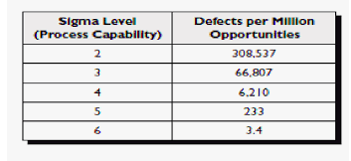
Measuring Baseline Sigma level
Not competitive
Industry average
World class

Slide 34
Lean Six Sigma

Slide 35
Display Data Over Time
500
480
460
440
420
400
0
1
2
3
4
5
6
7
8
9
10
11
12
13
14
15
Statistical Process Control (SPC): Used to determine if process is within process control limits during the process and to take corrective action when out of control
500
480
UCL
460
440
LCL
420
400
0
1
2
3
4
5
6
7
8
9
10
11
12
13
14
15

Slide 36
Sigma Statistic (measure of variation)
Normal Curve
68.27%
95.45%
99.73%
99.9997%

Slide 37
Statistical Process Control
Process in Statistical Control
Statistical process control is the use of statistics to measure the quality of an ongoing process
UCL
LCL
Process not in Statistical Control
A Process is in control when all points are inside the control limits
UCL
LCL
Process not in Statistical Control
A Process is not in control when one or more points is/are outside the control limits
UCL
LCL
Special Causes

Slide 38
Impact of Variation on Performance
Target
(LSL)
(USL)
Machine #1
Machine #2
There are other ways (cp, cpk, etc…) to calculate process capability
when the process is stable and data is normally distributed.

Slide 39
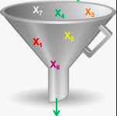
Looking forward to Analyze
Looking for the vital few X’s

