Slide 1
Origin and Objective of the Kano Model
Origin of the Kano Model
Objective of the Kano Model
Developed by Prof. Noriaki Kano and his colleagues from the University of Tokyo in 1978
Established as an approach towards analyzing customer satisfaction
Based on the assumptions of Herzberg’s motivation-hygiene theory that is widely accepted as a measure for customer -as well as employee- related satisfaction analyses
Used as a model to determine and customer requirements as well as to consider them within areas of product development and alterations
Tool for planning and evaluating a product or service by making a list of potential customer needs a product or service should aim to satisfy
Tool to analyze the alignment of the provider’s and the customers’ demands for the product or service
→ Include voice of customer and mind of customer into product or service design

Slide 2
Types of Customer Requirements
Basic criteria that are taken for granted and, thus, do not especially satisfy customers when fulfilled
Non-compliance leads to extremely dissatisfied customers
Fulfillment can only achieve the state of being not dissatisfied
Customers often do not explicitly demand these factors as they take it for granted
Important competitive factor as those requirements are order qualifiers
Must-be
Level of customer satisfaction is proportional to the degree of performance. → Consequently, the higher the degree of performance, the higher the satisfaction of the customer
One-dimensional requirements are normally specifically addressed by the customers and are often basis of competitive actions
One- dimensional
Attractive
Attractive requirements are typically neither directly expressed nor expected by the customer
They are customer-tailored surprises whose fulfillment results in an unpropor- tionally strong increase in the satisfaction level
A non-performance of attractive requirements, however, does not lead to the feeling of dissatisfaction
Provide an excellent chance for companies to differentiate themselves from their competition

Slide 3
Step 1: Develop the Questionnaire
Question Design
Questionnaire Example
Functional
Attribute 1:
I like it that way
It must be that way
I’m neutral
I can live with it that way
I dislike it that way
How do you feel if the respective feature is present in the product or service
If the gas mileage is good, how do you feel?
I like it that way
It must be that way
I’m neutral
I can live with it that way
I dislike it that way
Dysfunctional
If the gas mileage is poor, how do you feel?
How do you feel if the respective feature is not present in the product or service
Attribute 2:
If the radio antenna automatically retracts when the radio is turned off, how do you feel?
I like it that way
It must be that way
I’m neutral
I can live with it that way
I dislike it that way
Answer Design
I like it that way
It must be that way
I’m neutral
I can live with it that way
I dislike it that way
If the radio antenna does not automatically retract when the radio is turned off, how do you feel?
I like it that way
It must be that way
I’m neutral
I can live with it that way
I dislike it that way

Slide 4
Step 2 & 3: Test and Administer the Questionnaire
Step 2: Testing
Step 3: Administering
Internal test-run to identify unclear wording, typographical errors, or confusing instructions
Guidelines
Try to take customers’ perspective to identify problems while preparing the questionnaires
Internal test-run among varying employees
Take criticism into account – revise the questionnaire and retest it
Select target customer group for questionnaire (statistically significant sample – size & variety )
Decide on medium used to distribute questionnaire (phone, face-to-face, mail)
Include introduction and instructions in written questionnaires
Send out survey
Keep track of customers that were addressed to follow up
Record Responses

Slide 5
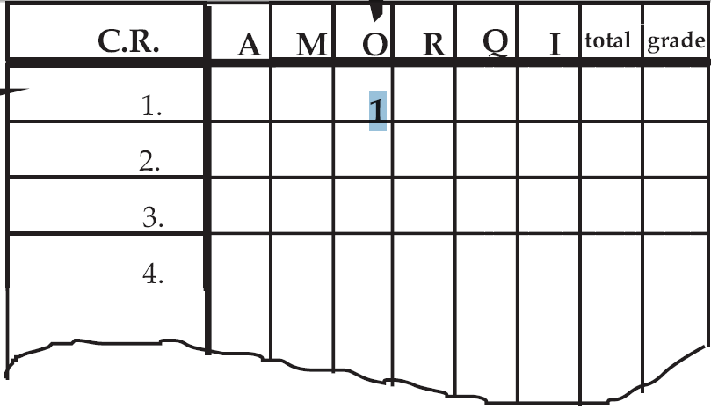
Step 4: Process the Results
Questionnaire
Kano Evaluation Model
Functional Form
If the gas mileage is good, how do you feel?
I like it that way
It must be that way
I’m neutral
I can live with it that way
I dislike it that way
Dysfunctional
Form
If the gas mileage is poor, how do you feel?
I like it that way
It must be that way
I’m neutral
I can live with it that way
. . .
Single Tabulation of Surveys
AMOI= primary measures of Kano model (attractive, must-be, one-dimensional, and
indifferent)
Q= Contradiction among customer’s answers
R = Company’s judgment of functional and dysfunctional is reverse to customer’s opinion
1

Slide 6
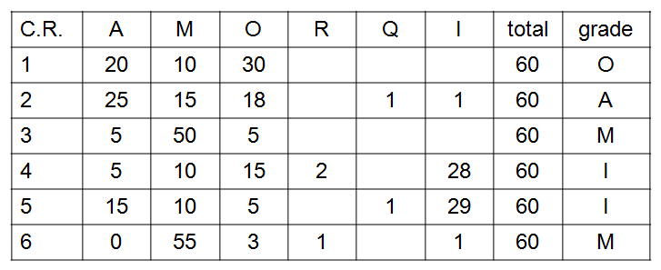
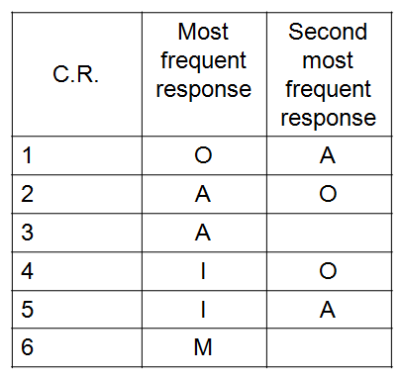
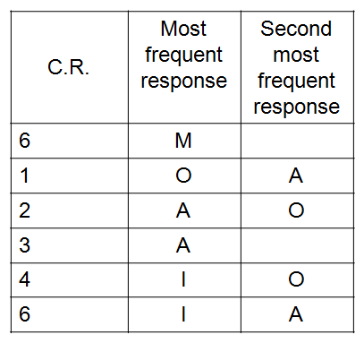
Step 5: Analyze the Results
Accumulated Tabulation of Survey Results
When two Kano codes are tied in the scoring for a given question, consider:
Following up with customers for additional insight
Looking for market segmentation differences
Selecting the classification that would have the greatest impact on the product and competitive positioning (M>O>A>I)
Rows can be rearranged into groups according to their results

Slide 7
Concluding Remarks (I)
Benefits
Limitations
Gaining a better understanding of customer requirements
Prioritizing requirements for development activities
Distinguishing market segment characteristics
Aiding in the design trade-off
Standardized process, however, not all customer requirements are not fully congruent
→ Response should only be regarded a guide that points you into the right direction. It does, however, not provide exact answers concerning what the product design must look like
Guidelines for Application
Must-be requirements should be fulfilled within the product design
Improving performance on a must-be requirement that is already satisfying is unproductive when compared to improving performance on a one-dimensional or attractive requirement
Be competitive with market leaders in the one-dimensional requirements
Include some attractive requirements as a possibility to induce customer loyalty and delight

Slide 8
Concluding Remarks (II)
General Results
Implications for QM
The Kano analysis and questionnaire can help you significantly to confirm or categorize your customers’ requirements
Can assist you in determining conscious as well as subconscious needs of customers
Provides you with knowledge regarding your customers’ perceived quality and attribute significance which enables you to design products and services with the perfectly matching attribute levels and characteristics
Highly applicable to the area of quality management as the early recognition of the right customer requirements can significantly reduce errors in the product design later in the process
A correct application of quality management can only be established with a well-founded knowledge of customer requirements as quality is perceived and defined by the customer

