Slide 1
Georgia State University
Lean Six Sigma
Black Belt Presentation
COUNTY MEDICAL CENTER
Darby Adolphsen, MBA, MHA, CPHQ
Mark Bowen, MBA, MHA

Slide 2
Lean Six Sigma Methodology
Change Management
Define
Measure
Analyze
Improve
Control

Slide 3
Define – Background 32,738 level 4/5 per year
County Medical Center
Largest hospital in the state of Georgia.
Public hospital for the city of Atlanta.
  5th largest public hospital in the US.
  Top Level I trauma centers in the US.
CMC’s ER Services
Blue Zone
Red Zone
Asthma Area
Care Management Unit
Behavior Health
Super Track
ESI 4/5s will be called to Super Track
Patients called according to LOS unless a more acute presentation checks in.
Patient is placed in room. Provider performs exam and place orders
Nursing orders are complete the patient will be pulled to the Super track WR.
A new patient placed in that room to keep 5/6 with 1 provider.
Testing and treatment are complete, patient can be called in the room for disposition

Slide 4
Define – Improving Super Track throughput
Problem Statement
Average provider productivity is 1.6 patients per hour.
Average wait time for a patient in fast track is >2 hours.
Project Scope
Identify current state process and flow of patients that according to EPIC produces an average 1.6 patients per hour in the Super Track. Develop a future state patient process flow that produces a 2.5 to 3.0 patient per hour in the Super Track. Future state will be standardized amongst all providers regardless of tenure in position.
Project Objective
Increase provider throughput to 3 patients per hour in the Super Track.

Slide 5
Define – Outcome metric is defined, “Y”
“Y”= Provider Throughput

Slide 6
Define – What activities do I measure?
Chart Assessment
Chart Note
Patient Reassessment
Patient Assessment
Chart Orders
Disposition
1
2
3
4
5
6
Activity Processing Order

Slide 7
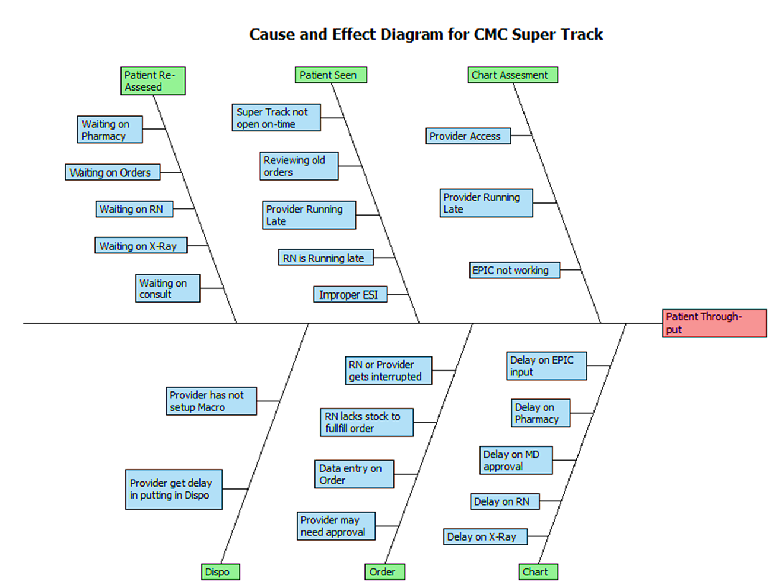
Define: Cause and Effect Diagram for CMC Super Track

Slide 8
Measure
1
2
3
4
Documentation
Area
EPIC
EPIC
EPIC
EPIC
EPIC
EPIC
RN
  Patient Wait Time 65% (Time between pt. enters to physical discharge)
  Documentation Time
  11%
  Patient Face Time 4%
  Provider GAP Time 20% (Interruptions, Lab, X-Ray, Etc.…)

Slide 9
Measure
Univariate
Bivariate

Slide 10
Analyze
SUMMARY OUTPUT
Regression Statistics
Multiple R | 0.821832353
R Square | 0.675408417
Adjusted R Square | 0.633070384
Standard Error | 0.025340046
Observations | 27
ANOVA
 | df | SS | MS | F | Significance F
Regression | 3 | 0.030730658 | 0.010243553 | 15.95275866 | 7.94073E-06
Residual | 23 | 0.014768713 | 0.000642118
Total | 26 | 0.045499371
 | Coefficients | Standard Error | t Stat | P-value | Lower 95% | Upper 95% | Lower 95.0% | Upper 95.0%
Intercept | 0.025696374 | 0.01126201 | 2.281686246 | 0.032086882 | 0.002399131 | 0.048993617 | 0.002399131 | 0.048993617
VA Time | 0.197277122 | 0.431539296 | 0.457147529 | 0.651853648 | -0.695429925 | 1.08998417 | -0.695429925 | 1.08998417
Pt Waits | 0.793397369 | 0.16004372 | 4.957378939 | 5.18437E-05 | 0.462321709 | 1.124473029 | 0.462321709 | 1.124473029
Discharge | 1.476718005 | 0.276649394 | 5.337868214 | 2.02551E-05 | 0.904425131 | 2.049010879 | 0.904425131 | 2.049010879

Slide 11
Analyze
Provider throughput – The number of patients seen from start to finish
Start – Patient assigned to provider, observed and electronic time stamp
Finish – Provider completes disposition, observed and electronic time stamp
 | Day | Shift | Observed | Patients Seen | Through-Put
Provider 1 | Monday, AM | 8 hours | 5:49 hours | 9 | 1.55
Provider 2 | Saturday, AM | 8 hours | 4:14 hours | 7 | 1.65
Provider 3 | Tuesday, AM | 8 hours | 1:24 hours | 3 | 2.14
Provider 4 | Tuesday, AM | 8 hours | 5:39 hours | 8 | 1.42
Average |  |  | 4:16 hours | 27 | 1.69

Slide 12
Analyze
1
2
3
4
Documentation
Area
EPIC
EPIC
EPIC
EPIC
EPIC
EPIC
RN
Scenario A: 1.42 pt./hr.

Slide 13
Analyze
1
2
3
4
Documentation
Area
EPIC
EPIC
EPIC
EPIC
EPIC
EPIC
RN
Scenario B: 1.65 pt./hr.

Slide 14
Analyze
1
2
3
4
Documentation
Area
EPIC
EPIC
EPIC
EPIC
EPIC
EPIC
RN
Scenario C: 2.25 pt./hr.

Slide 15
Analyze
Super Track
Provider Through-put
Chart Assessment
Patient is
SEEN
EPIC
Orders
EPIC
CHART
Patient
Re-Assessment
DISPO
I
I
I
I
I
  VA
  2.33 min
  NVA
  .47 Min
  VA
  4.92 min
  NVA
  .47 sec
  VA
  9.43 min
  NVA
  .47 sec
  VA
  2.25 min
  NVA
  .47 sec
  VA
  1.93 min
  NVA
  .47 sec
  VA
  2.95 min
  NVA
  .47 sec
Total Cycle Time | 2.80 min |  | 5.39 min |  | 2.72 min |  | 9.9 min |  | 2.4 min |  | 3.42 min
GAP Time |  | 0 min |  | 10.23 min |  | 6.7 min |  | 14.18 min |  | 2.75 min

Slide 16
Analyze
Current VSM Results
Total Cycle Time | 26.63 minutes
Total VA Time | 21.81 minutes
Total NVA Time | 2.82 minutes
Lead Time | 1.0 hours

Slide 17
Improve
Super Track
Provider Through-put
Chart Assessment
Patient is SEEN
EPIC Orders
EPIC Chart
Pt. Re- Assessment
DISPO
I
I
I
  VA
  2.33 min
  NVA
  .47 Min
  VA
  16.6 min
  NVA
  1.43 sec
  VA
  1.93 min
  NVA
  .47 sec
  VA
  2.95 min
  NVA
  .47 sec
Total Cycle Time | 2.80 min |  | 18.03 min |  | 2.4 min |  | 3.42 min
GAP Time |  | 0 min |  | 2.4 min. |  | 2.7 min.

Slide 18
Improve
Current VSM Results
Total Cycle Time | 26.65 minutes
Total VA Time | 23.81 minutes
Total NVA Time | 2.84 minutes
Lead Time | 31.8 minutes

Slide 19
Improve
Improvement Impact | Current State T-Put | Current Provider T-Put | Proposed Provider T-Put
(.47 hour / 1.69 pt./hour) + 1.69 pt./hour = 1.97pt./hour
8 hour Shift
3.94 pt./hour

Slide 20
Improve
1
2
3
4
Documentation
Area
EPIC
EPIC
EPIC
EPIC
EPIC
EPIC
RN

Slide 21
Improve
Grady Emergency Room has approximately 32,738 level 4/5 per year
1
2
3
4
Documentation
Area
EPIC
EPIC
EPIC
EPIC
EPIC
EPCI
RN
Waiting Room

Slide 22
Control - Revised Control Chart

Slide 23
Recommendations
Waiting Room
EPIC
EPIC
EPIC
EPIC
EPIC
EPIC
Open Super Track | Pt/hour | Pt/day | Pt/ month | Pt/Year
 |  |  | 1000 | 12,000 | 7 Rooms
24/7/365 | 3.94 | 94.56 | 2,836.8 | 34,041.6 | 12 Rooms
24/7/365 | 3.5 | 84 | 2520 | 30,240 | 12 Rooms
24/7/365 | 3.0 | 72 | 2,160 | 25,920 | 6 Rooms
24/7/365 With 2 RNs | 6.0 5.0 | 144 120 | 4,320 3,600 | 51,840 43,000 | 12 Rooms 12 Rooms
Open Super Track | Pt/hour | Pt/day | Pt/ month | Pt/Year
 |  |  | 1000 | 12,000 | 7 Rooms
24/7/365 | 3.94 | 94.56 | 2,836.8 | 34,041.6 | 12 Rooms
24/7/365 | 3.5 | 84 | 2520 | 30,240 | 12 Rooms
24/7/365 1 Nurse | 3.0 | 72 | 2,160 | 25,920 | 6 Rooms
24/7/365 2 Nurses | 6.0 | 144 | 4,320 | 51,840 | 12 Rooms
Open Super Track | Pt/hour | Pt/day | Pt/ month | Pt/Year
24/7/365 |  |  | 1000 | 12,000 | 7 Rooms
PA/NP
Open Super Track | Pt/hour | Pt/day | Pt/ month | Pt/Year
24/7/365 |  |  | 1000 | 12,000 | 7 Rooms
24/7/365 | 3.94 | 94.56 | 2,836.8 | 34,041.6 | 12 Rooms
Open Super Track | Pt/hour | Pt/day | Pt/ month | Pt/Year
 |  |  | 1000 | 12,000 | 7 Rooms
24/7/365 | 3.94 | 94.56 | 2,836.8 | 34,041.6 | 12 Rooms
24/7/365 | 3.5 | 84 | 2520 | 30,240 | 12 Rooms
Documentation
Area
Level 4/5 | Out patient Clinic | Total
32,738 | 5,200 | 37,938
RN
EPIC
RN
EPIC
PA/NP
EPIC
EPIC
EPIC
EPIC
EPIC
Notes:
Dr. Atallah was able to have a 3.25 patient per hour using this model.

Slide 24
Recommendations
Waiting Room
EPIC
EPIC
EPIC
EPIC
EPIC
EPIC
PA/NP
Documentation
Area
RN
EPIC
RN
EPIC
PA/NP
EPIC
EPIC
EPIC
EPIC
EPIC
Notes:
Dr. Atallah was able to have a 3.25 patient per hour using this model.

Slide 25
Recommendations
Metrics to Measure Daily
Overall length of stay for treat-and-release patients
Overall length of stay for ESI Level 4 (minutes)
Overall length of stay for ESI Level 5 (minutes)
Percentage of patients who leave prior to treatment
Door-to-Provider time
Notes:
This will allow you to engage the providers

Slide 26
Recommendations
  Consider Pay-for-Performance based of patients per hour
  Decrease utilization of exam tables, consider use of patient recliners
  Have a dedicated team of Mid-Levels and RN to Super Track
  Increase utilization of results pending area – Best practice
  Take away EPIC Computers in documentation area
  Develop Communication Plan
Notes:
Dr. Atallah

Slide 27
Recommendations Cont. - Change Management
Initiating Change | What do you need to have an effective start-up?
 | Ensure executive sponsorship Form a Core Team Establish a Sense of Urgency Voice of Vision
Mobilizing Commitment | How do we get strong commitment from key constituents to invest in the change and make it work?
 | Refine the Vision Empower others to act on the Vision Communicate, communicate, communicate
Transitioning | How do we keep the ball rolling?
 | Plan for & create short term wins Consolidate improvements & produce still more change
Making Change Last | How do we make the change the norm?
 | Institutionalize new approaches

Slide 28
Recommendations Cont. - Change Management
Initiating Need
Define Purpose
Create a Shared Need
Leading Change
Mobilizing Commitment
Design a Future Map
Build an Investment
Transitioning
Monitor Results
Build Systems and Structures
BEST-in-CLASS
PRACTICE
Assessing Progress
Making Change Last
Become “The Way of Doing Business”
Notes:
Dr. Atallah

Slide 29
Recommendations Cont. - Change Management
Gaps and wait times were driven by:
Providers:
  Lab
  X-Ray
  Pharmacy
  Lack of EPIC Macros
  Decreased sense of urgency for turn-a-round time for Super Track Team
  Decreased of awareness that mid-levels are leaders in the unit
  Personal interruptions from staff stopping by the Super Track
  Waiting on return calls
  Looking for equipment in room, no stock available
  Patients making a scene due to length of stay
All issues can be the beginning process improvement for patient flow team
Notes:
Dr. Atallah
7-3

Slide 30
Questions or Comments?
Notes:
Dr. Atallah

