Slide 1

DMAIC
Plastec-Stream
Reduce Scrap at the Extrusion

Slide 2
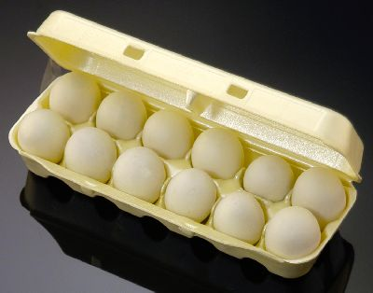
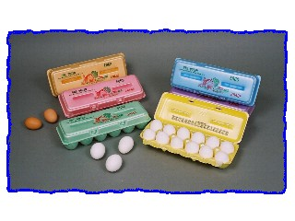
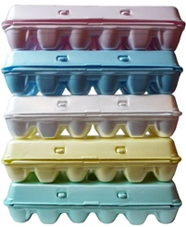
DMAIC

Slide 3
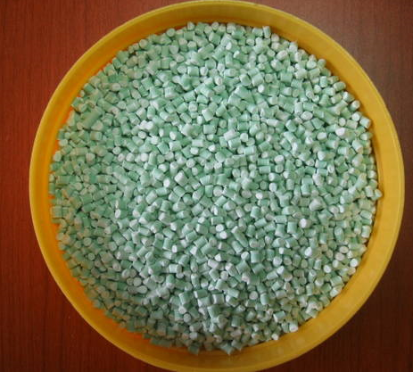
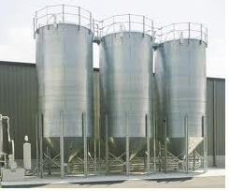
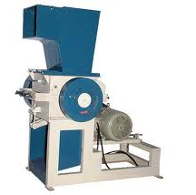

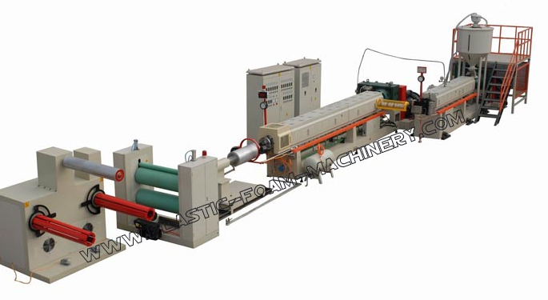
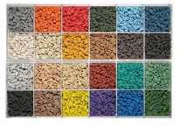
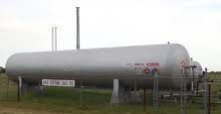
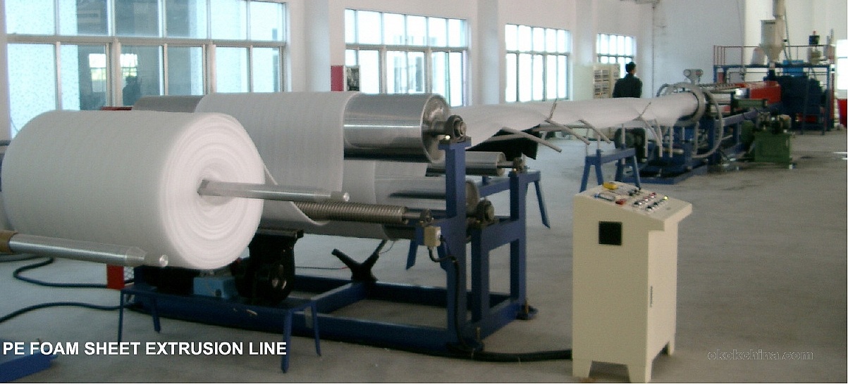
DMAIC
Regrind
SILOS
Regrind
Grinder
Polystyrene
Blender
Feeders
Color Concentrate
Primary Extruder
Foam Rollstock
Mandrel
Butane
Screen
Die/
Air Ring
Secondary Extruder
S-wrap
Winder
Testing

Slide 4
Roadmap
Project Progress Overview
Define
Measure
Analyze
Improve
Control
Milestone:
Planned
Completed
1/4/2014
1/26/2014
2/16/2014
3/16/2014
4/6/2014
1/25/2014
2/15/2014
3/15/2014
4/5/2014
5/26/2014
Steps:
D1.Project Charter
Problem statement.
Primary Metric
Goal statement
Purpose and scope
Team
D2 SIPOC
D3 CTQ: Roll stock Specs
M0 Measure outcomes
M1.Extrusion Current Process Map
M21 Summary of descriptive statistics on daily Extrusion scrap
M22 Control charts
M3 Actual yield, cost and process sigma and goals.
M41 Extrusion Scrap per cause
M42 Causes Tree Diagram
A0 Analyze outcomes
A1 Detailed process map
A2 Vital Few Identification
Pareto and Regression Analysis
A31 T- test conclusion
A32 Hypothesis test on Vital
Few Causes
A33 Root Cause Analysis
Fishbone Diagram
A4 List of Identified and verified main root causes of scrap.
I0 Improve outcomes
I1 Possible solutions to verified root causes.
I2 Evaluate and select
best solution(low
risk/high reward)
I3 Pilot and test solutions.
Actual key perf.indicator Vs baseline test
I4.Implement the optimized process model.
C0 Control outcomes
C1. Sustain the improvement:
control and monitoring plan:
control chart
Key Deliverables:
Project Charter
Key performance indicator
Defined goal
Project timeline
Baseline calculation.
Target performance outputs calculation.
Identify all x causing problems.
Vital few causes
Cause and Effect results.
Regression model
Optimal solution.
Pilot and test.
Implementation
Monitoring and control.
Ownership
Project charter.
SIPOC
CTQ Tree diagram.
Daily scrap data
Descriptive statistics.
Control chart
Capability analysis
Brainstorming
Process map
Detailed process map
Pareto analysis
Regression Analysis
Hypothesis test.
Fishbone/5 Whys
Brainstorming
Impact/Effort & cost Matrix
Descriptive statistics
Control chart.
Capability study.
Control plan.
Visual management tools
Mistake proof methods
Control Charts
SOP/ODS
Tools:
Time and progress:
Day | 21 | 21 | 28 | 21 | 21
Cumulative(%) | 18.75 | 37.50 | 62.50 | 81.25 | 100.00
Notes:
Update your dates. This is intended to give you ideas for tool selection.

Slide 5
Project Charter
Define - Step D1
Business Case:
Plastec-Stream Inc ,a packaging company that mainly produce egg cartons, has an excessive amount of rollstock sheet scrap at the Extrusion department.
This create a loss in raw materials and a big challenge on delivering on time customer orders.
Start / Stop Points for Project:
Extrusion Silos /Extrusion S-wrap Station
In Scope:
Extrusion Department
Defect:
Rollstock scrap.
Metric :LBS rollstock scrap per day
Problem Statement:
Manufacturing and delivering on time egg cartons can
not be sustained with the tremendous amount of scrap(Average 3,326 LBS/day) which cost more than
$3,357 per day or $1,208,520 a year.
Team/Key Stakeholder.
Ben Williamson Plant Manager Sponsor
Dennis Prayer QA Manager Champion
Ted Davis Extrusion Mgr Subject Expert
Donatien Toni Lean Six Sigma Black Belt
Sipola Ongewe Lean Six Sigma Black Belt
Goal Statement:
Reduce Extrusion line daily scrap from 3,325 LBS to 1500 LBS by end of June 2014 for a saving of $544,320 a year.
Notes:
1. Verify importance of problem and project with your Champion(s)
Discuss the goal and scope of the project with your Champion(s)
Determine project pace and update the cover page
Remember that your Charter page is a “living” document and CHANGES as you go through D-M-A-I-C and gather your data. In Step 2 of Measure we’ll “lock-in” these measures. As you complete your project, you should modify this page to reflect what you learn about your problem.

Slide 6
Extrusion SIPOC Map
Define - Step D2
SIPOC
Suppliers |  | Inputs |  | Process |  | Outputs |  | Customers |  | Requirements
 |  |  |  | Blender
 |  |  |  | Screws |  |  |  |  |  | Segment Weight
 |  | Crystal Polystrene
Raw materials |  | Virgin |  |  |  |  |  | Forming |  | Thickness
Suppliers |  | Color |  | Die |  | Foam sheet (Rollstock)
 |  | Talc |  |  |  |  |  |  |  | Cell size
 |  | Butane |  |  |  |  |  | Printing
 |  |  |  | Mandrel |  |  |  |  |  | Color
Grinders |  | Regrind |  |  |  |  |  |  |  | Orientation
 |  |  |  | S-wrap
 |  |  |  | Winder |  |  |  |  |  | In specs
External Customers

Slide 7
Outcome of Measure Phase
Measure-Step M0
The Goal of Measure Phase – To establish current baseline:
Current Process Map
Descriptive Statistics
Daily Scrap Average
Daily Prime Average
Variation Analysis
Can we trust data we obtain from the process?
Determine Process Capability
Can we produce a product which will meet the customers tolerances?
Scrap per cause
Identify our baseline list of scrap causes

Slide 8
Extrusion Current Process Map
Measure-Step M1
Baseline
Notes:
1. Addresses: What Does the Customer Want? What is a Good Product/Process? What is a Defect?
2. Goal of Performance Standard is to Translate the Customer Need into a MEASURABLE Characteristic.
3. Operational Definition is a Precise Description that Tells How to get a Value for the Characteristic You are Measuring.
To add or delete rows within this table, right-click and select “insert rows” or “delete rows”.

Slide 9
Baseline Statistics
Measure-Step M21
Extrusion daily yield
Mean daily Scrap = 3,326 LBS
Mean daily prime = 53,536 LBS
Date Prime Scrap Yield
10/1/13 55536 3594 93.5
10/2/13 58973 3159 94.6
10/3/13 39053 1418 96.4
10/4/13 41844 2793 93.3
10/5/13 58659 2116 96.4
10/6/13 55753 1278 97.7
10/7/13 43299 3614 91.7
10/8/13 45082 2615 94.2
10/9/13 63920 2225 96.5
10/11/13 47917 5416 88.7
10/12/13 60870 881 98.6
10/13/13 63668 2282 96.4
10/14/13 63527 972 98.5
10/15/13 47258 1524 96.8
10/16/13 36006 2315 93.6
10/17/13 48245 3186 93.4
10/18/13 50529 6793 86.6
10/19/13 44889 1278 97.2
N=103
Period = 10/1/2013 thru 1/24/2014
Notes:
1. Addresses: What Does the Customer Want? What is a Good Product/Process? What is a Defect?
2. Goal of Performance Standard is to Translate the Customer Need into a MEASURABLE Characteristic.
3. Operational Definition is a Precise Description that Tells How to get a Value for the Characteristic You are Measuring.
To add or delete rows within this table, right-click and select “insert rows” or “delete rows”.

Slide 10
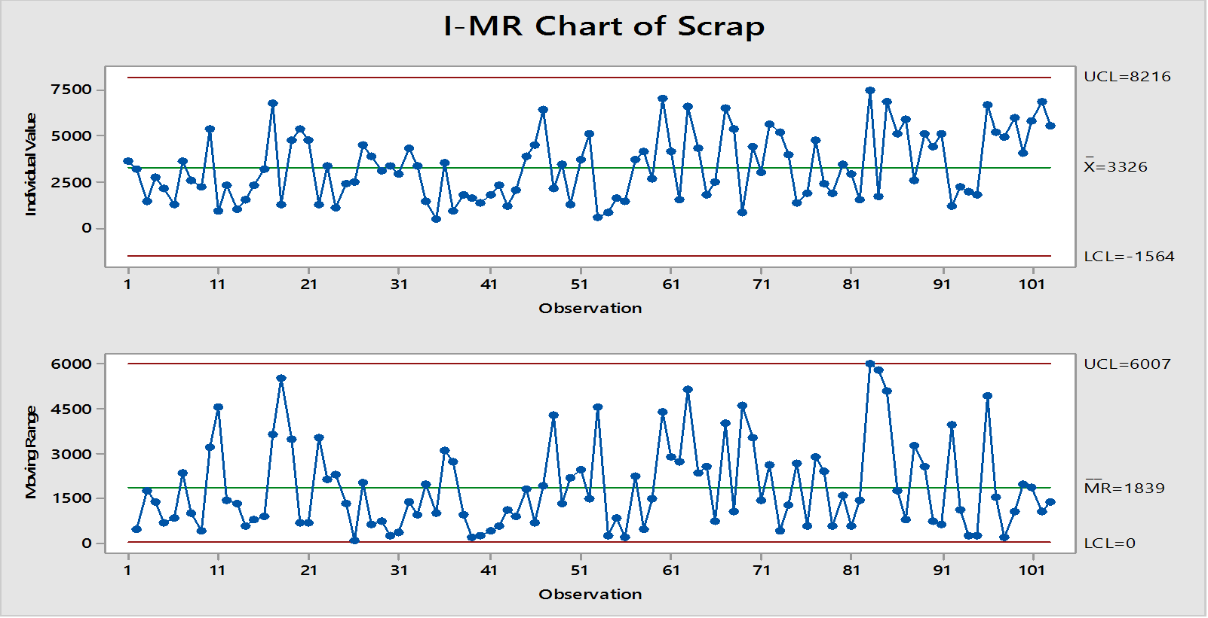
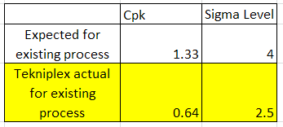
Baseline on Extrusion Daily Scrap
Measure-Step M22
Variation Analysis
IMR charts determined that the process variation is in control
Process Capability
Cpk was calculated at 0.64
Well below expected

Slide 11
Baseline on yield, cost and goals
Measure-Step M3
Actual/Goal
Notes:
1. Addresses: What Does the Customer Want? What is a Good Product/Process? What is a Defect?
2. Goal of Performance Standard is to Translate the Customer Need into a MEASURABLE Characteristic.
3. Operational Definition is a Precise Description that Tells How to get a Value for the Characteristic You are Measuring.
To add or delete rows within this table, right-click and select “insert rows” or “delete rows”.

Slide 12
Causes Tree Diagram
Measure-Step M42
Extrusion Scrap per Cause
 |  |  |  |  |  |  |  |  |  |  |  |  |  |  |  |  |  |  |  |  |  |  |  | SCRAP
Color Change |  |  |  | Mechanical |  |  |  | Start Up |  |  |  | Contaminated |  |  |  | Out of Spec |  |  |  | Feed Syst. |  |  |  | Trash in Die |  |  |  | Break Out |  |  |  | Butane Issues |  |  |  | Runout of |  |  |  | Runout of |  |  |  | Runout of |  |  |  | Shutdouwn
CC |  |  |  | MECH |  |  |  | SU |  |  |  | Regrind(CR) |  |  |  | OS |  |  |  | Failure(FSF) |  |  |  | TD |  |  |  | BO |  |  |  | BI |  |  |  | Regrind(RR) |  |  |  | Virgin(RV) |  |  |  | Color(RC) |  |  |  | SD
Change over |  |  |  | Screens |  |  |  | Inventory |  |  |  | Different |  |  |  | 4.5 RPM |  |  |  | Low Light |  |  |  | CR |  |  |  | Trash |  |  |  | Not at setpoint |  |  |  | Low light |  |  |  | Clumps in |  |  |  |  |  |  |  | Inventory
CO |  |  |  | Heaters |  |  |  | Maint. |  |  |  | regrind color |  |  |  | Blade dull |  |  |  | Compressed |  |  |  |  |  |  |  | Dirty Mandrel |  |  |  | Pump |  |  |  | not working |  |  |  | Hopper |  |  |  |  |  |  |  | Maintenance
CR |  |  |  | Mandrel |  |  |  | Unschedule |  |  |  | Trash |  |  |  | Spots on |  |  |  | air |  |  |  |  |  |  |  | Water flow |  |  |  |  |  |  |  | Empty Silos |  |  |  | Feeder Stop |  |  |  |  |  |  |  | Unschedule
FSF |  |  |  | Water flow |  |  |  | shutdown |  |  |  | Water |  |  |  | Sheet |  |  |  | Auger |  |  |  |  |  |  |  | Electrical |  |  |  |  |  |  |  | Jams |  |  |  | Compressed |  |  |  |  |  |  |  | shutdown
RR |  |  |  | Valve |  |  |  | Power out |  |  |  |  |  |  |  | 4.5 Amps |  |  |  | Feeder |  |  |  |  |  |  |  |  |  |  |  |  |  |  |  | Clumps |  |  |  | air |  |  |  | ` |  |  |  | Power out
RC |  |  |  | Compressed |  |  |  |  |  |  |  |  |  |  |  | Operator |  |  |  | Pump |  |  |  |  |  |  |  |  |  |  |  |  |  |  |  | Trash
Operator |  |  |  | air |  |  |  |  |  |  |  |  |  |  |  | Water flow |  |  |  | Shaker |  |  |  |  |  |  |  |  |  |  |  |  |  |  |  | Operator
Colorator |  |  |  | 4.5 RPM |  |  |  |  |  |  |  |  |  |  |  | Pressure |  |  |  |  |  |  |  |  |  |  |  |  |  |  |  |  |  |  |  | Compressed
 |  |  |  | 4.5 AMPS |  |  |  |  |  |  |  |  |  |  |  | Butane |  |  |  |  |  |  |  |  |  |  |  |  |  |  |  |  |  |  |  | air
 |  |  |  | Power out |  |  |  |  |  |  |  |  |  |  |  | S-wrap Speed |  |  |  |  |  |  |  |  |  |  |  |  |  |  |  |  |  |  |  | Bent auger
 |  |  |  | Feeder |  |  |  |  |  |  |  |  |  |  |  | Talc Feeder |  |  |  |  |  |  |  |  |  |  |  |  |  |  |  |  |  |  |  | Power out
 |  |  |  | pump |  |  |  |  |  |  |  |  |  |  |  | Die Gap |  |  |  |  |  |  |  |  |  |  |  |  |  |  |  |  |  |  |  | Feeder pump
 |  |  |  | Die |  |  |  |  |  |  |  |  |  |  |  | CC
 |  |  |  | Air ring
 |  |  |  | Water leak
 |  |  |  | Die /mandrel
 |  |  |  | change
 |  |  |  | Colorator
Notes:
1. Addresses: What Does the Customer Want? What is a Good Product/Process? What is a Defect?
2. Goal of Performance Standard is to Translate the Customer Need into a MEASURABLE Characteristic.
3. Operational Definition is a Precise Description that Tells How to get a Value for the Characteristic You are Measuring.
To add or delete rows within this table, right-click and select “insert rows” or “delete rows”.

Slide 13
Outcome of Analyze Phase
Analyze-Step A0
Our Objective is to narrow to the vital few
By looking at each step and seeing where the problems are originating from.
Detailed Process Map with root cause analysis
By narrowing down to the vital few using the following tools.
Pareto Analysis – 80 percent of our Scrap was produced by 20% of the causes
6 key causes identified
Regression Analysis – Proved that the six identified were significant
Hypothesis Testing – The vital few were identified (Color Change and Mechanical Issues)
Summarizing the root causes of our vital few
By identifying variation of our causes
Root cause analysis

Slide 14
Detailed Process Map
Analyze-Step A1
Root Cause Analysis
Notes:
1. Addresses: What Does the Customer Want? What is a Good Product/Process? What is a Defect?
2. Goal of Performance Standard is to Translate the Customer Need into a MEASURABLE Characteristic.
3. Operational Definition is a Precise Description that Tells How to get a Value for the Characteristic You are Measuring.
To add or delete rows within this table, right-click and select “insert rows” or “delete rows”.

Slide 15
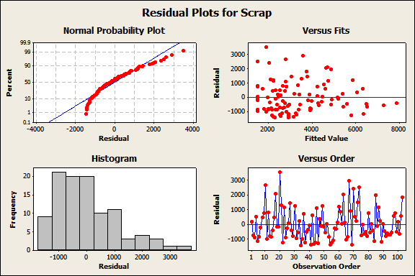
Vital Few Identification
Analyze-Step A2
Pareto Analysis
Regression Analysis
Regression Equation
Scrap = 706.534 + 0.978373 CC + 0.91847 MECH + 0.795376 OS + 0.883489 SU + 1.10903 CR + 1.01107 FSF
Coefficients
Term Coef SE Coef T P value
Constant706.534 155.355 4.54786 0.000
CC 0.978 0.108 9.08724 0.000
MECH 0.918 0.093 9.87326 0.000
OS 0.795 0.106 7.53331 0.000
SU 0.883 0.125 7.09266 0.000
CR 1.109 0.127 8.72552 0.000
FSF 1.011 0.136 7.40936 0.000
Summary of Model
S = 810.594 R-Sq = 81.30% R-Sq(adj) = 80.13%
PRESS = 69633608 R-Sq(pred) = 79.35%
82% Of scrap are due to:
Color Change(CC) procedure - 21 %
Mechanical (MECH)Issues – 19 %
Out of Specifications (OS) – 13 %
Start Up (SU) issues - 11 %
Contaminated Regrind(CR) – 9 %
Feed System Failure(FSF) – 9%
Notes:
1. Addresses: What Does the Customer Want? What is a Good Product/Process? What is a Defect?
2. Goal of Performance Standard is to Translate the Customer Need into a MEASURABLE Characteristic.
3. Operational Definition is a Precise Description that Tells How to get a Value for the Characteristic You are Measuring.
To add or delete rows within this table, right-click and select “insert rows” or “delete rows”.

Slide 16
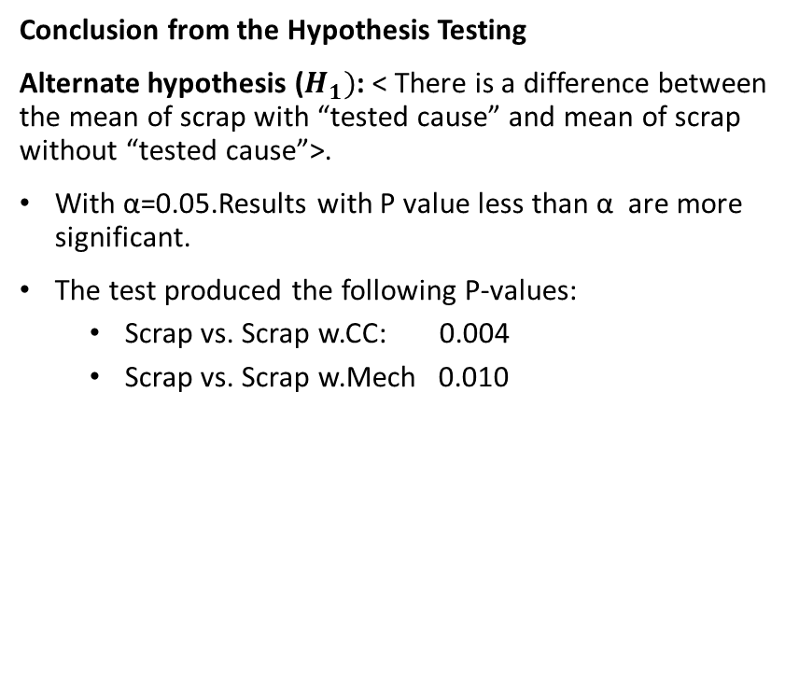
T-test conclusion
Analyze-Step A31
Hypothesis Testing on vital few - T-Test
Conclusion from the Hypothesis Testing
Alternate hypothesis ($H_{1})$: < There is a difference between the mean of scrap with “tested cause” and mean of scrap without “tested cause”>.
With α=0.05.Results with P value less than α are more significant.
The test produced the following P-values:
Scrap vs. Scrap w.CC: 0.004
Scrap vs. Scrap w.Mech 0.010

Slide 17
List of Vital Few
Analyze-Step A4
Notes:
Use this slide only if your data is continuous. Delete this page for Discrete Data sets.
Goal: Provide a visual/graphical display of the current process output data and determine whether your data is normal, which will dictate which analysis tools apply to your project. Some tools are based on your data being “normal” (such as the MSA you just completed in Step 3). See your BB/MBB coach for assistance.
To delete a sample chart or banner, use your mouse to select the item with one left click, right click and select ‘cut’ from the drop-down menu.
Populating the Minitab Graphic:
Select “Stat” from menu bar
Select “Basic Statistics” from pull down menu
Select “Display Descriptive Statistics” from pull down menu
Under “Variable”, with curser in box, double-click on column(s) containing data (output, Y, measures)
Click “Graphs” button (lower right corner) and check “Graphical Summary” and “OK” box
Click “OK” box again to calculate
Right click on graphic, choose “Copy Graph”; Right click in Power Point pitch page and select “Paste”
Enlarge by highlighting graphic (click once to get a box at each corner as needed) and go to a corner box to get a line with two arrows – Left click and drag out to desired size
Reposition to Center (Left click on image and drag to position)
Highlight/Circle Centering Tendencies and Standard Deviation

Slide 18
Improve Step I0
Outcomes of Improve phase
Possible solutions to verified root causes
Evaluate and select best solution(low risk/high reward)
Pilot and test solutions.
Actual key performance indicator Vs baseline test
Implement the optimized process model.
Notes:
Examples of additional analysis tools. Minitab directions for populating follows.
To delete a sample chart or banner, use your mouse to select the item with one left click, right click and select ‘cut’ from the drop-down menu.
Minitab Box Plot:
select ‘Graph’ from menu bar, choose ‘Boxplot’ from drop-down menu
Left click once in ‘Y1’ field; double click on column name at left containing the data
Left click once in ‘X1’ field; double click on column name at left containing the data
click on ‘ok’; right click and select ‘Copy Graph’; right click and select ‘Paste’ in Power Point slide
use mouse to select graph and position on slide
Minitab Histogram:
select ‘Graph’ from menu bar, choose ‘Histogram’ from drop-down menu
Left click once in ‘X1’ field; double click on column name at left containing the data
click on ‘ok’; right click and select ‘Copy Graph’; right click and select ‘Paste’ in Power Point slide
use mouse to select graph and position on slide
Minitab Time Series Plot:
select ‘Graph’ from menu bar, choose ‘Time Series Plot’ from drop-down menu
Left click once in ‘Y1’ field; double click on column name at left containing the data
click on ‘ok’; right click and select ‘Copy Graph’; right click and select ‘Paste’ in Power Point slide
use mouse to select graph and position on slide
Minitab Dot/Frequency Plot:
select ‘Graph’ from menu bar, choose ‘Dotplot’ from drop-down menu
Left click once in ‘Variables’ field; double click on column name at left containing the data
click on ‘ok’; right click and select ‘Copy Graph’; right click and select ‘Paste’ in Power Point slide
use mouse to select graph and position on slide

Slide 19
Possible solutions
Improve Step I1
Problem |  |  | Vital Few |  | Root Causes |  | Solution |  | Data
 |  |  | Color Change(CC) |  | Changeover procedures |  | Changeover schedule by color |  | Scrap per color
 |  |  |  |  | Grindng at wrong grinder |  | Dedicate one Extruder to run white |  | (White,Yellow)
 |  |  |  |  | Grinder Trash |  | Grinding Matrix and training |  | Scrap per cause
 |  |  |  |  | Grinder connected to wrong silos |  |  |  | CR
Scrap |  |  | Color Change(CC) |  | Extruder type(Tandem vs Mixer & Cooler) |  | Convert E2 to tandem Extruder |  | Cause by Extruder
 |  |  | Mech |  | Running out of raw material(empty containers |  | More failure detection tools |  | CC on M/C vs Tandem
 |  |  |  |  | Feed System Failure,Clots ,raw material clumps) |  | (mistake proofing devices/Poke Yoke) |  | Extruder
 |  |  |  |  |  |  | PM program and training |  | Scrap by cause FSF
 |  |  |  |  | 6 heating zones on primary extruder |  | PM program |  | Scrap by Cause
 |  |  | Mech |  | Butane control system |  |  |  | Mech
 |  |  |  |  | Compressed air and chilling water supply system
Notes:
Examples of additional analysis tools. Minitab directions for populating follows.
To delete a sample chart or banner, use your mouse to select the item with one left click, right click and select ‘cut’ from the drop-down menu.
Minitab Box Plot:
select ‘Graph’ from menu bar, choose ‘Boxplot’ from drop-down menu
Left click once in ‘Y1’ field; double click on column name at left containing the data
Left click once in ‘X1’ field; double click on column name at left containing the data
click on ‘ok’; right click and select ‘Copy Graph’; right click and select ‘Paste’ in Power Point slide
use mouse to select graph and position on slide
Minitab Histogram:
select ‘Graph’ from menu bar, choose ‘Histogram’ from drop-down menu
Left click once in ‘X1’ field; double click on column name at left containing the data
click on ‘ok’; right click and select ‘Copy Graph’; right click and select ‘Paste’ in Power Point slide
use mouse to select graph and position on slide
Minitab Time Series Plot:
select ‘Graph’ from menu bar, choose ‘Time Series Plot’ from drop-down menu
Left click once in ‘Y1’ field; double click on column name at left containing the data
click on ‘ok’; right click and select ‘Copy Graph’; right click and select ‘Paste’ in Power Point slide
use mouse to select graph and position on slide
Minitab Dot/Frequency Plot:
select ‘Graph’ from menu bar, choose ‘Dotplot’ from drop-down menu
Left click once in ‘Variables’ field; double click on column name at left containing the data
click on ‘ok’; right click and select ‘Copy Graph’; right click and select ‘Paste’ in Power Point slide
use mouse to select graph and position on slide

Slide 20
Best solutions
Improve Step I2
Impact/Effort & Cost Matrix
Notes:
Examples of additional analysis tools. Minitab directions for populating follows.
To delete a sample chart or banner, use your mouse to select the item with one left click, right click and select ‘cut’ from the drop-down menu.
Minitab Box Plot:
select ‘Graph’ from menu bar, choose ‘Boxplot’ from drop-down menu
Left click once in ‘Y1’ field; double click on column name at left containing the data
Left click once in ‘X1’ field; double click on column name at left containing the data
click on ‘ok’; right click and select ‘Copy Graph’; right click and select ‘Paste’ in Power Point slide
use mouse to select graph and position on slide
Minitab Histogram:
select ‘Graph’ from menu bar, choose ‘Histogram’ from drop-down menu
Left click once in ‘X1’ field; double click on column name at left containing the data
click on ‘ok’; right click and select ‘Copy Graph’; right click and select ‘Paste’ in Power Point slide
use mouse to select graph and position on slide
Minitab Time Series Plot:
select ‘Graph’ from menu bar, choose ‘Time Series Plot’ from drop-down menu
Left click once in ‘Y1’ field; double click on column name at left containing the data
click on ‘ok’; right click and select ‘Copy Graph’; right click and select ‘Paste’ in Power Point slide
use mouse to select graph and position on slide
Minitab Dot/Frequency Plot:
select ‘Graph’ from menu bar, choose ‘Dotplot’ from drop-down menu
Left click once in ‘Variables’ field; double click on column name at left containing the data
click on ‘ok’; right click and select ‘Copy Graph’; right click and select ‘Paste’ in Power Point slide
use mouse to select graph and position on slide

Slide 21
Implement Solutions
Improve Step I3
Pilot and Implementation Activities
Notes:
Examples of additional analysis tools. Minitab directions for populating follows.
To delete a sample chart or banner, use your mouse to select the item with one left click, right click and select ‘cut’ from the drop-down menu.
Minitab Box Plot:
select ‘Graph’ from menu bar, choose ‘Boxplot’ from drop-down menu
Left click once in ‘Y1’ field; double click on column name at left containing the data
Left click once in ‘X1’ field; double click on column name at left containing the data
click on ‘ok’; right click and select ‘Copy Graph’; right click and select ‘Paste’ in Power Point slide
use mouse to select graph and position on slide
Minitab Histogram:
select ‘Graph’ from menu bar, choose ‘Histogram’ from drop-down menu
Left click once in ‘X1’ field; double click on column name at left containing the data
click on ‘ok’; right click and select ‘Copy Graph’; right click and select ‘Paste’ in Power Point slide
use mouse to select graph and position on slide
Minitab Time Series Plot:
select ‘Graph’ from menu bar, choose ‘Time Series Plot’ from drop-down menu
Left click once in ‘Y1’ field; double click on column name at left containing the data
click on ‘ok’; right click and select ‘Copy Graph’; right click and select ‘Paste’ in Power Point slide
use mouse to select graph and position on slide
Minitab Dot/Frequency Plot:
select ‘Graph’ from menu bar, choose ‘Dotplot’ from drop-down menu
Left click once in ‘Variables’ field; double click on column name at left containing the data
click on ‘ok’; right click and select ‘Copy Graph’; right click and select ‘Paste’ in Power Point slide
use mouse to select graph and position on slide

Slide 22
Pilot and Test Solutions
Improve Step I4
Before & After Performance Assessment
Daily Extrusion Scrap decreased by 46 %
Have I Reached My Goal?
Notes:
Examples of additional analysis tools. Minitab directions for populating follows.
To delete a sample chart or banner, use your mouse to select the item with one left click, right click and select ‘cut’ from the drop-down menu.
Minitab Box Plot:
select ‘Graph’ from menu bar, choose ‘Boxplot’ from drop-down menu
Left click once in ‘Y1’ field; double click on column name at left containing the data
Left click once in ‘X1’ field; double click on column name at left containing the data
click on ‘ok’; right click and select ‘Copy Graph’; right click and select ‘Paste’ in Power Point slide
use mouse to select graph and position on slide
Minitab Histogram:
select ‘Graph’ from menu bar, choose ‘Histogram’ from drop-down menu
Left click once in ‘X1’ field; double click on column name at left containing the data
click on ‘ok’; right click and select ‘Copy Graph’; right click and select ‘Paste’ in Power Point slide
use mouse to select graph and position on slide
Minitab Time Series Plot:
select ‘Graph’ from menu bar, choose ‘Time Series Plot’ from drop-down menu
Left click once in ‘Y1’ field; double click on column name at left containing the data
click on ‘ok’; right click and select ‘Copy Graph’; right click and select ‘Paste’ in Power Point slide
use mouse to select graph and position on slide
Minitab Dot/Frequency Plot:
select ‘Graph’ from menu bar, choose ‘Dotplot’ from drop-down menu
Left click once in ‘Variables’ field; double click on column name at left containing the data
click on ‘ok’; right click and select ‘Copy Graph’; right click and select ‘Paste’ in Power Point slide
use mouse to select graph and position on slide

Slide 23
Control Step C0
Outcomes of Control phase
Sustain the improvement:
control and monitoring plan control chart
How Can I Sustain the Improvement?

Slide 24
Process Control
Control Step C1
Monitoring
Defect | Measurement
Daily Extrusion Scrap(lbs) | Weight Scrap
Turnover to the Business
Has the business agreed to accept this process? YES
Who owns the new process? Ted Davis Extrusion Department Manager
Who runs the new process? Ted Davis and Extruder Operators
Has this person(s) been properly trained? YES
Who monitors the new process and metrics? Ted Davis ,Extrusion Operators and QA Department
How Can I Sustain the Improvement?

Slide 25
Appendix
APPENDIX
1 | Grinding Matrix
2 | Bi-weekly Changeover Schedule by color
3 | Annual PM Program
4 | Color wheel

