Slide 1
About This Project
This project is a simulation of actual occurrences
Covers key six sigma concepts including
Seeks to accomplish key outlined objectives
Applying the DMAIC approach to process improvement
Identification and selection of process improvement opportunities
Utilizing Statistical Analysis and Tests
Addressing/Improving Customer Satisfaction
Cost Savings & Ongoing Financial Benefits
Provide Detailed Explanations Throughout
Illustrative Analysis
Comprehensive Use of Recommended Tools
Effective Resolution/ Final State
Presenters Knowledge of Six Sigma Methodology

Slide 2


INSTALLATION Department
DSL Eastern Division
Ghost Installation Reduction Project
Prepared By:
Joe Banks & Cecilyn Cayetano

Slide 3

Definition:
Ghost Installation (GI’s): Installation attempt in which the installer found no one available on-site once he/she arrived to perform an installation; resulting in a defective installation job.

Slide 4
Project Description
DMAIC
Problem:
During a review of year over year comparisons of DSL-East installation reports it was discovered that the GI rate across the DSL-Eastern Division’s territory is trending an all time high of 15%, causing repeat installs and lost customers.
In conjunction with the rise in GI’s there has also been a 10% increase in customer complaints due to the missed installation appointments.
Objective:
To reduce the rate of GI’s (Big Y) below the upper specification limit of 10%, which will in turn increase the rate of completed jobs back to normal levels of 90% or more.
It is our goal to reduce the rate of Ghost Installations from 15% of total installs to below 10%, a 33% reduction resulting in DPMO < 100,000 and a yield of 90%.
Scope:
Metrics (unit of measure):
The rate of successfully completed Installations, non-defective.
Defect Definition: Installation attempt in which the installer found no one to be available on-site once he/she arrived to perform an installation resulting in a defective installation job.
Measurements:
Completed installations >90% (5% improvement).
Installations achieve a long term process sigma of > 2.7.
Eliminate the 10% increase in customer complaints.
Achieve cost savings of $99,700 within 12 months.

Slide 5
DSL-East Total Install Process
DMAIC
Key Point: Our Project’s Focus will be in the DSL Installation Department
Project Selection:
Several departments within the unit have improvement areas and possible projects.
We selected this project by using a Project Prioritization Matrix.
Prioritization Scores:
scores are weighted
Our Focus
* RLD = Regional Logistics Department

Slide 6
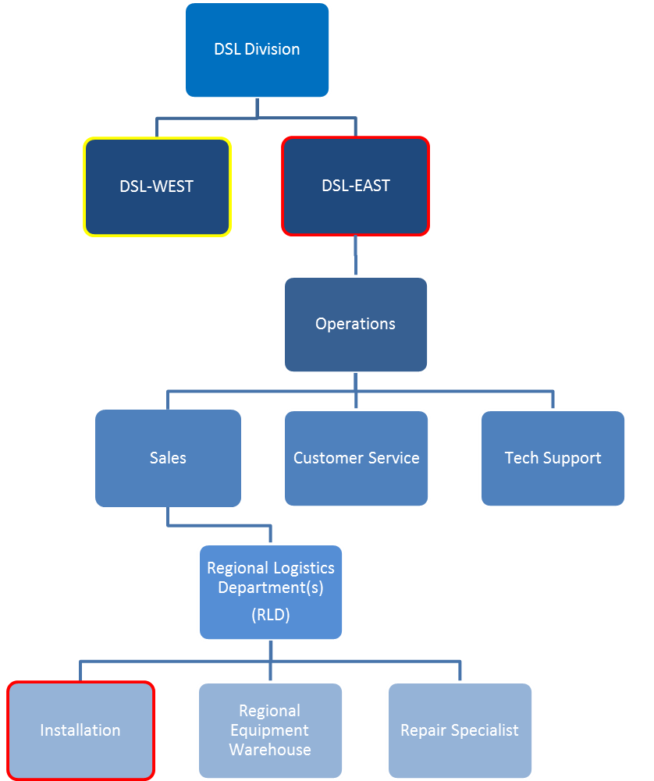
DSL-East’s GI Defects vs. Other Unit
DMAIC
Key Point: The DSL East’s GI’s are Higher than Normal
Project Validation:
From the historical data we can see that the amount of DSL-East GI’s is at an all time high. The DSL-West Division is performing normally.
Scale zoomed in for impact.
8% Historical Baseline
Scale zoomed in for impact.
Our Focus
6.5% Historical Baseline

Slide 7

Recent Changes for DSL-East Specifically
DMAIC
Key Point: Geographical Expansion Has Expanded Service Areas for Cities Serviced by DSL-East Units
Fact:
Eastern U.S. Cities Experience Explosive Population Growth During the Recent Housing Boom:
With the recent housing expansion in the United States we have seen new neighborhoods and rural expansion surrounding many previously smaller eastern US cities.
This is in contrast to the West having greater population than geographical growth in major cities with less rural territory expansion, this evidenced by higher home prices.
Jacksonville, FL 10.6%
Orlando, FL 21.5%
Charlotte, NC 24.9%
Nashville, TN 11.0%,
Atlanta, GA 29.2%
Miami, FL 19.5%
Raleigh, NC 40.7%
*Source: USA Today
http://www.usatoday.com/news/nation/census/2010-06-22-census_N.htm

Slide 8



Scope, VOC & VOB
DMAIC
Key Point: Customers are Complaining; There’s a Problem…
So you’re going to be 30mins late…
SIPOC
I had my phone with me… The jerk never called!!!
Voice of the Customer:
We used the call center database to retrieve details on missed installations. The data contains customer comments about why the install was missed, the order info that was provided to the installer originally, as well as the installers reference code for the Ghost Installation.
Voice of the Business:
There are several key factors that accurate, timely, and courteous installations affect. All of which add to the success of the business, the business wants...
High Customer Satisfaction
Potential Referrals W.O.M
To Secure New Billings
Fewer Re-Installs (Rework)
Reduce Equipment Restocks
Reduce Customer Complaints
I don’t care if you're stuck in traffic. I have to leave in 30mins!!!

Slide 9
KPIV,KPOV, & Data Collection
DMAIC
Key Point: KPIV’s: Traffic & Distance, KPOV: Completed Jobs
Cause & Effects Matrix
From the results of our cause and effects matrix we can see that the key inputs (x’s) to the process are estimating traffic delays and effectively measuring the distance from location to location ahead of leaving for the installation.
Traffic
Reaching Customers
Location Distance
Weather
Other
Causes for Ghost Installations
Based on the coded data retrieved from the data entry system it appears that the most common cause for missed appointments as stated by installers is traffic (construction, detours, accidents), followed by distance (location to location distance), communication (cannot reach customer), etc...

Slide 10
Measure System Analysis
DMAIC
Key Point: The Overall Process is Normally Distributed
The frequency histograms below helped us determine that our data is normal. On the left we can see that the combined % of completed installations across both divisions is normally distributed at a rate of about 88%. To the right is the completion rate for both divisions shown independently; DSL-East’s mean is below the LL specification of 90%.
West’s Benchmark

Slide 11

MSA Continued
DMAIC
Key Point: X’s & Y’s are in Control, Yet Not Meeting Process Specs
Control Charts Analysis
The P Chart corresponds with the histograms that about 15% of the installations are actually defective.
The sample data used for the I-MR charts of traffic and distance (KPIV’s) shows us that the data is in control, although we know by the rate of defective installations (15%) that the process isn’t meeting specifications (<10%).
Defectives Baseline
Baseline for logged traffic times
Baseline for logged distance traveled

Slide 12


MSA Continued
DMAIC
Key Point: GPS’s are Performing their Desired Function; Installer Can Trust the Route Information Given to Them by the GPS System
Testing The System:
We evaluated the measurement system (GPS’s) used to determine the distance from the dispatch location to a fueling station with a known distance of 2mi. We’ve imposed a tolerance level of .1 mi, and performed 50 observations.
The Result: Accept Ho
The P Value in the measurement system is .477 suggesting that no bias is present in the measurement system. This result preserves the H0; there is no difference in the results the GPS provides over multiple uses /users. Also, we noticed that many of the observations plotted on the run chart appear evenly distributed both above and below the reference of 2mi.
The difference of the largest and smallest values = .04 which is less than our tolerance level of .1 signaling the gage (GPS) and its user(s) may be considered accurate and repeatable and therefore shouldn’t be improved.
This conclusion leaves us with the unanswered question of why is distance the #2 reason for GI’s?

Slide 13
MSA Continued
DMAIC
Key Point: GPS’s are Performing their Desired Function, Estimating the Area Traffic Isn’t Proving to be a Consistent Method Across Installers
Testing The Operators vs. The System:
Three locations were selected that represent the expected range of the process variation. Three operators measured the expected traffic times for the three locations (assuming no special circumstances), three different days per location, in a random order.
Understanding The Results:
In the Components of Variation graph (located in the upper left corner), the percent contribution from Total Gage R&R (97.97) is larger than that of Part-To-Part (2.03). Thus, most of the variation arises from the measuring system (estimating traffic times) not the locations themselves.
In the Xbar Chart by Operator most of the points in the X and R chart are inside the control limits, indicating the observed variation is mainly due to the measurement system. In the By Part graph (located in upper right corner), there is little difference between parts, as shown by the nearly level line.
The Total Gage R&R accounts for 98.98% of the study variation. The measurement system of individual drivers estimating traffic times/conditions is unacceptable and should be improved.

Slide 14
MSA Continued
DMAIC
Key Point: The Process is 5% below the Lower Specs, We Now Have Clues as to Why
The Result:
Here we’ve displayed the Current State of DSL-East Completed Installs, we can see that the DSL-East division is currently completing only 85% of their installations on average, we can expect performance below our specified (LSL) completion rate of 90%, 96% of the time. This process is incapable of meeting the specs and must be corrected!

Slide 15

Process Capability
DMAIC
Key Point: The Process is Incapable of Meeting Specification
Capability Analysis:
Running a capability analysis we confirmed that the DSL-East division is yielding 85% of their installations on average, with 15% of all installations being defective, producing 150,000 defectives per million opportunities. With a yield of less than 6%, and a dismal long term process sigma of .1, we must reduce process variability and move into the spec range.
We currently run the risk of being out of the spec range 95% of the time.
* Capability Analysis Courtesy of Thomas A. Little Consulting
* Defects = Defectives : There are no defects for GI’s, the job is simply defective if the installer found no one present or no location to perform the install .

Slide 16
Current State Process Map
DMAIC
Key Point: Missed Installs Causes Rework & Increased Costs
VOC
Opportunity
Ends the process
Starts the Process
Causes Rework
VOC
Opportunity
Causes Rework
Ends the process
Cost of Poor Quality
Poor execution of this process leads to…
Costly Rework
Worker Inefficiency (overstaffing)
Equipment Restocking
Lost Business Opportunities
Low Customer Satisfaction
Rise in Customer Complaints
Low Return on Investments
Ends the process
Causes Rework
VOC
Opportunity
Ends the process

Slide 17


Ishikawa (Fishbone) Diagrams
DMAIC
Key Point: Brainstorming on Possible Causes of KPIV’s
Why is traffic causing Ghost Installations?
Environment
Machinery
Materials
Construction
Poor Weather
GPS has no traffic function
Source for Traffic Info
Road Blocks
Fuel Needs
Missing Equipment
Waiting in
Traffic
No way to gauge changes
No Standard Policies
Unfamiliar with Area
Radius too wide
Route Errors
Installation Times (am,pm)
Training
Measurement
Methods
Man
Environment
Machinery
Materials
Are the GPS Systems Out of Date?
Too Much Traffic
Slow Responses from GPS
Doesn’t Display Traffic
Severe Weather
Address not visible
Determining
Distance
GPS Cannot Find Loc.
Wide Service Area
GPS Use Not Mandatory
No Local Familiarity
Poor Time Estimates
Use Personal Experience
Training
Measurement
Methods
Man

Slide 18
FMEA
DMAIC
Key Point: Critical Effects: 1) Est. Traffic 2) Est. Distance 3) Customer Communication
Failure Modes & Effects Analysis:
Walking through the FMEA process has allowed us to assign values to critical process inputs so that we can prioritize our corrective efforts.
Ah Ha… Installers Discretion Causes Errors in Distance Measurements!!!

Slide 19
Root Cause & DOE Analysis
DMAIC
Key Point: Traffic & Distance Have the Most Significant Effect on Travel Times; Also GI’s vs. Customer Complaints p-value = .000
2009 Common Causes of GI’s
1206
Defect Inputs: Pareto
The Pareto chart illustrates that over 80% of GI’s are due to the top 3 causes (x’s).
Traffic - 40.2%
Dist. - 26.6%
Comm. - 16.6%
Interaction Plot: Time
The non parallel lines found across all the interactions indicate that at high levels of any 2 of the factors (traffic, distance, temp.) the response (travel time) will increase.
Scale: 3= High, 2= Med, 1= Low
798
498
312
186
DOE: Pareto Effects
This chart indicates that all the main effects are significant although weather (temp.) much less than the others. We can also see the interactions that are significant are Traffic and Distance or all 3.
In the analysis of variance table Traffic * Distance (p = 0.021), and main effects are significant.
Regression: Reject H0
The p-value in the Analysis of Variance table (0.000), indicates that the relationship between defects (x) and customer complaints (y) is statistically significant at an alpha level of .05.
Because there is significance in the rate of complaints versus GI’s we must reject H0: That there is no significance between the two occurrences, and accept the alternative.

Slide 20





Future State Brainstorming
DMAIC
Key Point: 3 Main Areas Identified for Improvement Opportunities
Potential Solutions
* solutions in green text can be implemented immediately
Training:
GPS Features
Route Selection
Time Management
Quarterly Service Area Briefings
Technology:
Upgrade to GPS w/ Live Traffic Conditions
Upgrade to GPS that provides alternative routing
Text Weather Alerts
Automated Calling - Confirmation System
Construction Starts Downtown October 2nd
Policy & Procedures:
No Discretionary Routes
Require Customer Confirmation Before Traveling to Site
Post New Obstructions
Assign Drivers as Locally as Possible to Their Neighborhood
Hand-Off Routing (Flexible Ad-HOC Dispatching)

Slide 21

Future State Brainstorming
DMAIC
Key Point: Top Three Solutions Identified at Kaizen Event
When possible…
Why not move up waiting
customers by dispatching
close-by waiting installers?
Prioritization of Solutions

Slide 22
Pilot Testing of Solutions
DMAIC
Key Point: Over Our 3 Month Trial Period Major Overall Gains Have Been Made Regarding Installation Attempts
Forecasted Reductions Shows We’ll Beat Our Historical Benchmark!!!
Defects Reduction:
52% Overall Defective Reduction Achieved
Traffic, Communication, and Distance Have the Most Improvement
Updated GPS Technology w/Alternate Traffic Views Reduced Traffic Counts
Traffic Times:
Ave. In-Traffic Times Reduced by -24%
-8mins
Logged Traffic Delay Counts Down by 67%
Flexible Dispatching Reduced Ave. Distance Traveled
Distance Logged:
Ave. Distance Reduced by -14%
-3mi
Logged Traffic Delay Counts Down by 37%

Slide 23
Hypothesis Testing
DMAIC
Key Point: The Percentage of Completed Installs Has Risen Into the Specification Area.
In-Spec Area
Two Sample T-Test
Non-Spec Area
The Boxplot and Value Plot of before and after completed installations shows the expected average % of completed jobs has risen to meet specs of > 90% , and will slightly surpass the prior historical baseline of 92%.
After Improvements
Before Improvements

Slide 24

Improved Yield Analysis
DMAIC
Key Point: Process Capability is Higher and Complaints Will Decline by > 30% and Below All Historical Levels by Year End
Post Improvement
Capability
With the defective installs slashed by 52% we can expect to achieve an acceptable yield of 93% of all jobs completed without GI issues.
We can also see below that customers complaints are decreasing in response to the improvements in service delivery.
I’m telling you Homer, the guy was on time and did a great job!
May 2010 Improvements Implemented!
* Capability Analysis Courtesy of Thomas A. Little Consulting

Slide 25


Forecasted Process Capability
DMAIC
Key Point: Capability Analysis Shows on Average We Can Now Expect to Meet Service Specifications
This Process Simply Missed the Mark Before Our Analysis.
Now We are on Target and Ready to Fully Implement the Solution!

Slide 26
Updated Process Map w/SOPs
DMAIC
Key Point: Key Process Improvements: 1) Increased Efficiency 2) Increased Customer Contact 3) Key SOP’s are Now in Place
SOP-Process
Improvement Steps
SOP-Customer Interaction
Gather VOC
Gather VOC
Gather VOC

Slide 27
Process Monitoring via Control Charts
DMAIC
Key Point: Defectives and Customer Complaints Due to GI’s are Now In Control After the Improvements

Slide 28
Financial Benefits Summary
DMAIC
Key Point: Through Project Improvement Efforts We Have Created $276,000 in Total Benefits for the next 12mo., and $196,400 in Reoccurring Annual Revenues
(Ex-Equipment)

Slide 29

Questions or Comments?
DMAIC
Thank You for Your Time
Ghost Installation Reduction Project

