Slide 1

LEAN SIX SIGMA
BLACK BELT PROJECT
SHAHNAWAZ FARID

Slide 2




BACKGROUND INFO
RockTenn Acquired Major Competitor (Smurfit-Stone) In May 2011
RockTenn - $3 Billion Annually
(Pre-Merger)
Smurfit-Stone - $7 Billion Annually
(Pre-Merger)
(DATABASE INTEGRATION)
Smurfit-Stone
RockTenn

Slide 3
SMART OBJECTIVE
SPECIFIC VALUE
Quality of FAS Database
UNIT OF MEASUREMENT
Time
MEASUREMENT
Actual Measurement
CURRENT VALUE
6-6.5 Weeks
DESIRED VALUE
2 Weeks
GOAL (BIG “Y”)
Reduce Monthly Transaction/Reconciliation Process in FAS Database from 6 Weeks to 2 Weeks

Slide 4
CURRENT STATE ANALYSIS
Managers Directors Executives JDE Accountants | FAS JDE Microsoft Excel |  | Monthly Transaction Reports Updated & Reconciled Database | Fixed Assets Department Tax Department | JDE Reports Fast Running Servers More Database Capability
Receive Activities from JDE Accountant
FAS Accountant Completes Activities in FAS
FAS Accountant Runs Reports
FAS Accountant Reconciles (Database & Reports)
Submit Reports
1 week
2 weeks
1 Day
3 Weeks
LEAD TIME:
> 6 Weeks

Slide 5
PROCESS MAP
(OVERALL PROCESS)
(SUB-PROCESS)
1.) Receive Activities from JDE Accountant
2.) FAS Accountant Complete Activities in FAS
A.) Customize Addition Templates
B.) Upload Addition Assets
C.) Retire Assets
D.) Transfer Assets
3.) FAS Accountant Runs Reports
4.) FAS Accountant Reconciles (Database & Reports)
A.) Format Reports
B.) Reconcile with JDE Sources
C.) Reconcile with Other Sources
5.) Submit Reports

Slide 6
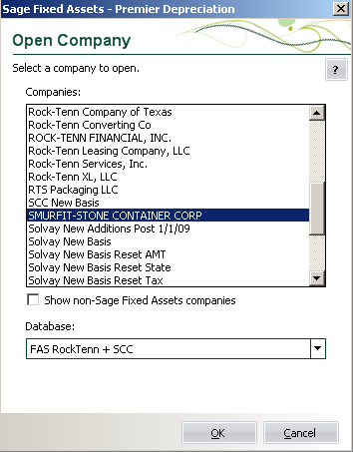
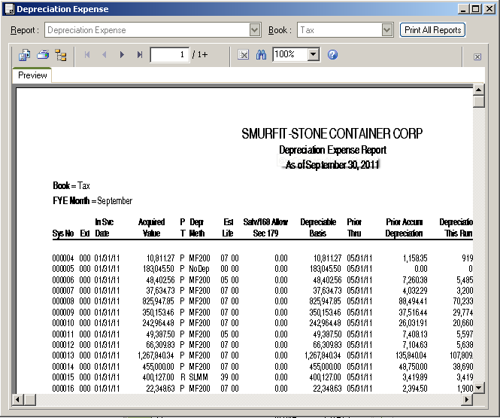
SUBPROCESS EXAMPLES
CUSTOM ADDITION TEMPLATES
FORMAT REPORTS

Slide 7
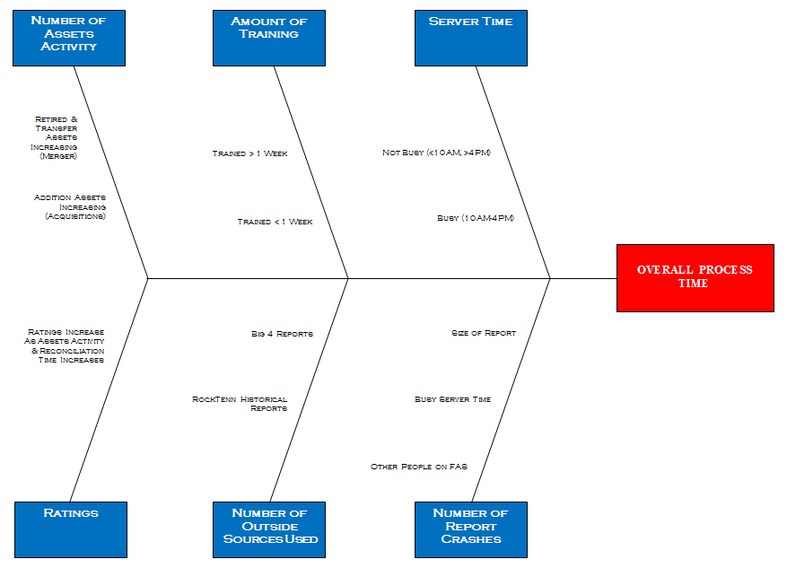
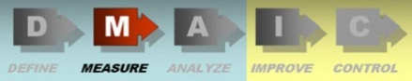
ROOT CAUSE ANALYSIS

Slide 8
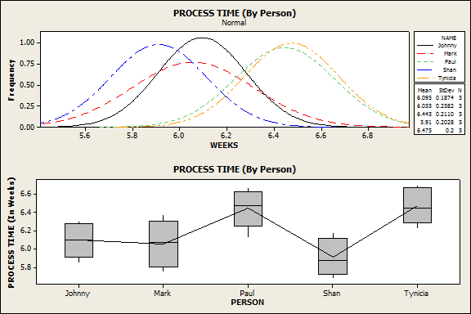
PROCESS TIME ANALYSIS

Slide 9
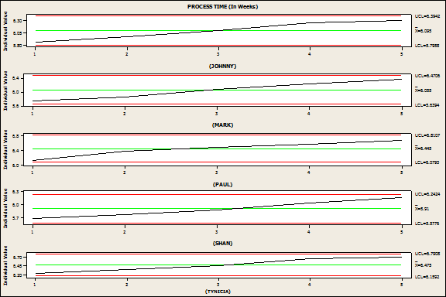
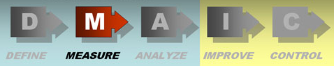
PROCESS TIME ANALYSIS

Slide 10
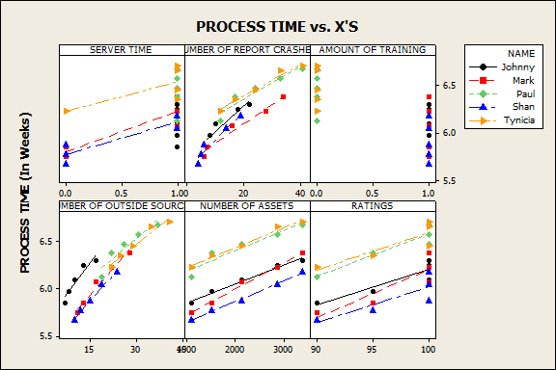
PROCESS TIME vs X’s

Slide 11
PROCESS CAPABILITY ANALYSIS

Slide 12
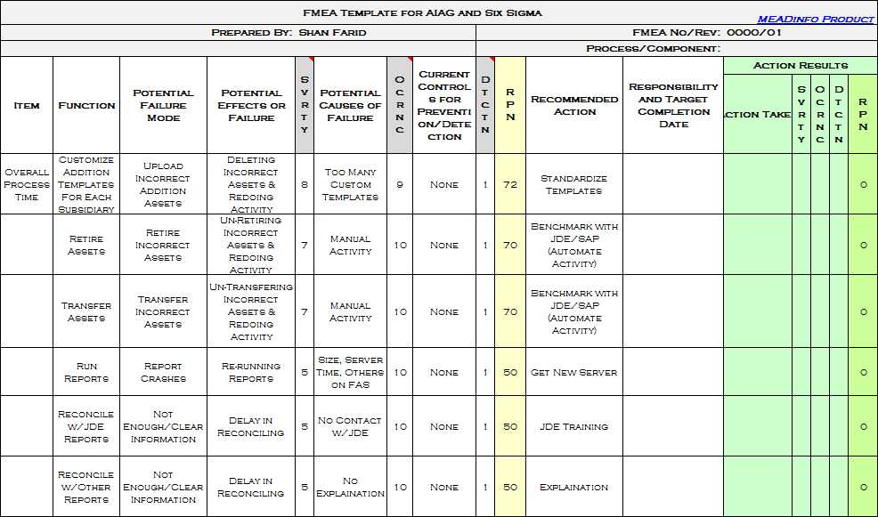
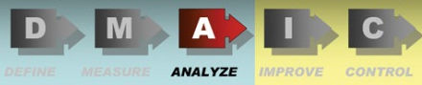
ANALYSIS OF FAILURE MODES

Slide 13
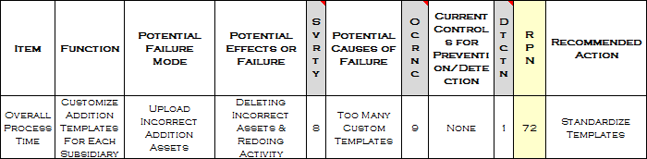
FAILURE MODE EXAMPLE

Slide 14
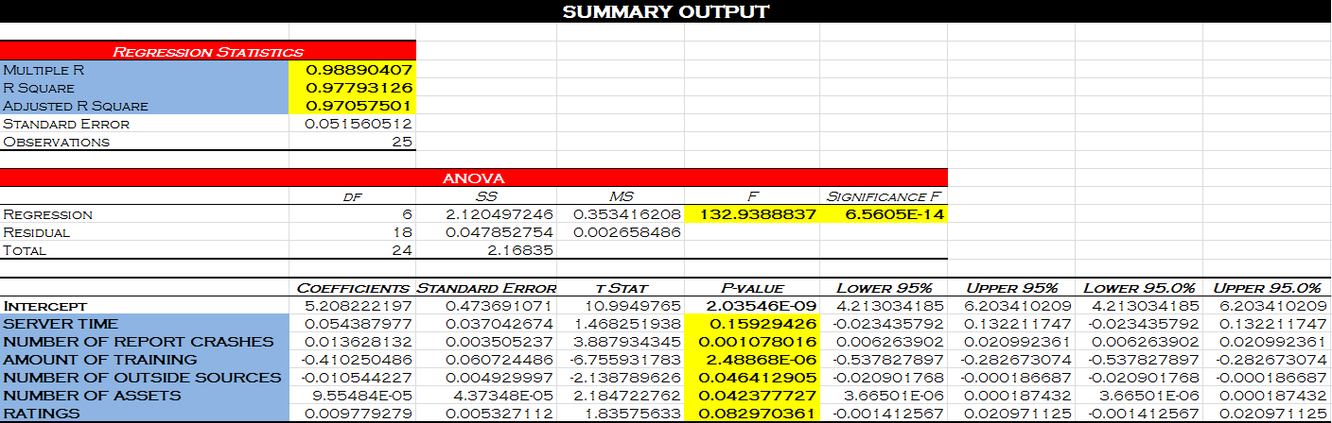
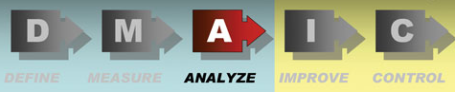
PREDICTION MODEL OF PROCESS TIME (Y=PROCESS TIME)

Slide 15
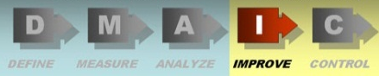
MISTAKE - PROOFING
STANDARDIZATION
Addition Templates (Uploading Addition Assets)
Created Tutorial (Training)
BENCHMARK
Automate Addition/Retirement/Transfer Activities in FAS as in JDE/SAP
OTHER
Audited Every Asset in FAS
Labeled Each Asset
Got New Server
Cross-Training (FAS & JDE)

Slide 16
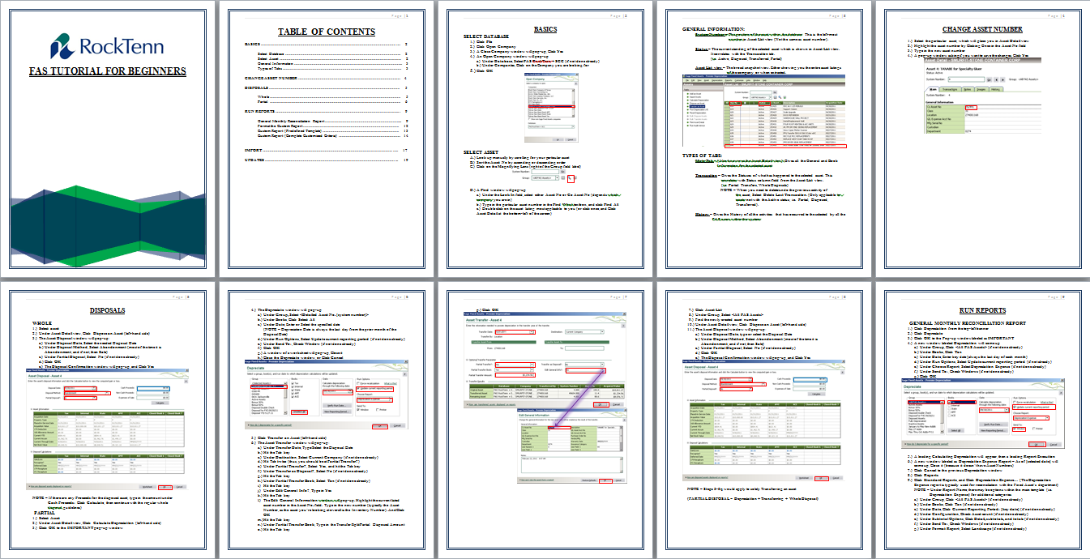
STANDARDIZATION
TRAINING TUTORIAL:

Slide 17
BENCHMARKING
JDE/SAP ASSET ACTIVITIES:
FAS ASSET ACTIVITIES:
1.) Input Activities
2.) Filter For Retired Assets
3.) Retire Assets in 1-Clcik
4.) Filter For Transferred Assets
5.) Transfer Assets in 1-Clcik
1.) Receive JDE Activities
2.) Upload Standardized Templates
3.) Filter For Retired Assets
4.) Retire Assets in 1-Clcik
5.) Filter For Transferred Assets
6.) Transfer Assets in 1-Clcik

Slide 18
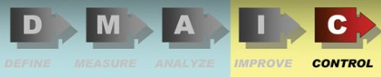
QUALITY ASSURANCE
NEW SOP’s/CHECKPOINTS
MANAGER INVOLVEMENT
STANDARDIZED TRAINING
BI-WEEKLY CHECK-IN FROM IT DEPARTMENT
CREATED BRIDGE BETWEEN SAGE AND IT DEPARTMENT
“X’s”
(RECONCILIATION)
(TRAINING & NUMBER OF OUTSIDE SOURCES USED)
(SERVER TIME & NUMBER OF REPORT CRASHES)

Slide 19
REMOVE BOTTLENECKS
BEFORE:
AFTER:
DELAY
CONTACT
IT
DELAY
MEET W/JDE ACCT OR MGR
YES
NO
DID REPORT CRASH?
IS FAS RECON-CILED W/JDE?
RECEIVE ACTIVITIES FROM JDE
COMPLETE FAS ACTIVITIES
RUN REPORTS IN FAS
NO
FAS RECON
YES
SUBMIT REPORTS
RUN JDE REPORTS
MEET W/MGR
(RECON)
COMPLETE FAS ACTIVITIES
RUN REPORTS IN FAS
SUBMIT REPORTS

Slide 20
RESULTS
REDUCED PROCESS TIME (6 WEEKS TO 1 WEEK):
Reduced Monthly Transaction/Reconciliation Process in FAS Database From 6 Weeks to 1 Week
IDENTIFIED OVER $30 MILLION COST SAVING OPPORTUNITIES:
$20 Million in Transaction Errors
$ 6 Million in Depreciation Errors
$ 4 Million in Potential Tax Credit

Slide 21
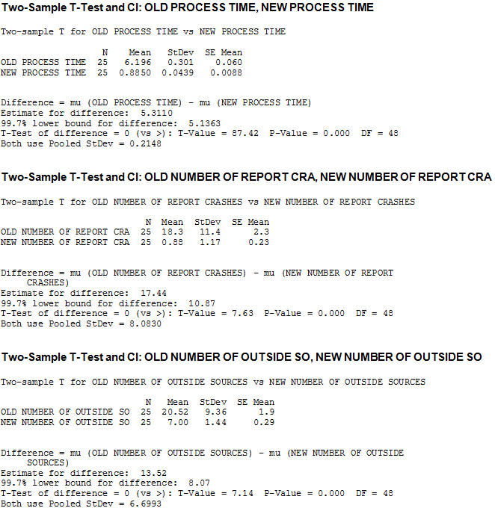
COMPARISION ANALYSIS

Slide 22
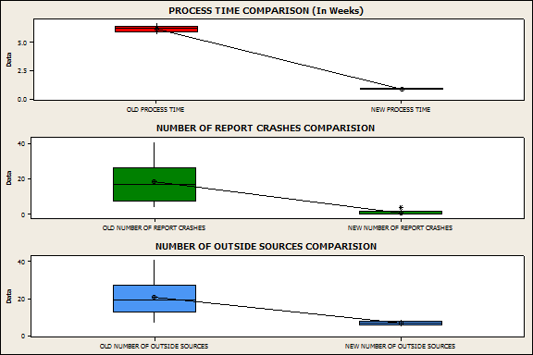
COMPARISION ANALYSIS

